Slide 1
Pitch Perfect: Turning advocacy into story

Slide 2
Form your pitch
A pitch is your organization’s advocacy written like an idea for a news story and sent to media outlets.
Many times, through press statements/releases, we are pitching the sample articles, to mass media.
A good press release will get published with little to no intervention.
Your pitch is usually about one issue only.

Slide 3
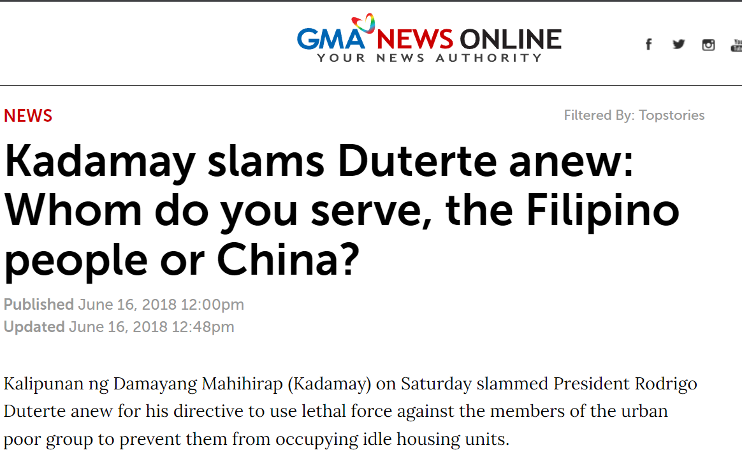
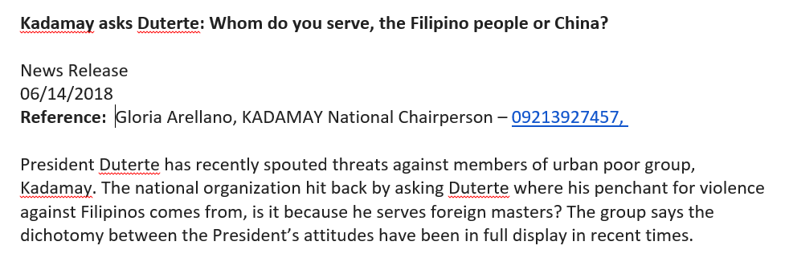

Slide 4
Form your pitch
Work your angle. Determine what kind of story your are “selling.” Is this a news piece, a reaction, a human interest feature, or maybe an expose?
Keep it newsworthy. Ask yourself, why is this important and who would want to read this?
Less is more. For most press statements, try to keep it at just about 400 words.
Pitches and press releases can establish your organization as an authority on certain issues.

Slide 5
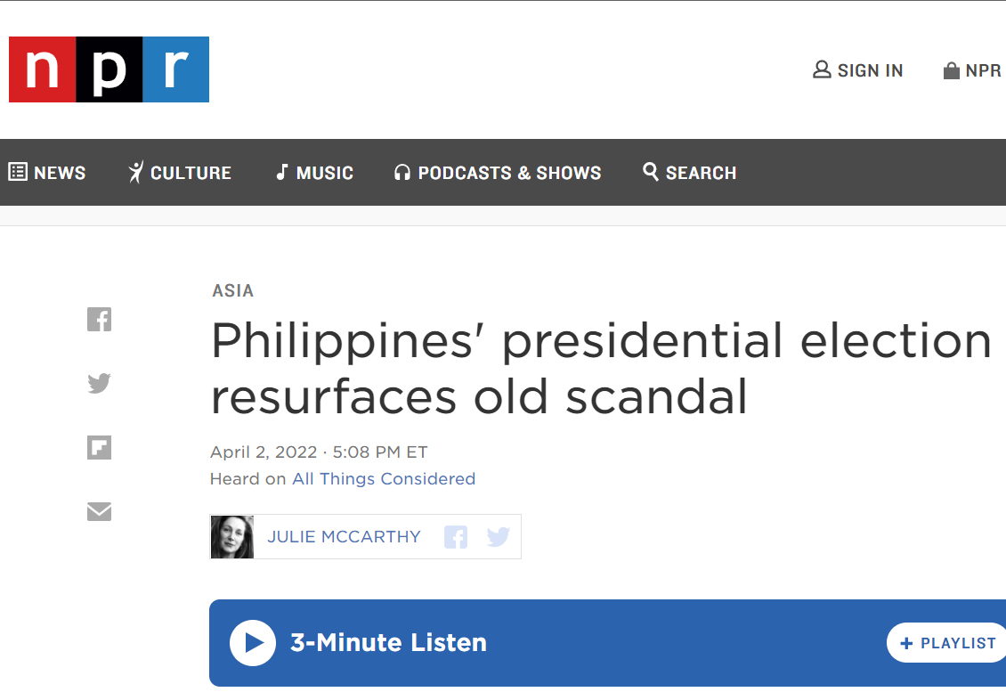
News/reaction

Slide 6

Case Study

Slide 7
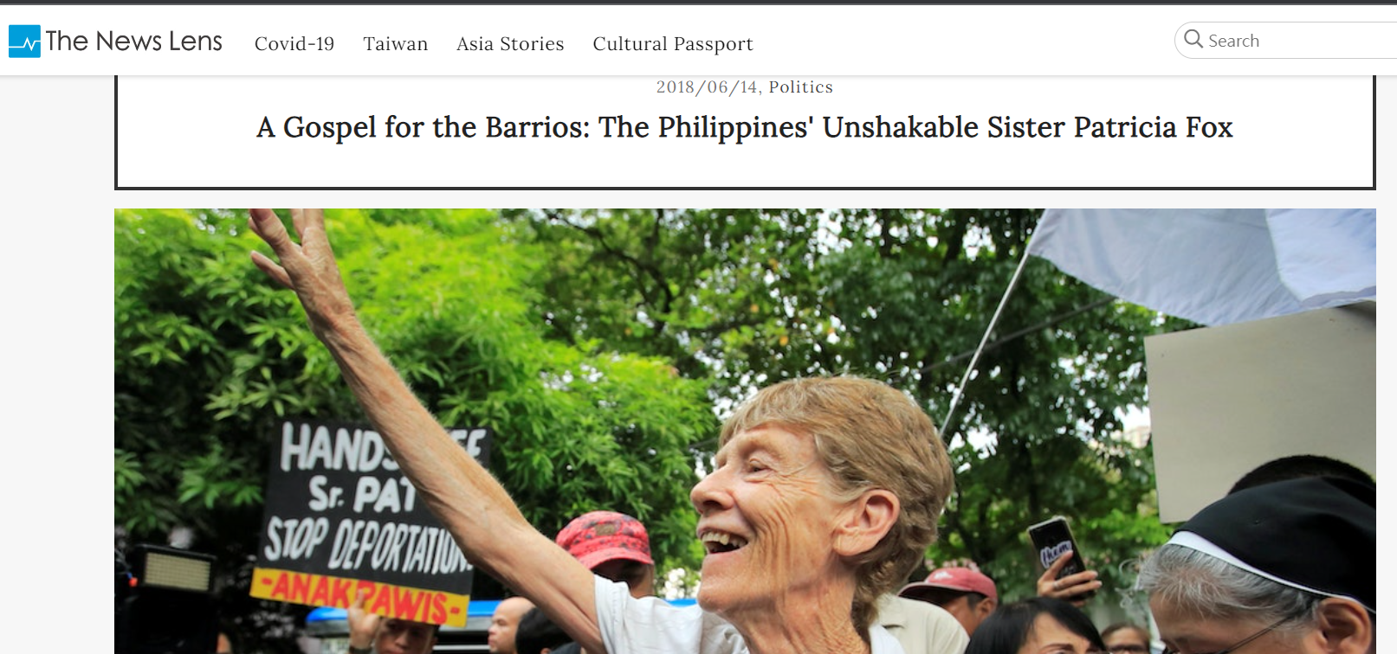
Human interest

Slide 8
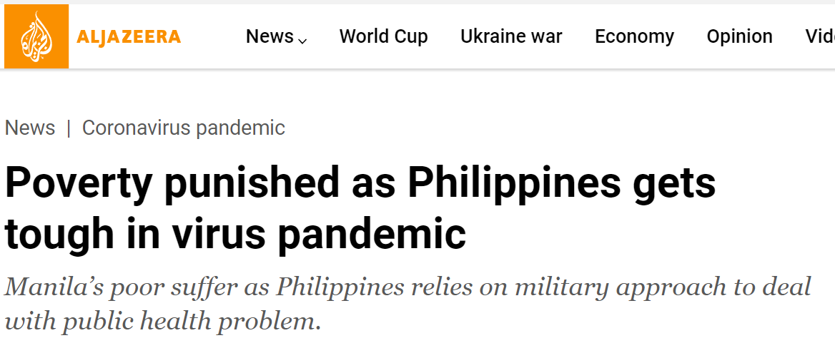
Feature

Slide 9
Pro-tip!
How often should we release press releases? Whenever our advocacy demands public attention and whenever something related to it is already in the news.
To whom do we send the press releases to? To as many as you can. If the story is relevant, then the “more entries you send, the more chances of winning.”
Get yourself published! There are many websites with significant readerships that welcome well-written and grounded opinion pieces.
Check it out: https://forsea.co/, https://www.newmandala.org/, https://globalvoices.org/, https://www.culturalsurvival.org/, and many more!

Slide 10
Get to know the publication (and their reporters)
Keep an eye on the news and work your advocacy into the news stream.
Tailor your pitches to the character of each publication. See where your advocacy or pitch fits.
Consider specific audiences, their professions, geographic locations, backgrounds etc.
Pitch the same information, with a different angle to different publications.
Get in touch with the editors, reporters, their beats/fields and convince them that your advocacy warrants a story.

Slide 11
Some publications to consider
The New Humanitarian (formerly IRIN, created by the UN Office for the Coordination of Humanitarian Affairs) - https://www.thenewhumanitarian.org/
Foreign Policy - https://foreignpolicy.com/
The Diplomat - https://thediplomat.com/
Lowy Institute, The Interpreter - https://www.lowyinstitute.org/the-interpreter
New Naratif - https://newnaratif.com/
Pro tip: Subscribe to Telum media.

Slide 12
Distil your advocacies
Stick to the issue
Write with the press and the public as your audience, not your peers.
Avoid jargons
Don’t say everything all at once. Build your narrative over time.

