Slide 1

MEDIA RELATIONS WORK
FOR CPDE MEMBERS
Working together as a platform to engage the media

Slide 2

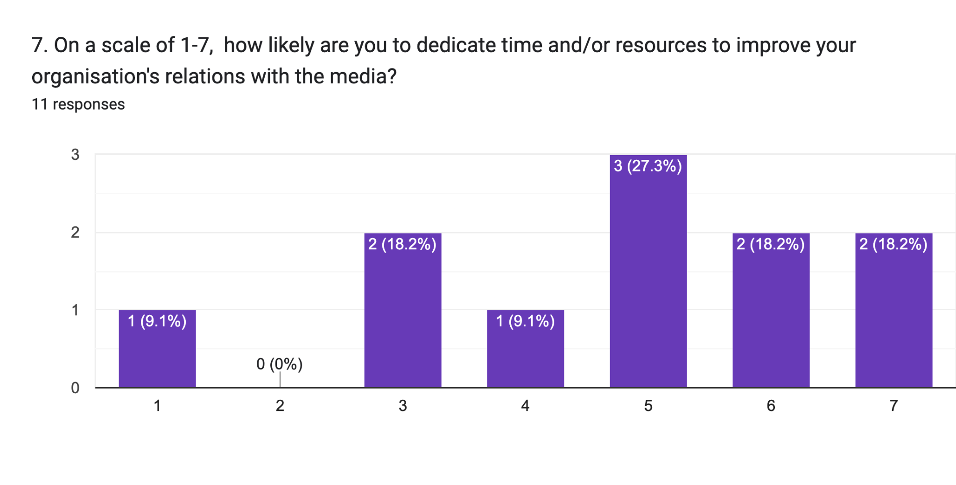
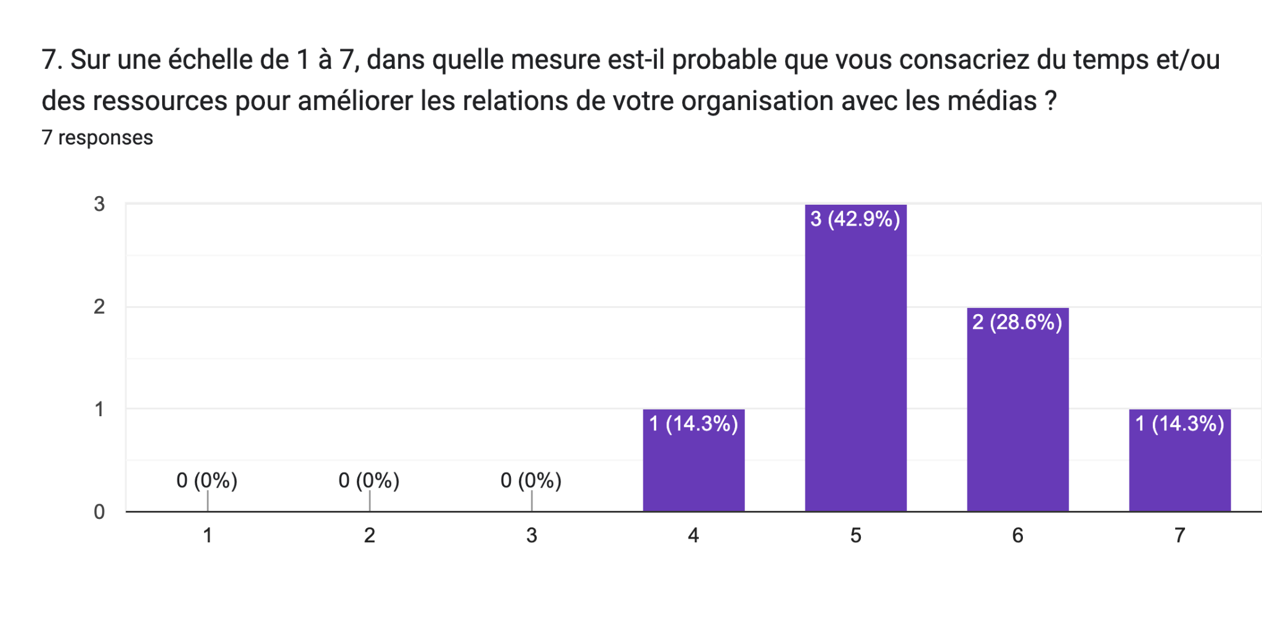
TNA Results
Notes:
Out of the 18 respondents, only 4 are not willing or barely willing to dedicate their time or resources to improve relations with the media

Slide 3
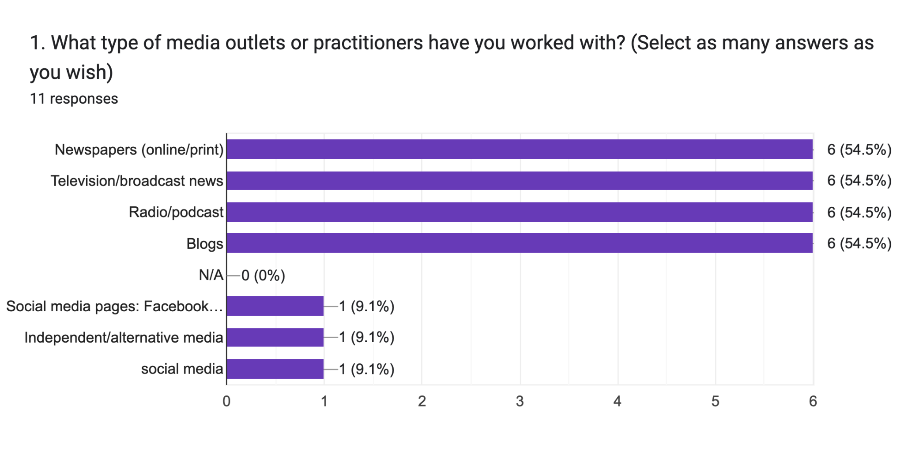
TNA Results
Notes:
Just over half of the English respondents have experience with these different media outlets

Slide 4
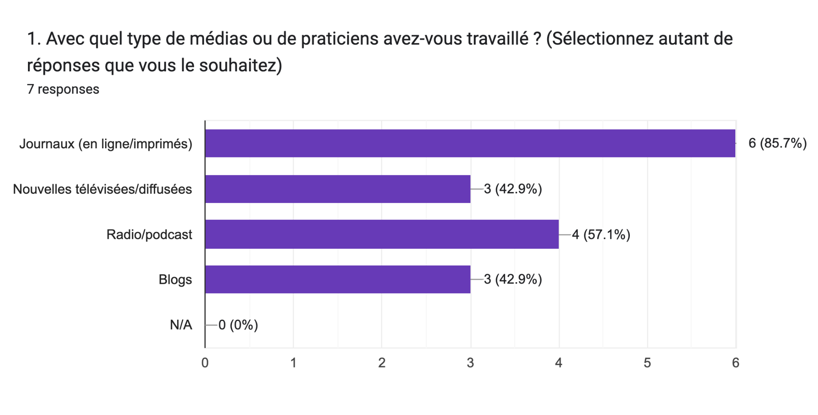
TNA Results
Notes:
While most of the French respondents have worked with print media, only half of the French respondents have experience with broadcast news, radio, podcasts or Blogs

Slide 5
TNA Results - Challenges in engaging with the media
Media equipment and knowledge of using technologies
Writing articles/press releases
Mainstream media does not frequently feature news/articles on Indigenous Peoples
Time Zones; syncing technologies; being quick
Mostly the media prefer in-person to telephone interviews and resources may not be available to go to the studios.
Sometimes do not show up for coverage especially when they feel there is no money involved.
Media don’t give time for Development Effectiveness and Gender Equality perspectives
Reaching a bigger audience
issues on aid and development cooperation not much of an interest to the media
Mainstream media focuses on political and high level events with a little interest in civic space
“Getting media's attention to the development agenda as the national arena is crowded with domestic concerns and, occasionally, with the most severe international crisis. The long term narrative on the 2030 Agenda goes to the back bench in most cases.”
Being able to convince the media of the importance and impact of the news to be conveyed related to our work
Availability of media and self-censorship
Invitation to cover our activities is very costly
competition with other organisations in the area of visibility, the area of being followed by listeners via the media with whom we work, this competition makes it difficult to have visibility space, broadcasting space
The commercialization of all media services including simple coverage of events and the high cost of their services
Making them understand the subject they have to write about and sharing with them our ideals and motivations
self-censorship
Getting media’s attention on “slow” news issues
Writing articles/press releases
Notes:
Most predominant challenge seems to be getting media’s attention to report on development effectiveness issues

Slide 6
Road to HLM
NO TO STATUS QUO! ACT FOR SDGs NOW. Sustainable development goals, development cooperation
THERE IS NO PLANET B. Climate change/finance
AID NOT LOANS. Conflict and fragility
PEOPLE OVER PROFIT. Private sector engagement
STOP THE ATTACKS. Shrinking civic space
Notes:
These are some of our comms messages for HLM3
Send us your stories that are related to any of these topics or EDC topics in general in the run up to

Slide 7
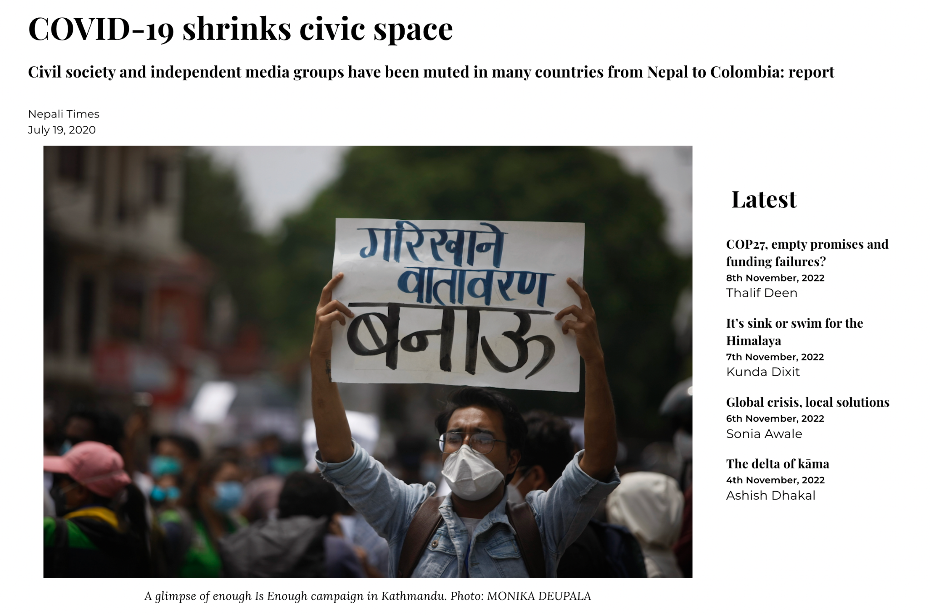

Slide 8
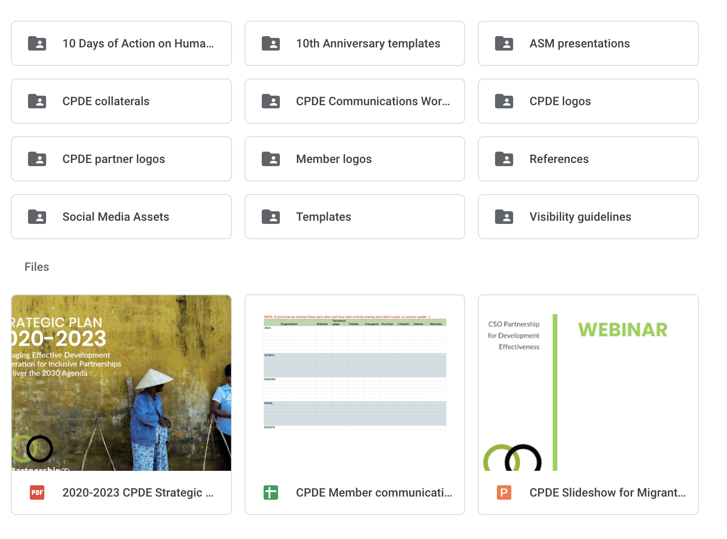
CPDE Communications Kit

