Slide 1



Slide 2
Making a podcast
CEGR
11/11/2022

Slide 3
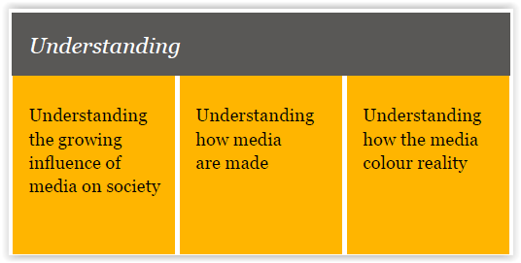
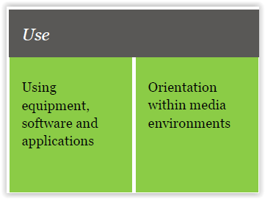
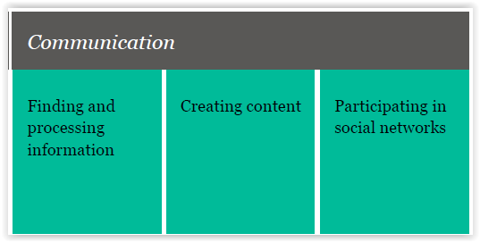
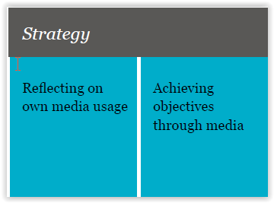
What is ´Media literacy´
How to measure media literacy ? 10 Competences.
Awareness of the mediatization of our society
Understanding how media is created
How the media ´color´ reality
The use of peripherals, software and applications
Orienting in different media environments
Find and process information
Creating content
Participating in social networks
Reflecting on personal media use
Reaching the media by yourself
source: mediawijzer

Slide 4
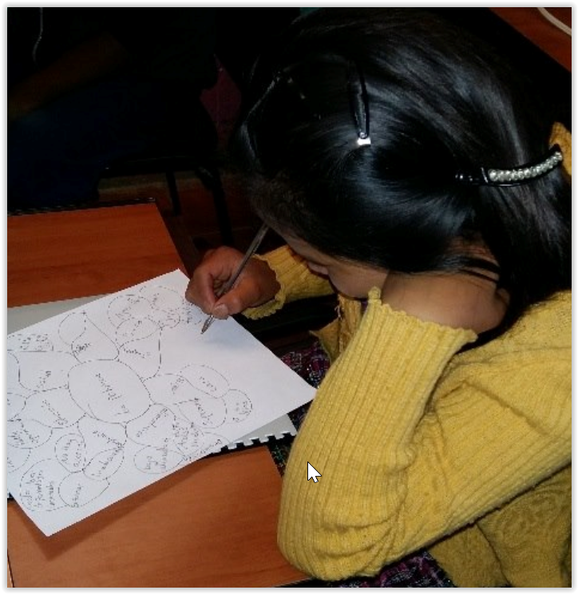
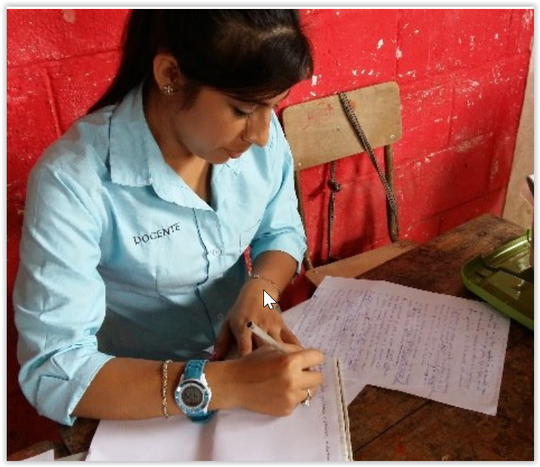
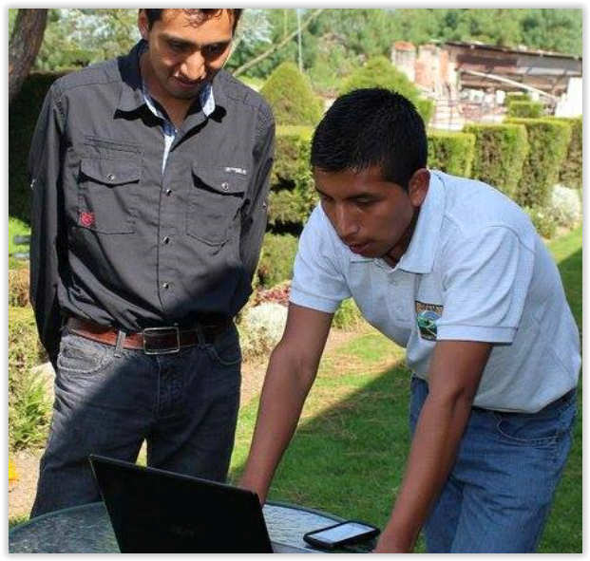
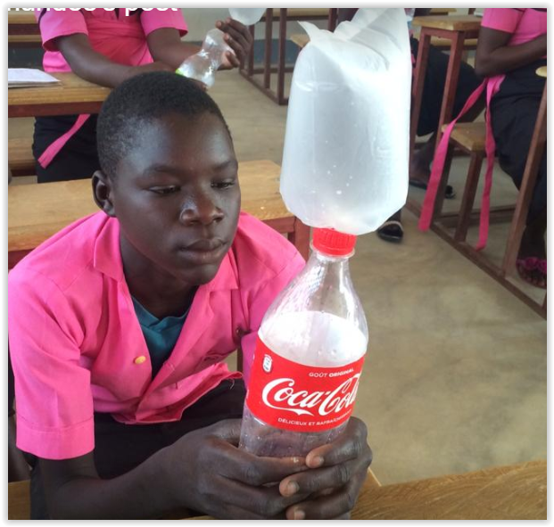
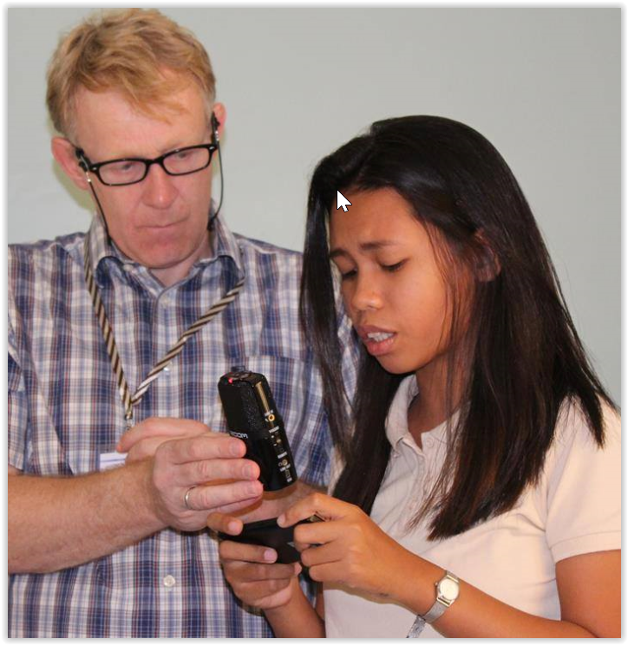
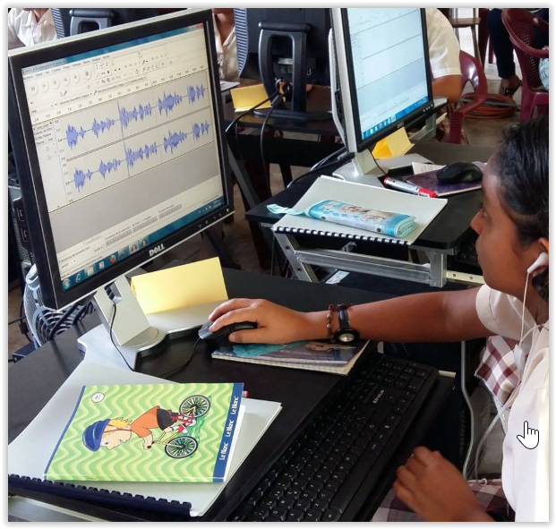
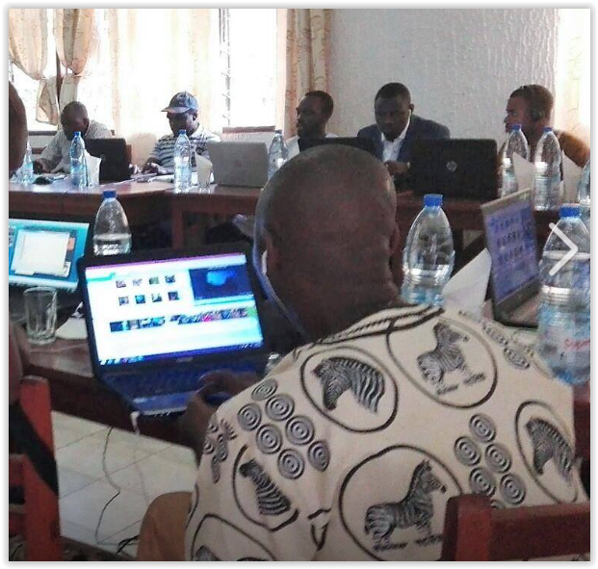
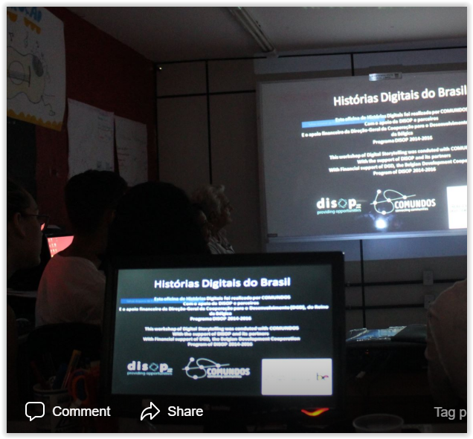

Brainstorm on the topic
Adapting the text to a story
Listening to each others story
Finding and taking pictures
Recording the narrative
Clearing ´voice over´ + music
Editing video
Presentation and evaluation

Slide 5


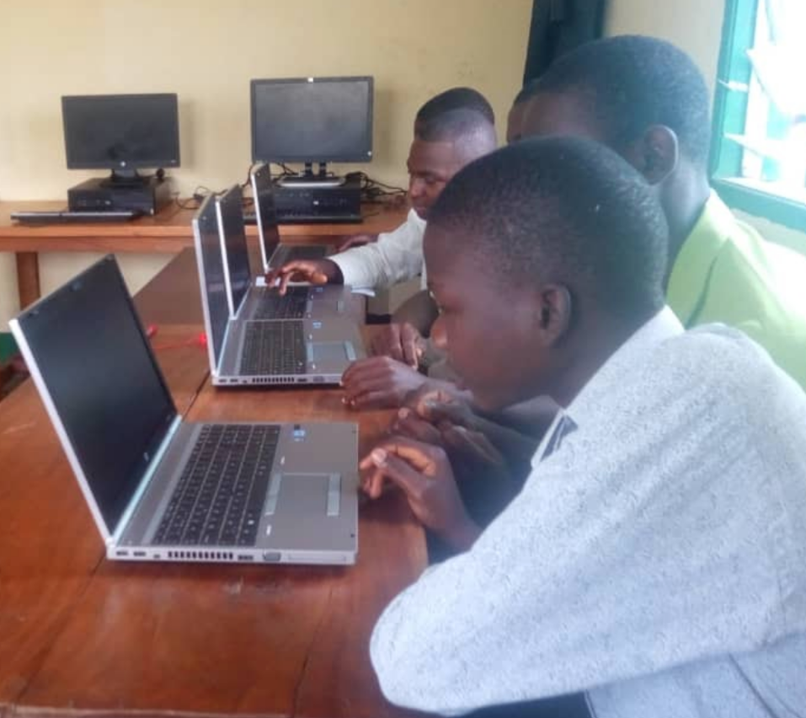



SDG 4 target 4.4: By 2030, substantially increase the
number of youth and adults who have relevant
skills, including technical and vocational skills, for
employment, decent jobs and entrepreneurship.
intercultural dialogue
digital storytelling
contextual ICT
media & information literacy

Slide 6
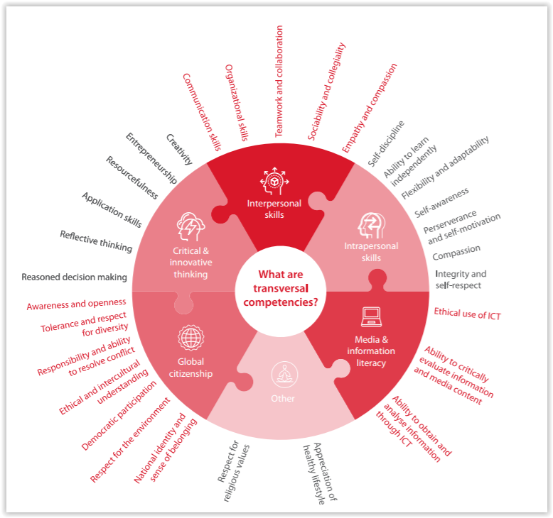
Transversal
competencies
Transversal
competencies

Slide 7



Podcast /Digital storytelling
Why are stories important ?
Power to explain
Provide meaning
Faster brain imprints
Universal
Build communities
Hold attention
Transfer experiences
Change behaviour
Persuades

Slide 8
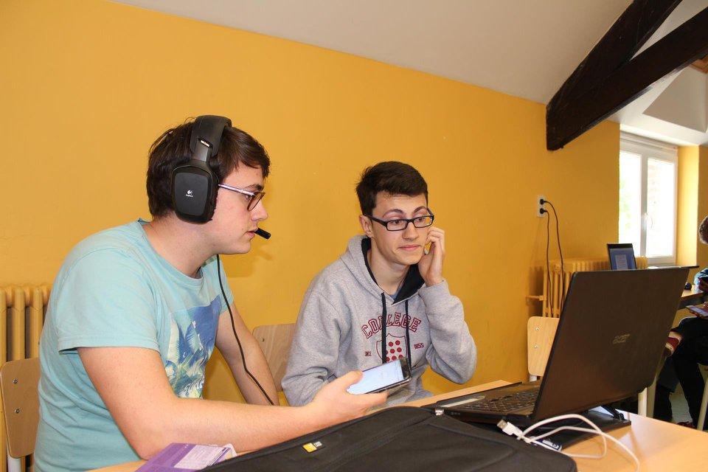
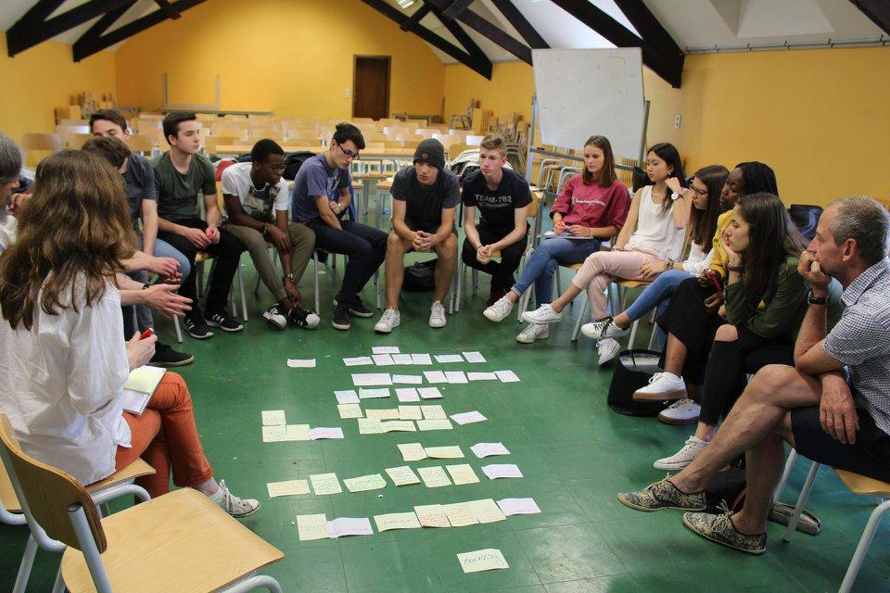
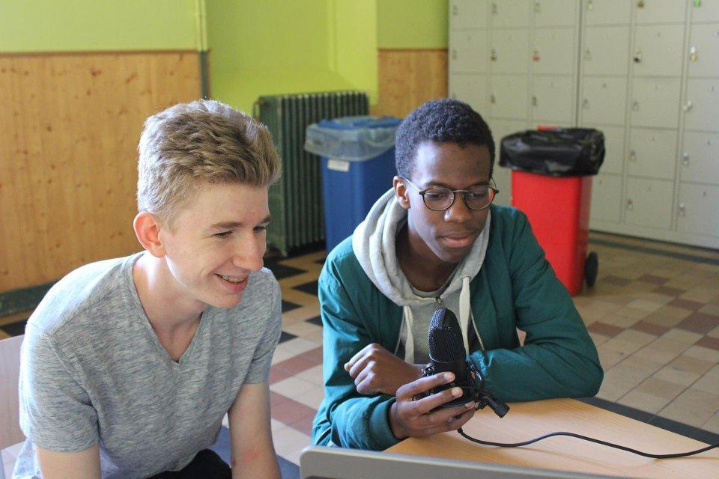


Slide 9
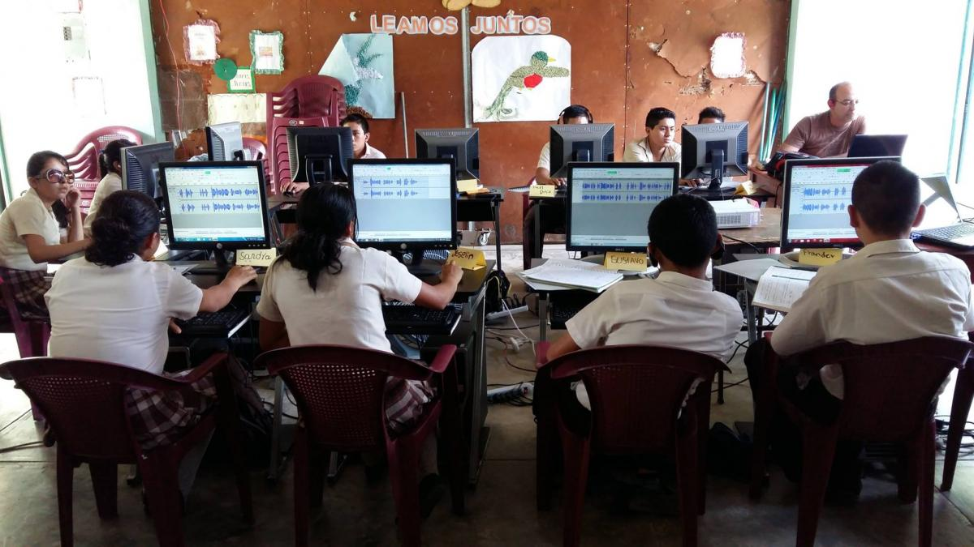
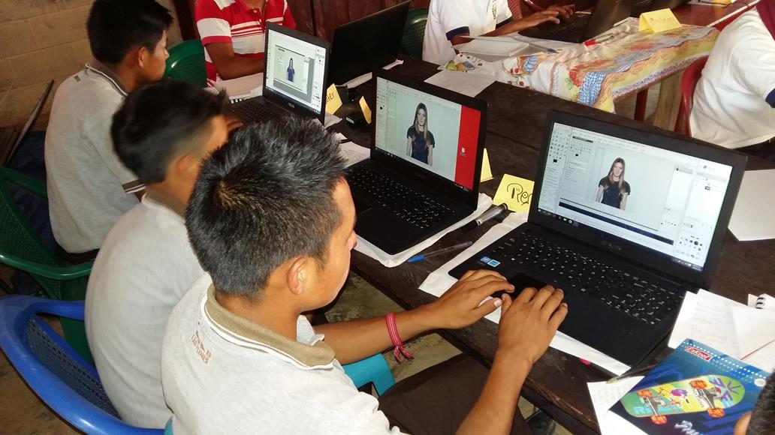
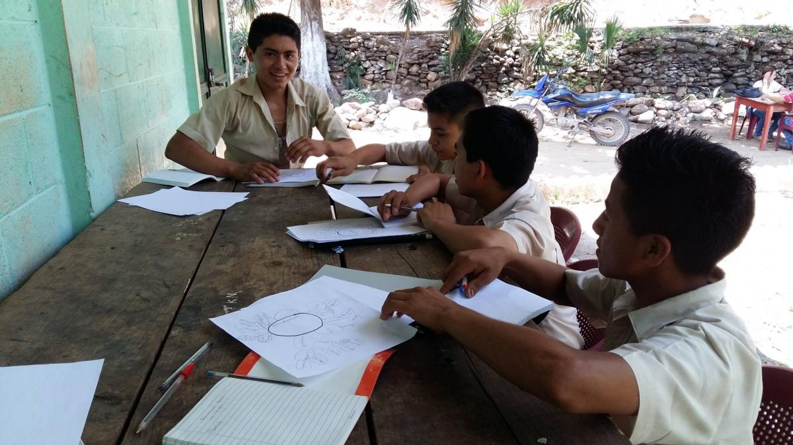

Slide 10
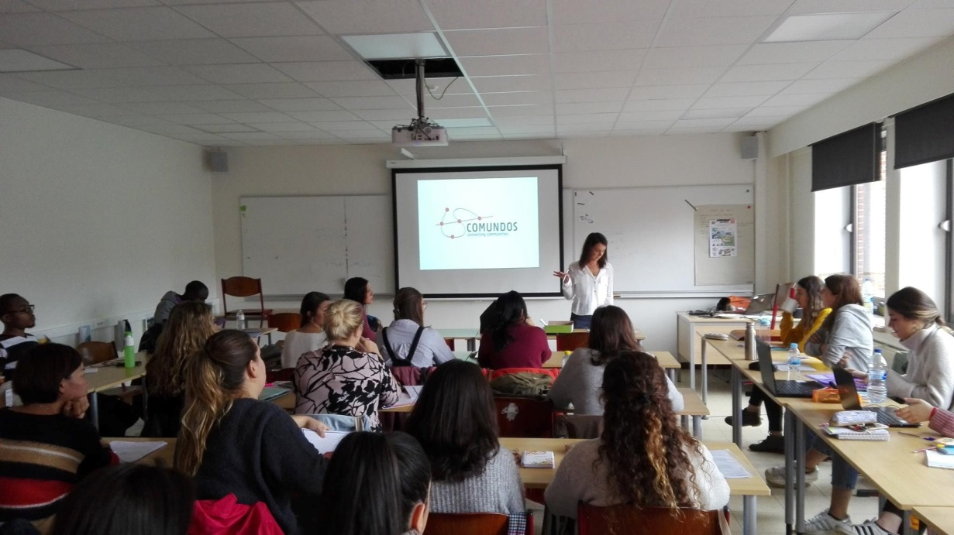
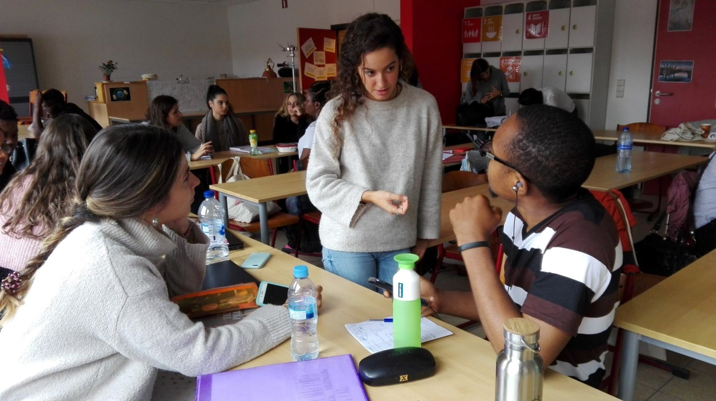

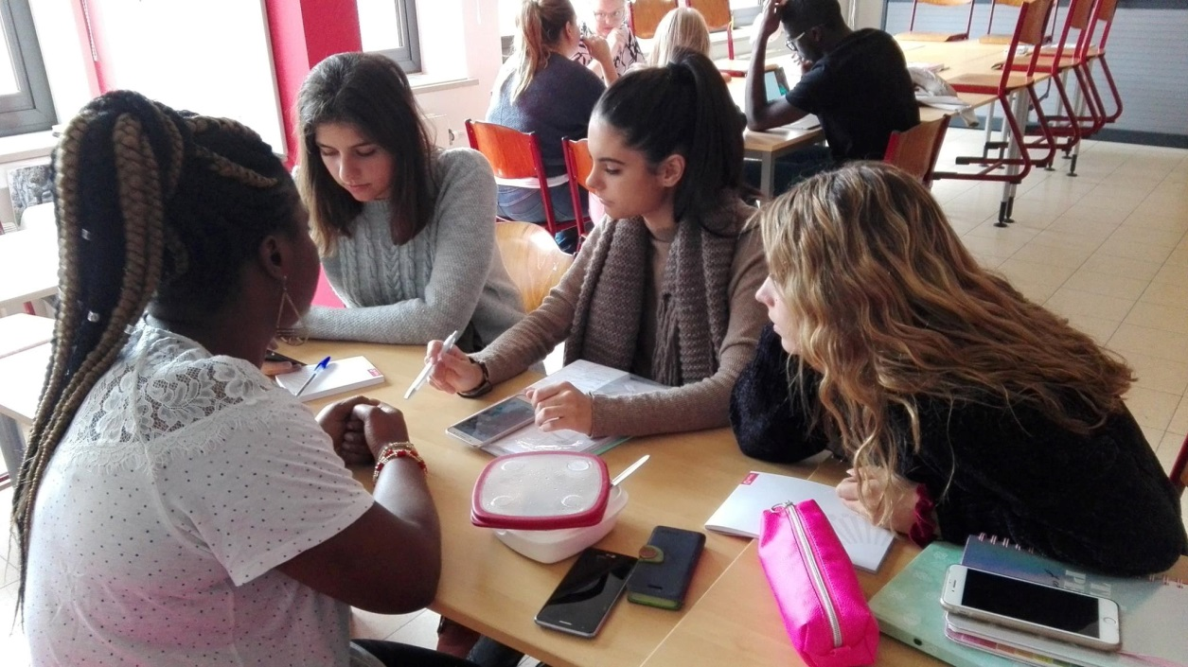
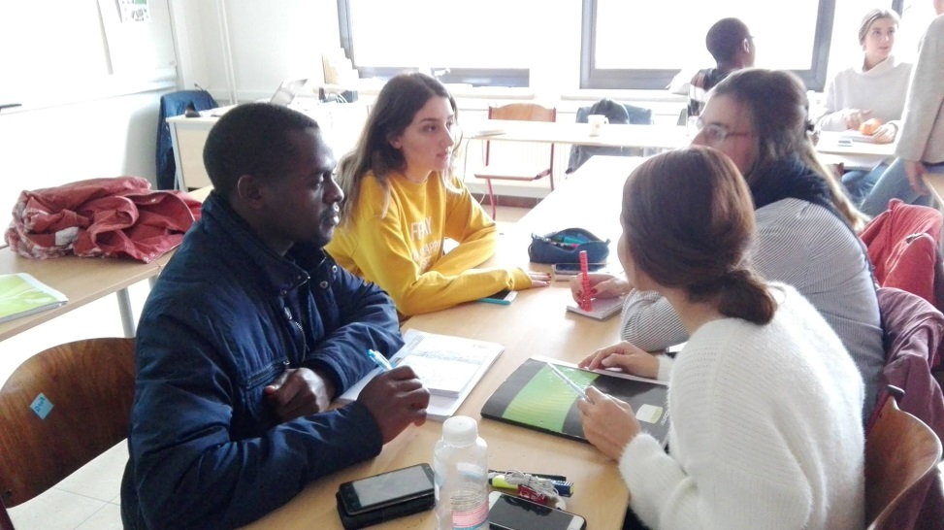
Using stories in a classroom

Slide 11
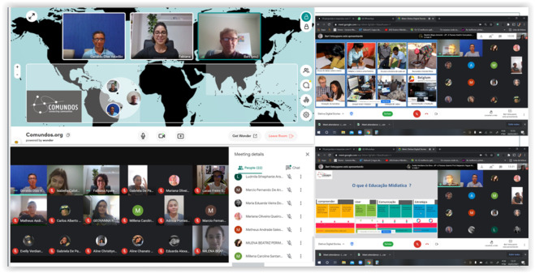

Slide 12

Storytelling brings
Reflective and problem solving skills
Empowerment through writing skills, structuring content
Identity development
Happiness and satisfaction (empirically proven)
Identify media and how it affects them/us
Digital
Storytelling

Slide 13
Making a Podcast:
Let´s practice

Slide 14


Making a podcast
Step 1: Choose the story you want to tell
Build a podcast around a problem / solution / desire to solve / an action / activity/ a theme of reality having in mind the themes you are interested in.
What are we aiming for? What should/could be addressed ?
Challenges and the knowledge obtained can make a story/podcast more interesting
(The viewer learns or discovers something...).
Tip : Think what could be interesting for the viewer
to listen to

Slide 15




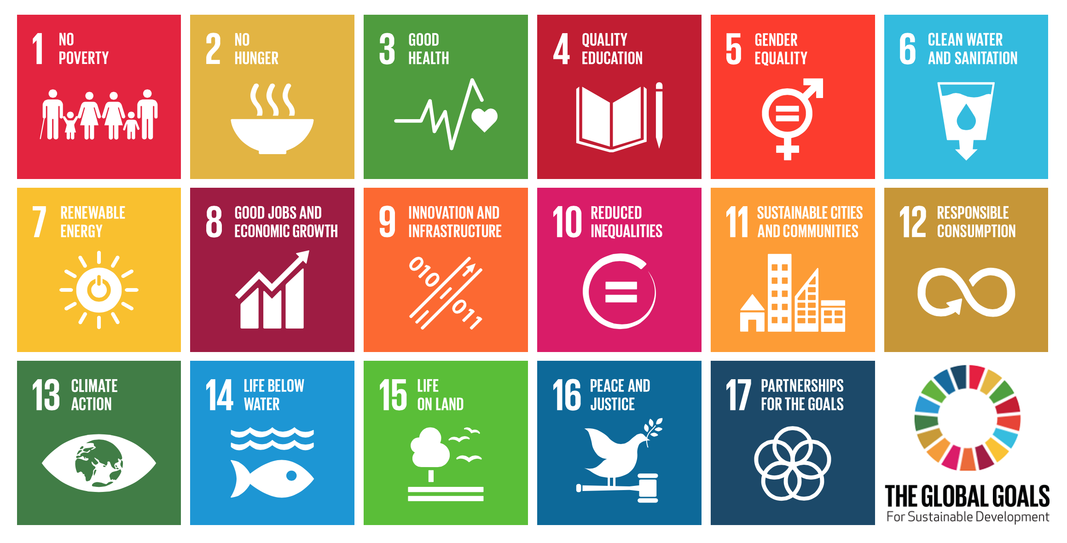
Making a podcast:
Step 1: Choose the story/Podcast you want to tell
What is our niche?
Shrinking civic space
Enabling environments
Aid .. but no loans
Climate Justice
Development led by communities
Climate Justice
People over profit

Slide 16
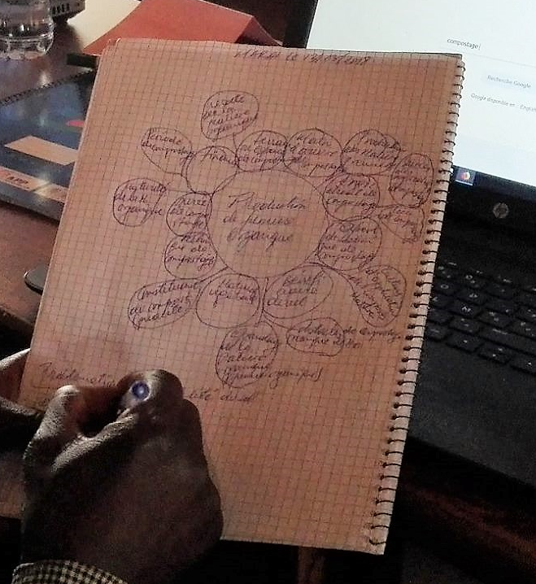
Making a podcast:
Step 2: Brainstorm
Brainstorm technique:

Slide 17
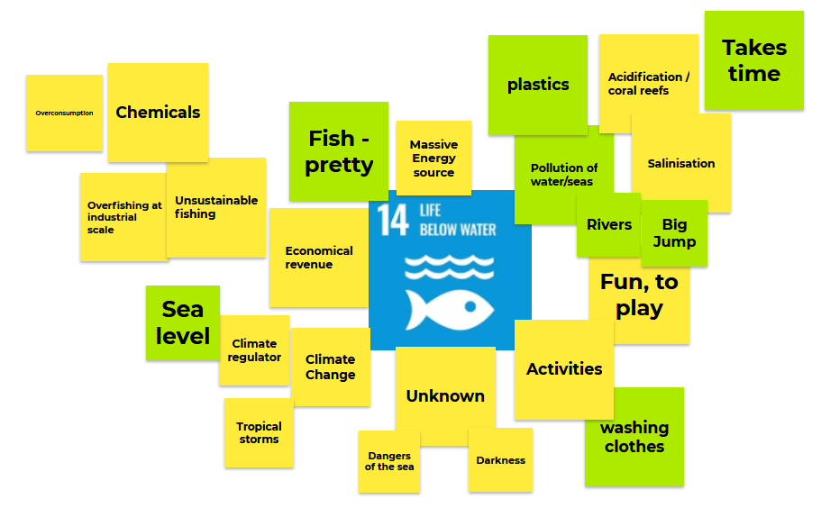
Making a podcast:
Step 2: Brainstorm
Brainstorm technique:

Slide 18
Making a podcast
Step 2: Brainstorm
Brainstorm technique:
Choose a particular theme and write it in the center
Write down all secondary ideas that come to your mind
At this stage, what matters is the number of items, not the quality
Follow associating your ideas with other ideas
Write only the essential
Help yourself by listening the comments
and observations from others.

Slide 19
Making a podcast
Step 2: Brainstorm
- Think and reflect on the story/Podcast you want to tell (why do you want to tell this story?
- Identify and select what to use from the brainstorm.
Take some blocks of the brainstorm and write
some words about them
Make a first version of your podcast

Slide 20
Making a podcast
Step 3: Choosing the Format
Interview, in which the host or hosts chat with one or more guests.
Monologue, in which a single host speaks on a given topic.
Multiple host, in which two or more hosts banter back and forth.
Narrative, which is similar to a monologue but focuses on a particular story.
Mixed, which simply means that the format of the podcast can vary by episode.
Interviewing – 4 or 5 questions

Slide 21
Step 4: Writing a Script
Making a podcast
[Opening music jingle and sound effects]
Intro: Set the stage for your episode. Include details that set up your episode's theme. Name of your podcast show, why your show exists, who you are, etc.
/
Question #1:
Answer
Supporting data (?)
Question #2:
1. Answer
2. Supporting data (?)
…
Closing remarks or recap: Summarize the main points you covered, tease an upcoming episode, etc.
[Closing music jingle or sound effect]

Slide 22
Step 4:: Writing a Script
The ingredients of a good story
Making a podcast
A CHALLENGE/ OBSTACLE. What is interesting in a story are the challenges a person is facing in a particular context.
“I got up, went to work, came home“. Is not a story.
GOALS AND DECISIONS which the protagonist takes.
Every story has an end – was it a win, a loss,
or something else , a lesson?
Tip : Respect your audience (what's in it for me?).
Does your audience know about the topic?

Slide 23
Making a podcast
Step 4: Writing a Script
The success factors of a story
Simplicity:: Find the key idea., talk in an easy language
Concreteness/ Specificity: Abstract ideas are harder to remember than concrete ones.
Express feelings/sentiments: Insert something of your own interest and identity. Make it personal (love/hate/pain/happiness/.... (Are ingredients of series).
Tell a story that is worth spreading and inspires others.
Humor makes it like playing with your audience, but be careful for wrong interpretations.
Short sentences: try to avoid long sentences as they may sound too complicated and hard to follow.

Slide 24
Making a podcast:
Step 4::: Writing a Script
For a scripted podcast, write, revise, and rewrite your script several times, and have people you trust read it over for clarity and style.
/
Then, practice it several times so you sound like you're speaking naturally (and not just reading a script) during the podcast.

Slide 25

Making a podcast
Step 5: Organize the material
One headfolder with subfolders … to keep the material together

Slide 26
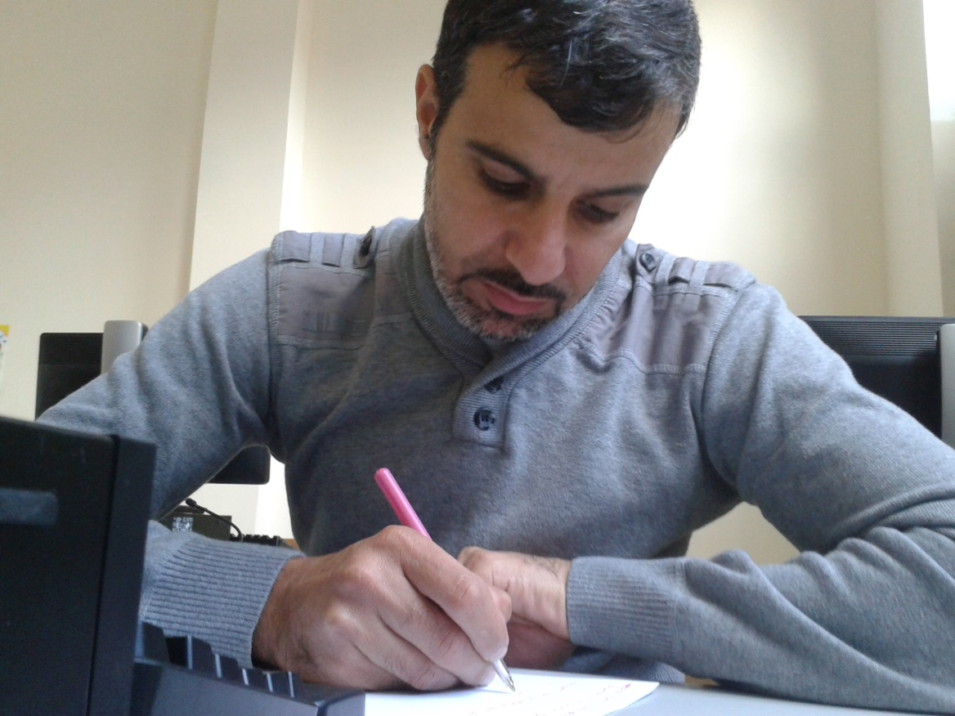
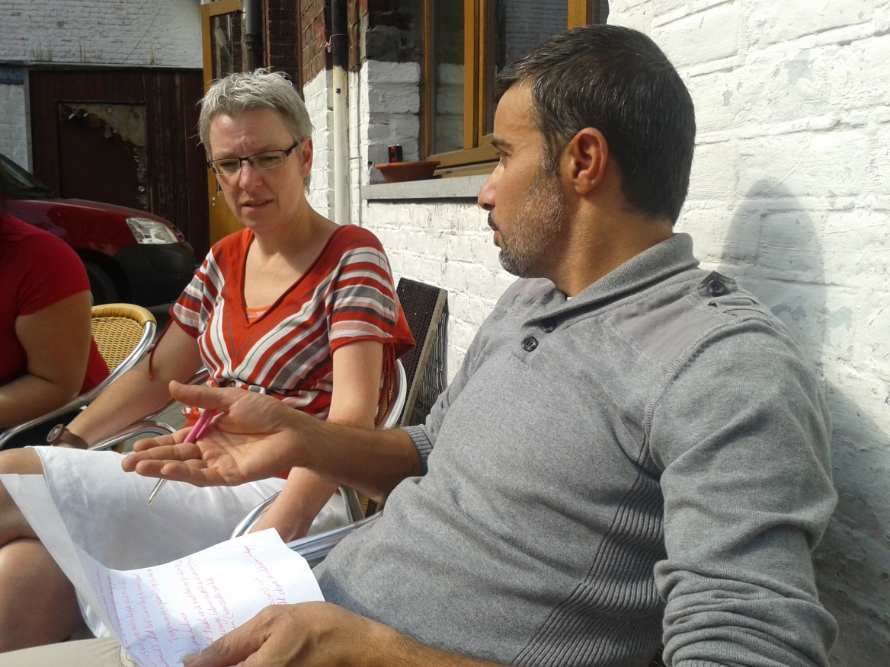
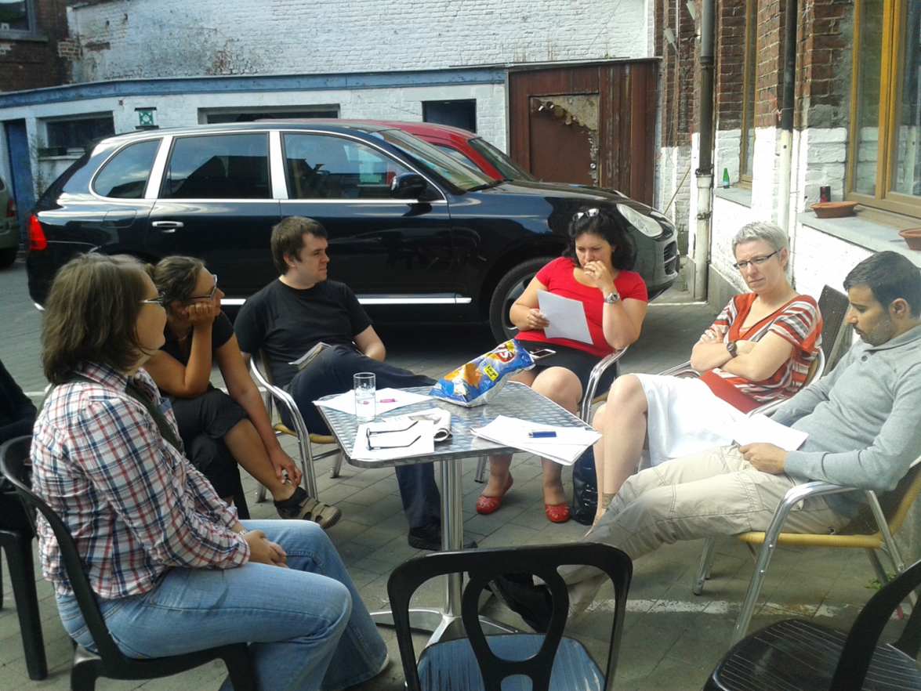
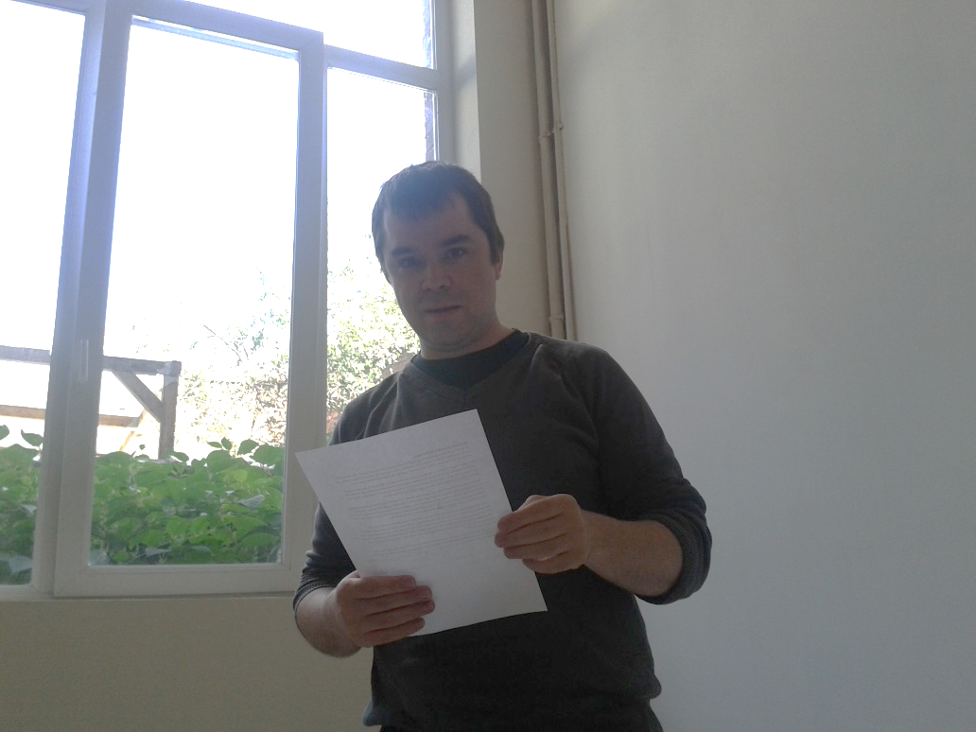
Making a podcast
Step 4: Gather existing material

Slide 27
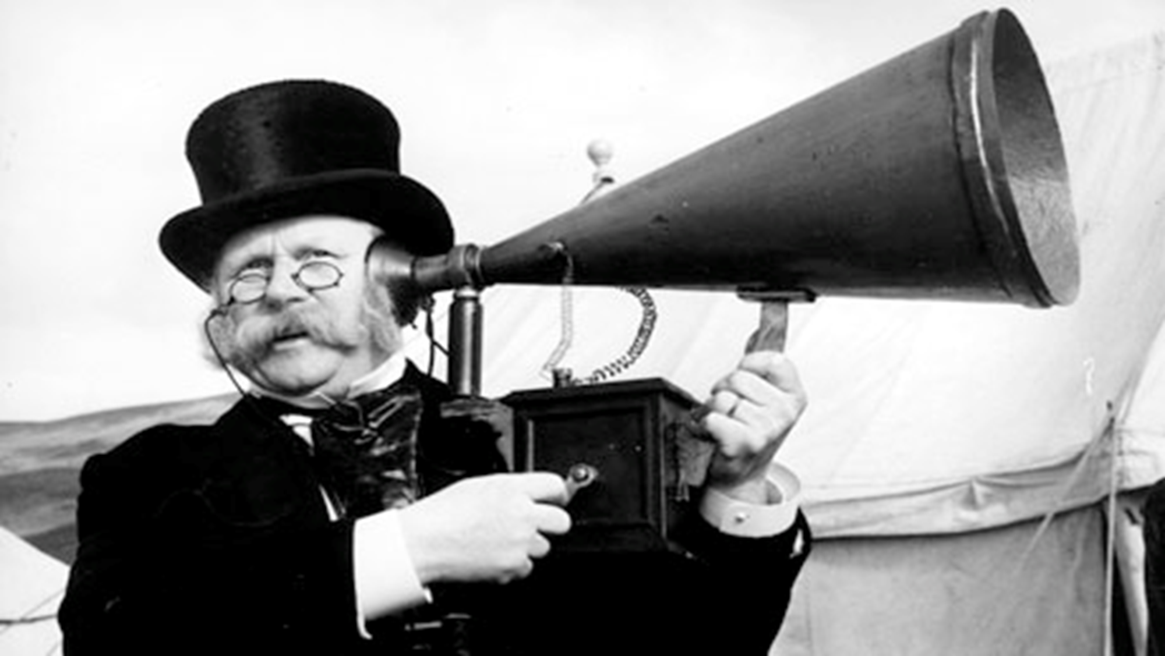

Making a podcast
Step 6: Reading the narrative
TIP
Important:
find an appropriate place to record.

Slide 28
Thank you
Bart Vetsuypens
bart@comundos.org
0032 479 085 338
Comundos.org
https://www.facebook.com/comundos

