Slide 1

A Campaign of the International Trade Union Confederation https://timefor8.org/

Slide 2
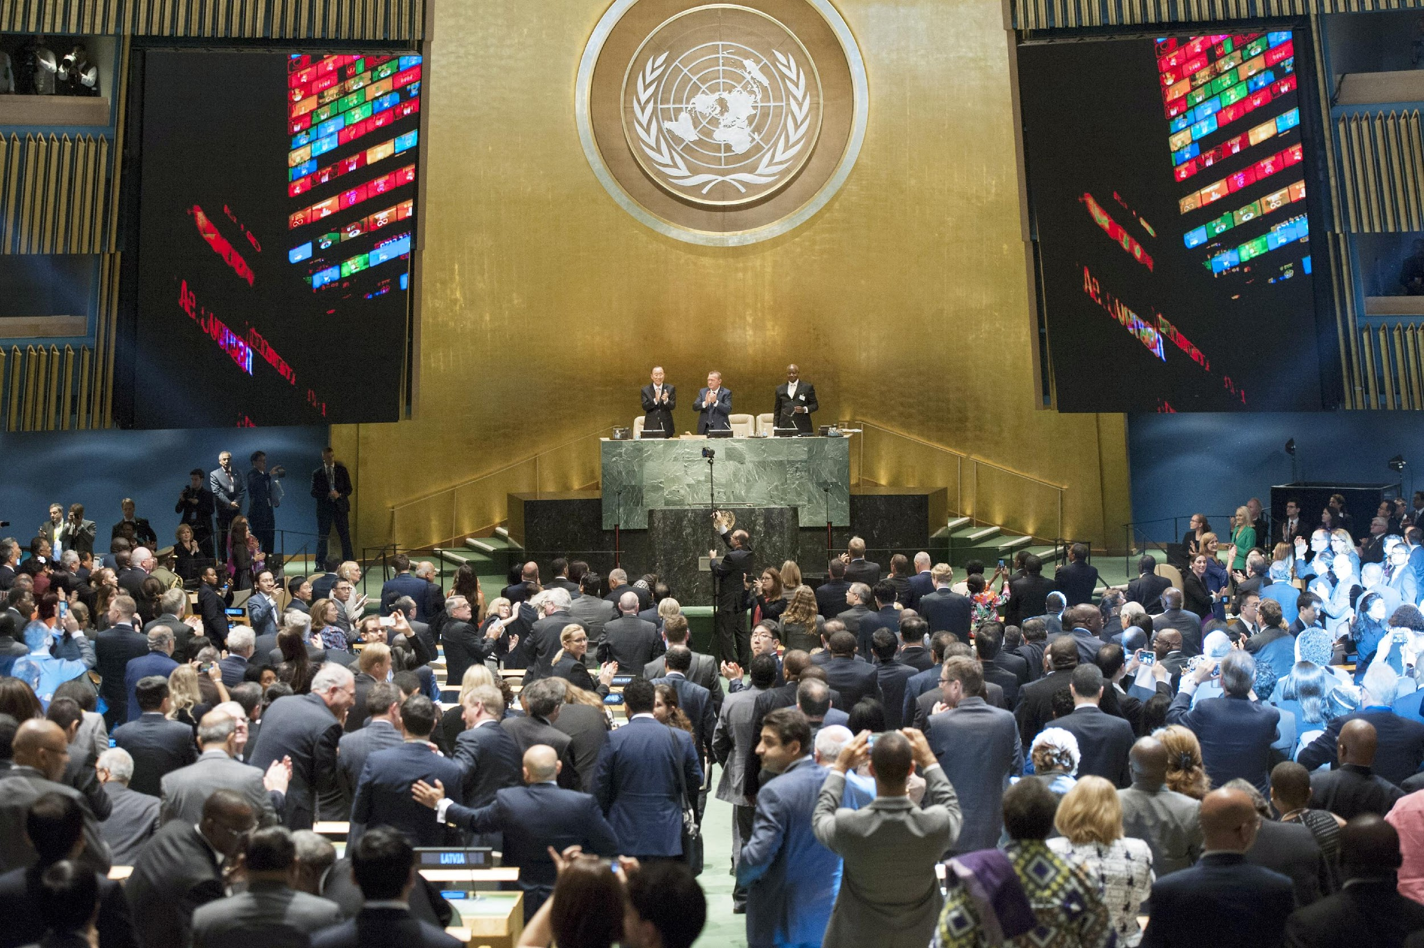
A campaign about going from…
UN Summit adopts 2030 Agenda for Sustainable Development.
Photograph: UN Photo/Cia Pak

Slide 3
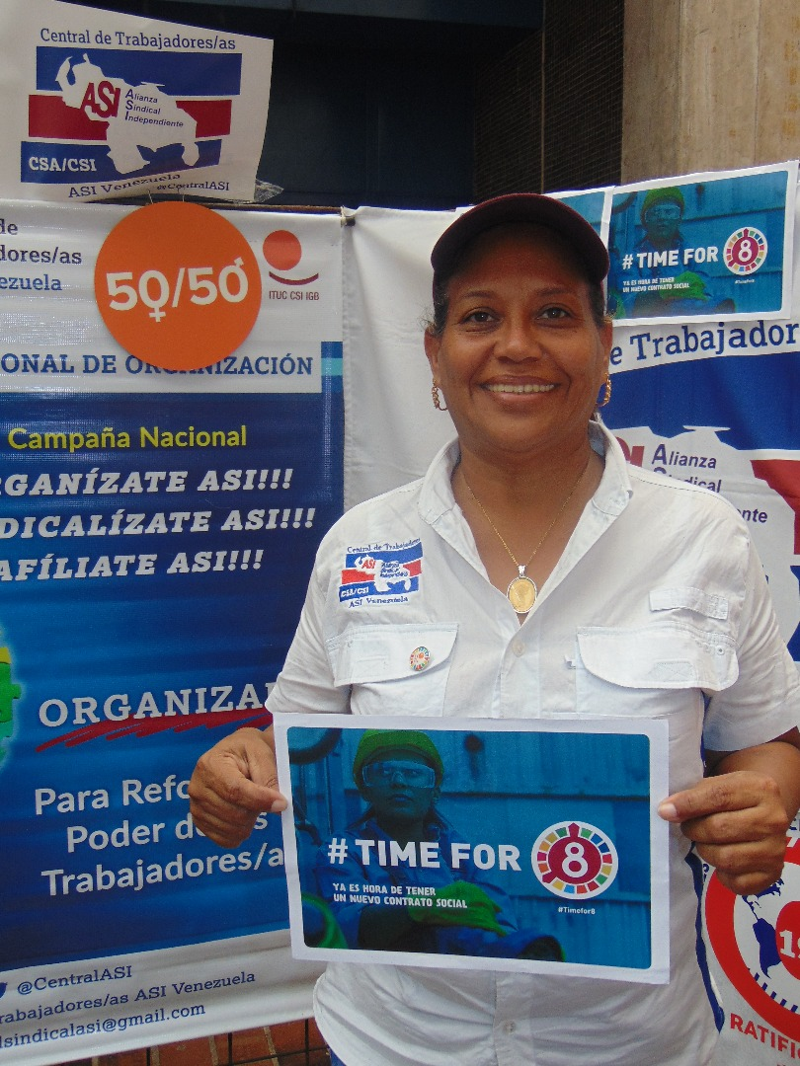
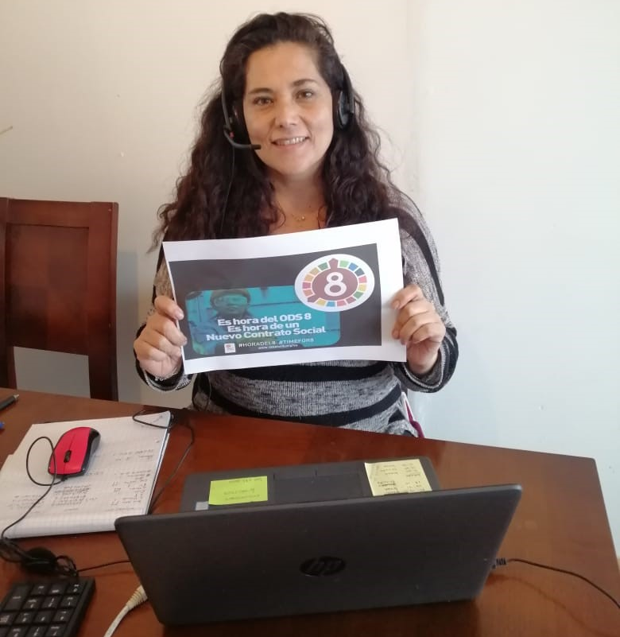
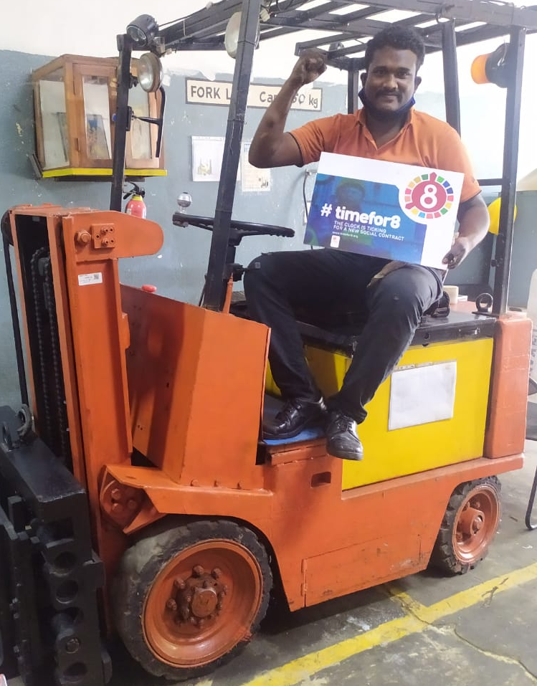
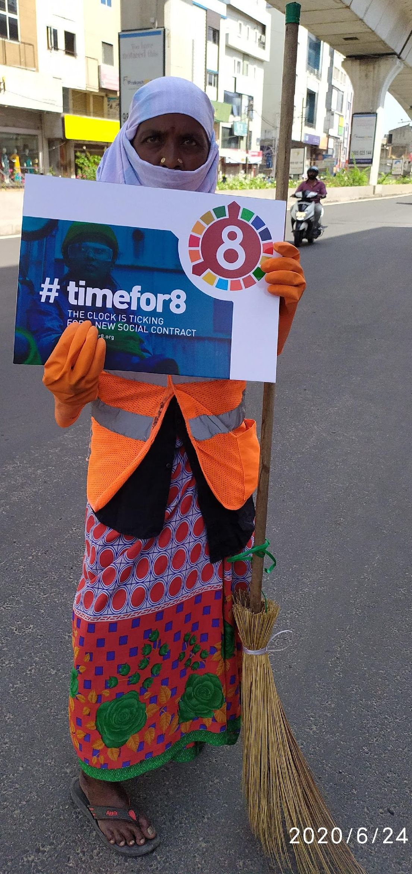
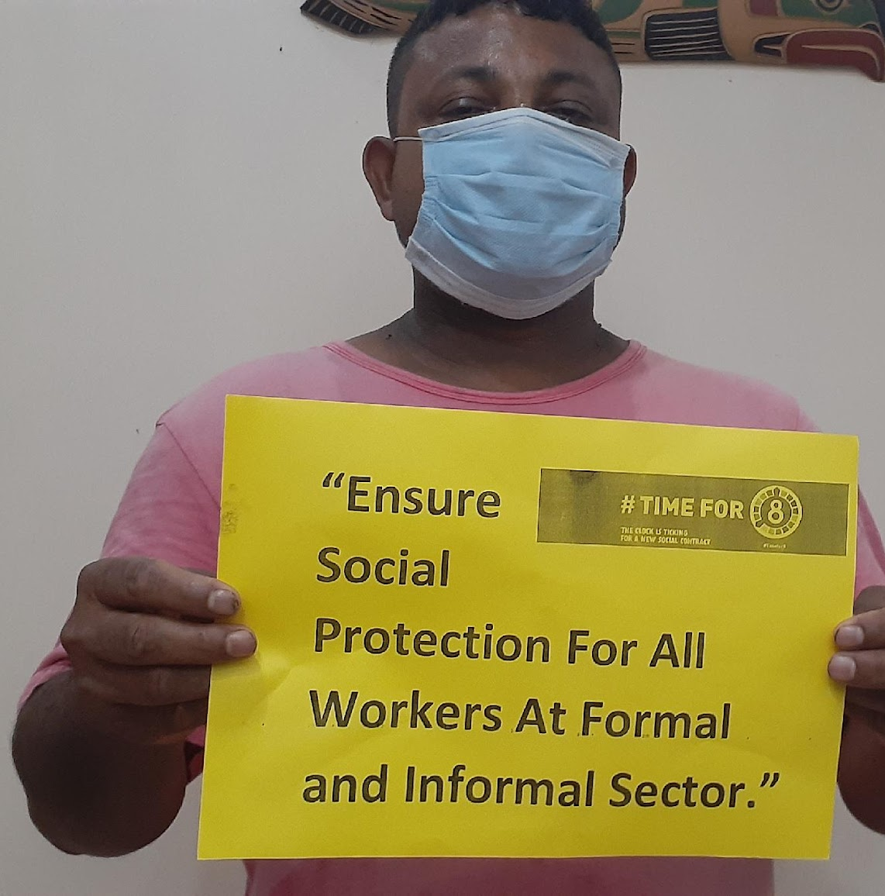
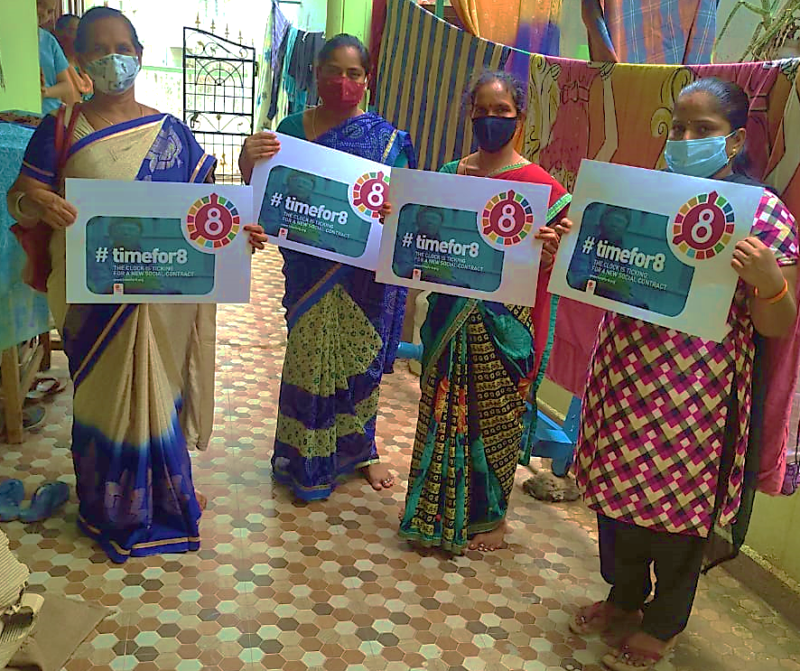
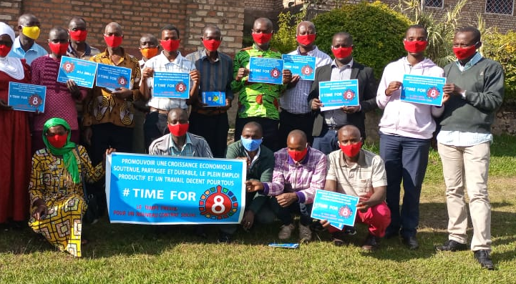
to…

Slide 4
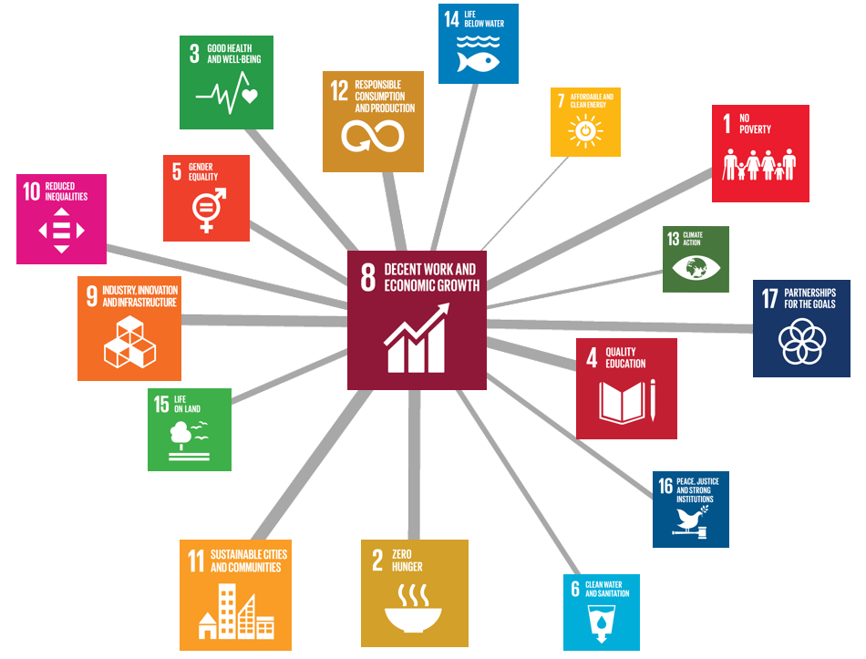
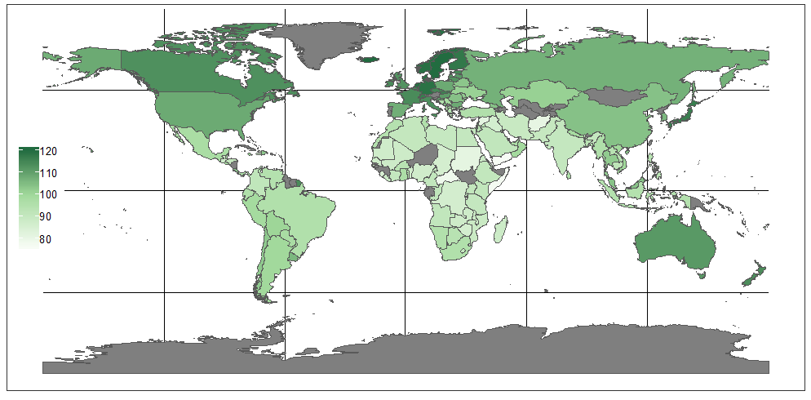

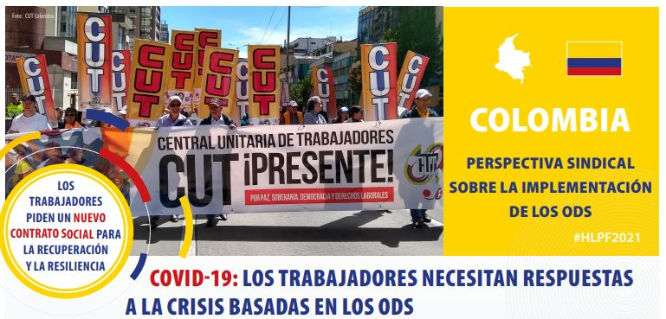
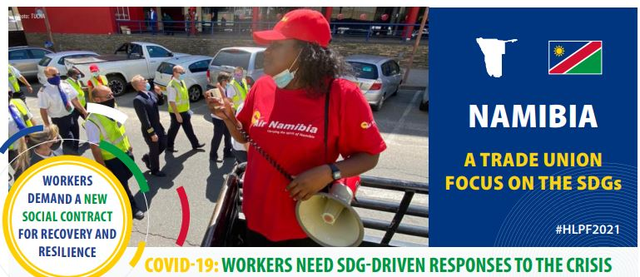
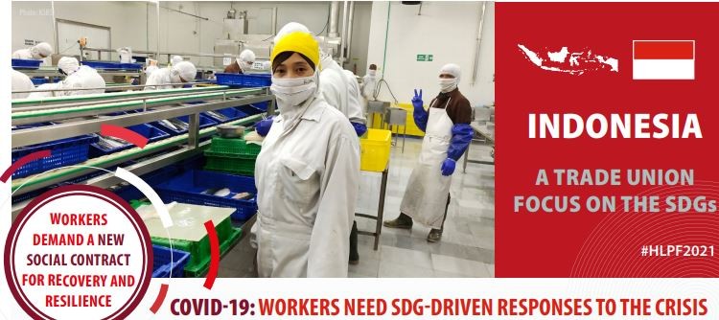
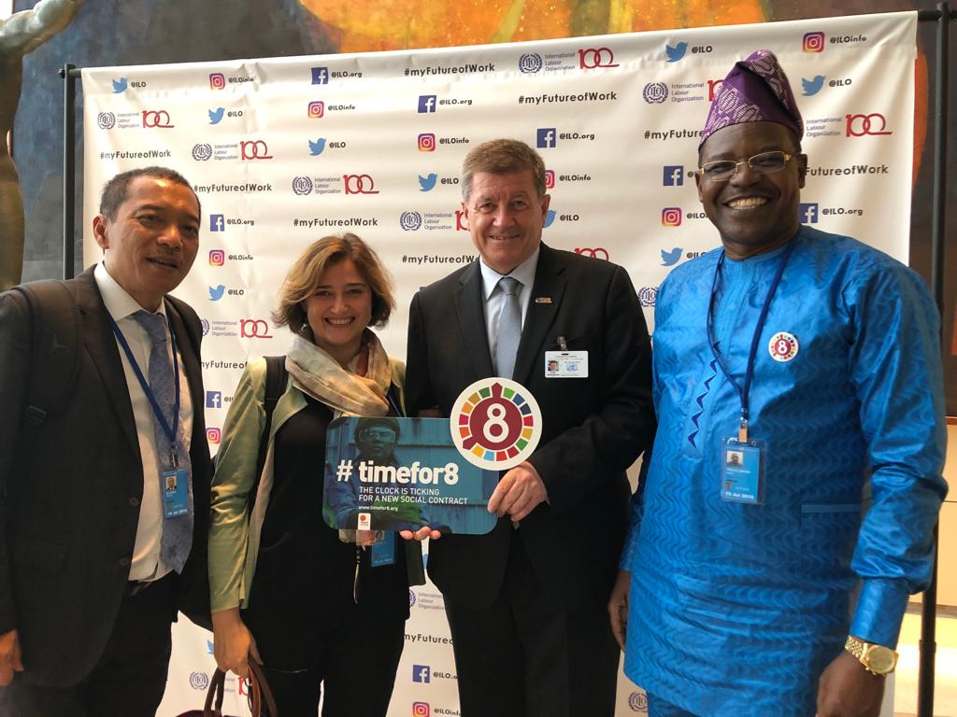
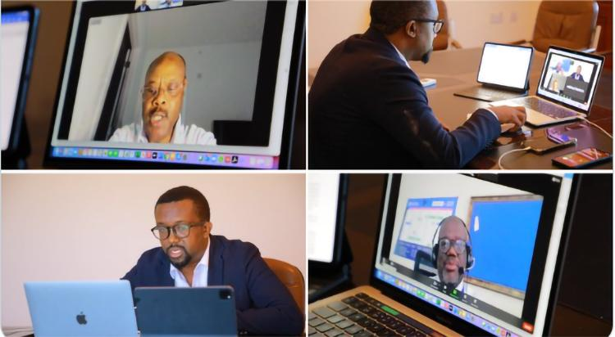
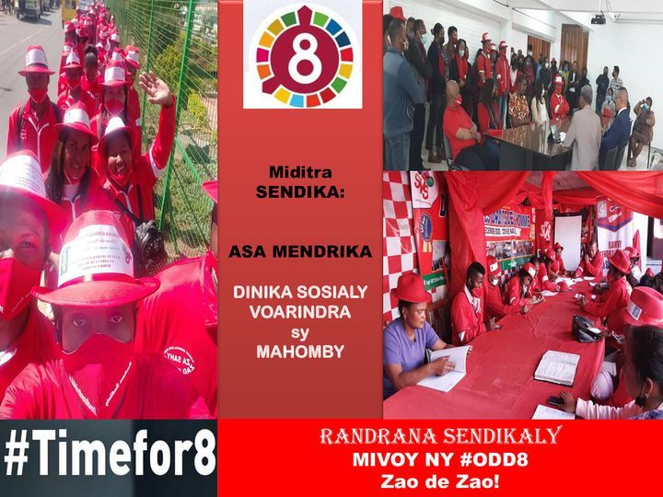
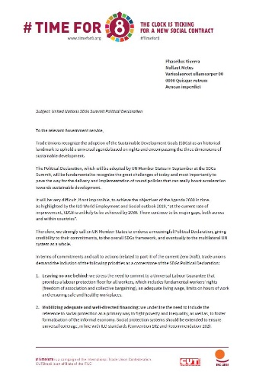
Tools
SDG 8 GLOBAL MONITOR https://www.ituc-csi.org/sdg8-as-a-new-social-contract-for-a-job-rich-recovery-and-resilience
Global
Research
A Trade Union Take on the SDGs
https://www.ituc-csi.org/2030Agenda
National
Monitoring
Glocal
Advocacy
Online
Campaign
timefor8.org #timefor8

Slide 5




Campaign’s main objectives & targets
Visibilise unions’ position on sustainable development in the
#HLPF2021 feed
Stimulate unions’ engagement by visibilising union’s activities both
during the HLPF2021 (side-events, plenaries, VNRs…) and at national
level (country reports, local
campaigns, testimonies).
Followers of the HLPF feed
Trade unions

Slide 6


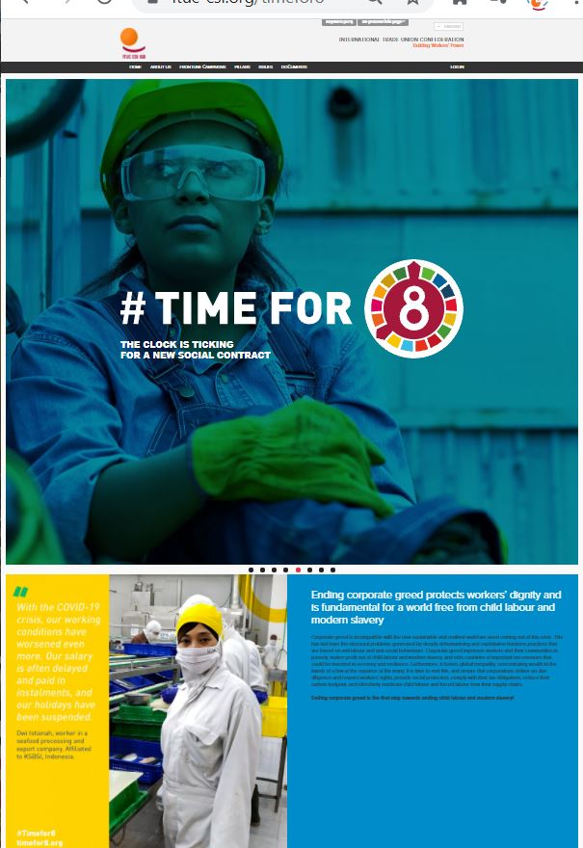
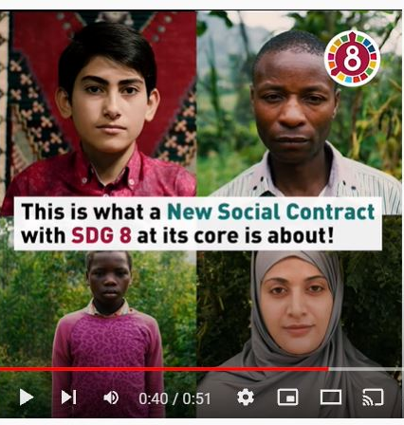




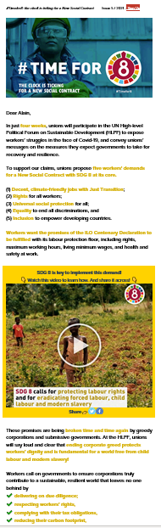
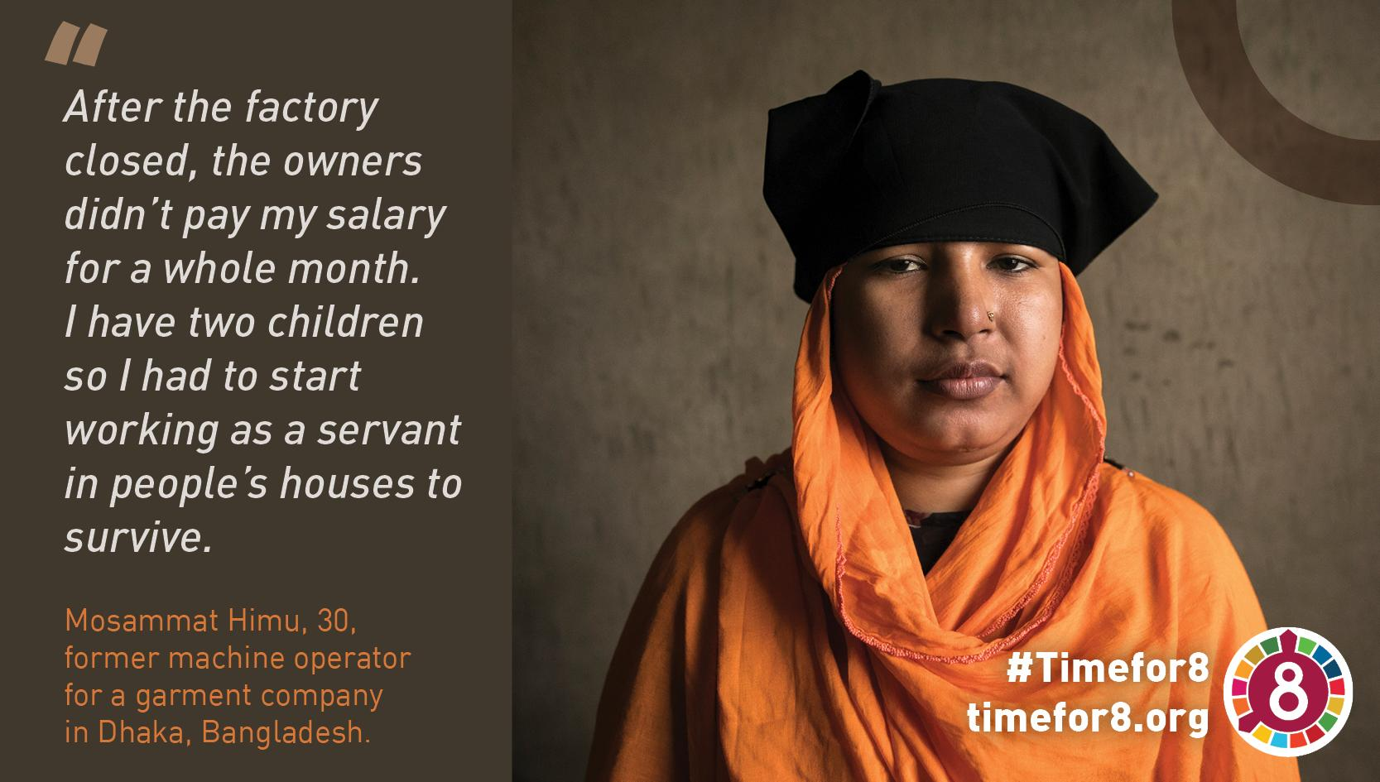
Campaign materials and some figures
Website
Videos
1 webpage x 3 languages
8 videos x 3 languages
640 Average unique visits
Top media post in twitter
July, 396 views, 4K impr.
June, 297 views, 4.5K impr.
Budget
in-house
Budget
€4.6K
Newsletters
Testimonies
10 issues x 3 languages
8 testim. x 4 lang.
2 formats
25% average unique open
4,86% average cliks
Top post in twitter
June, 4.6K impr.
Budget
in-house
Budget
€1K

Slide 7
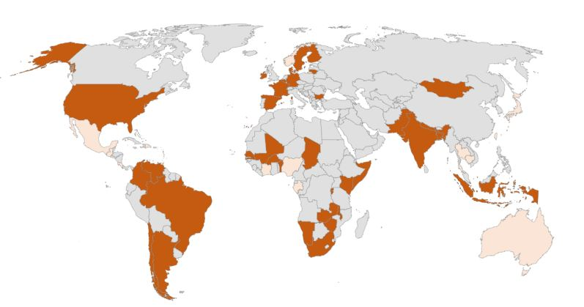
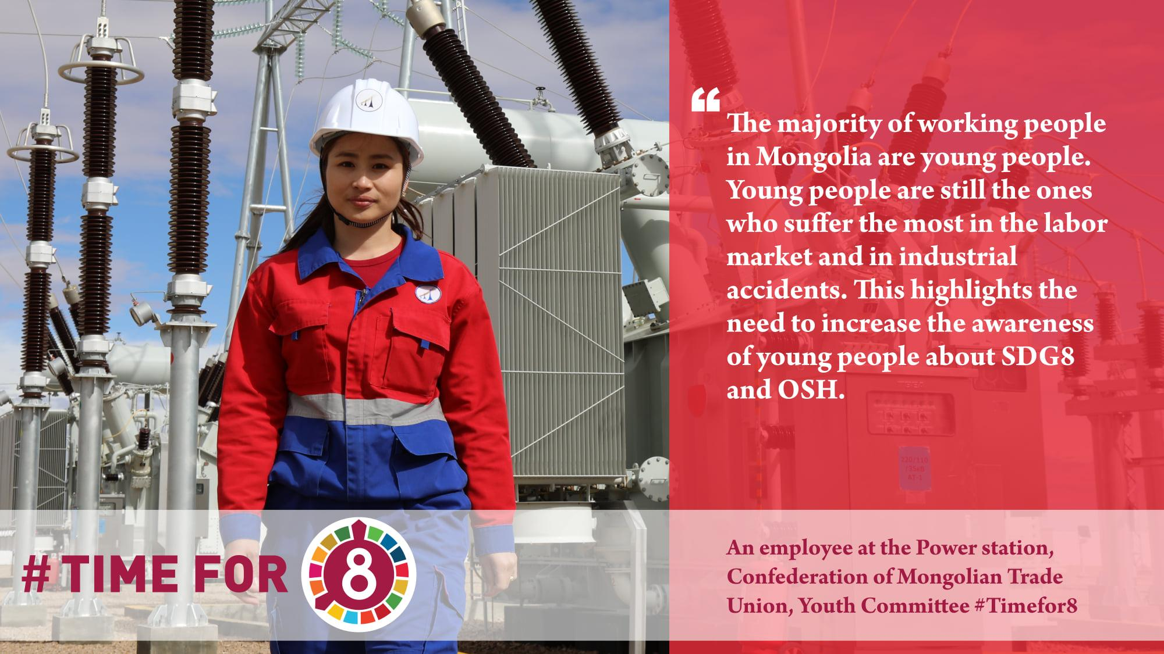
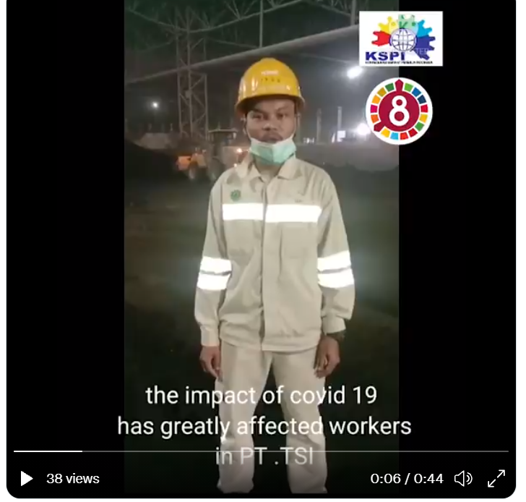
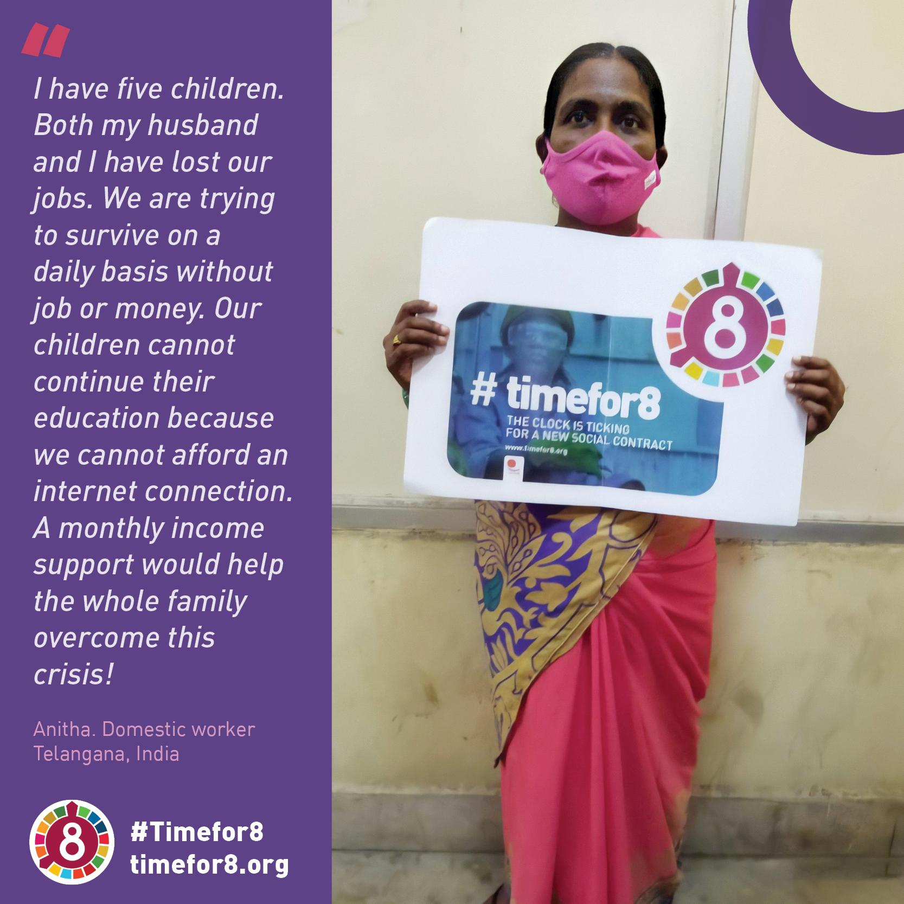
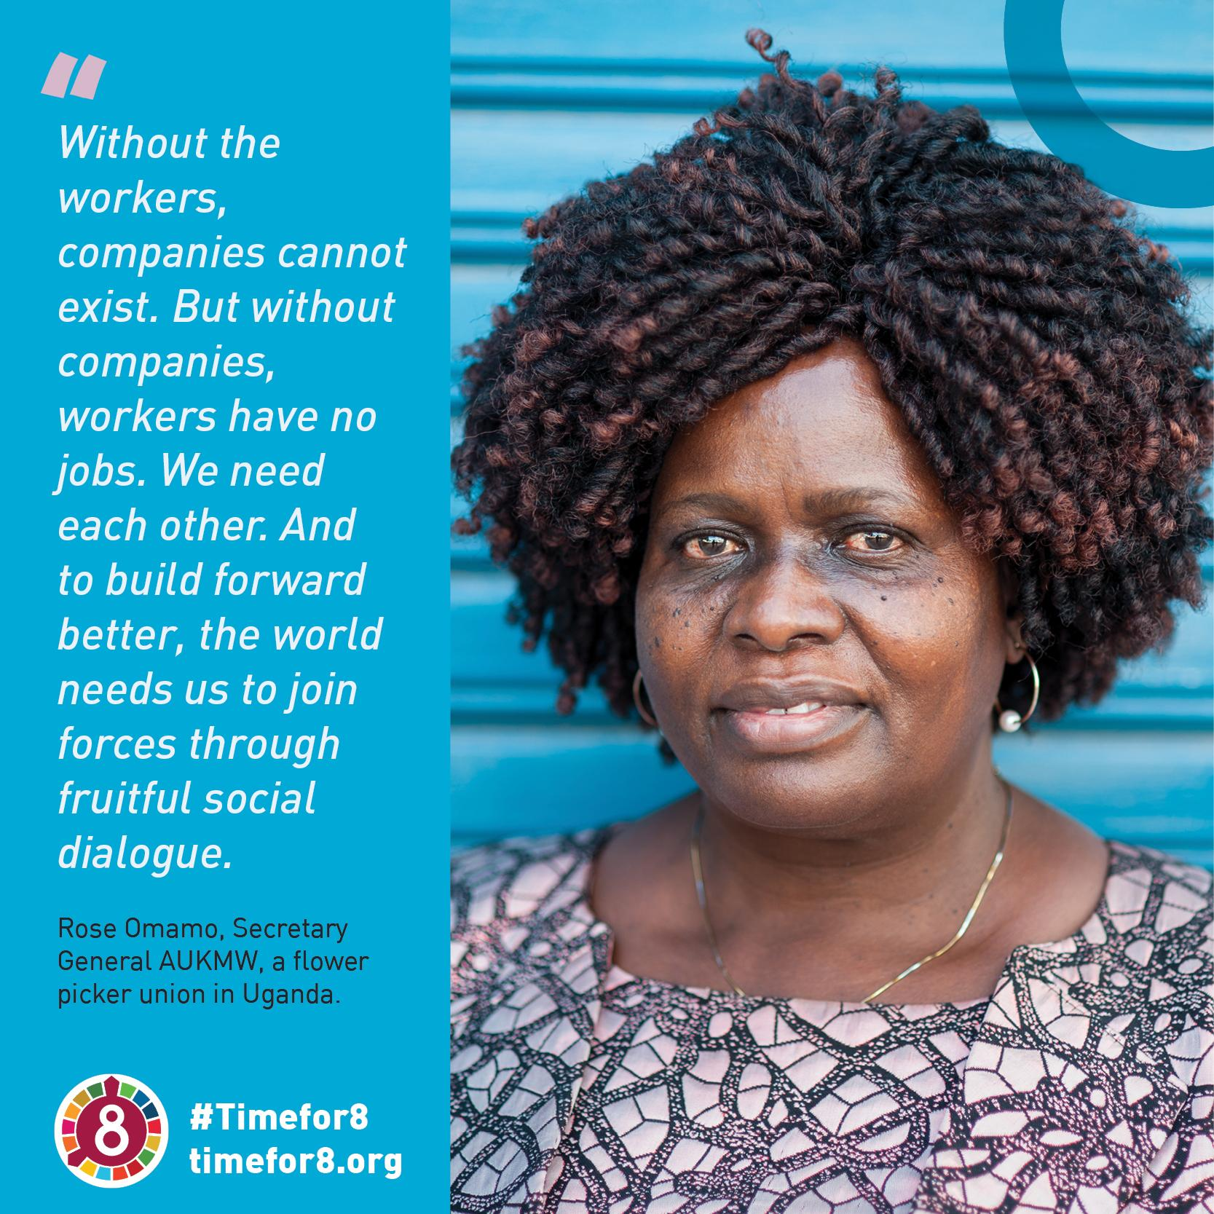
Campaign contributions from affiliates
58 countries
+-100 contributions/year
Budget vids 2021
€2.5K
Budget picts 2021
€1.7K

Slide 8
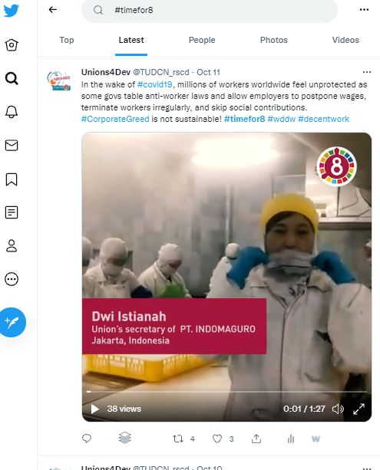
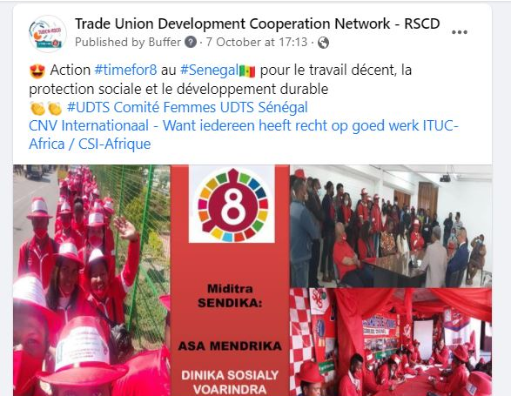
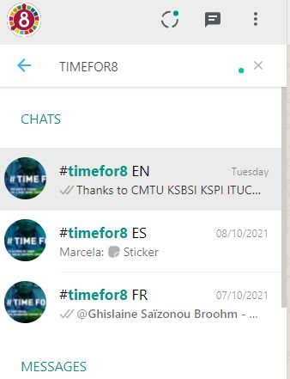
Main channels
Twitter:TUDCN_rscd
#timefor8
Facebook:TUDCN.RSCD
#timefor8
Email:
timefor8@ituc-csi.org
17 May – 15 July
6 posts/day
5 days/week
W-E recycle
3 languages
120 own posts
@ affiliates
@ relevant target
157.8K impr.
Tool: Buffer.com
17 May – 15 July
2 posts/day
5 days/week
W-E recycle
3 languages
50 own posts
@ affiliates
@ relevant target
16.5K reach
Tool: Buffer.com
17 May – 12 July
1 edition/week
10 editions
3 languages
CTA share video
1282 recipients
25% average unique open
4,86% average cliks
Tool: CRM4.dynamics
Whatsapp:
#timefor8

Slide 9

Some reflections and open questions…
Twitter seems to be THE platform to be when it comes to advocacy campaigning...
But what about Facebook?
Whatsapp groups have proven to be very useful for internal communication, good complement to emailing.
Affiliates’ sense of ownership of the campaign generates messages that are truly connected with their realities.
Making the narrative as accessible – jargong free – as possible is still a challenge... And helps bringing the message through despite language barriers...

