Slide 1
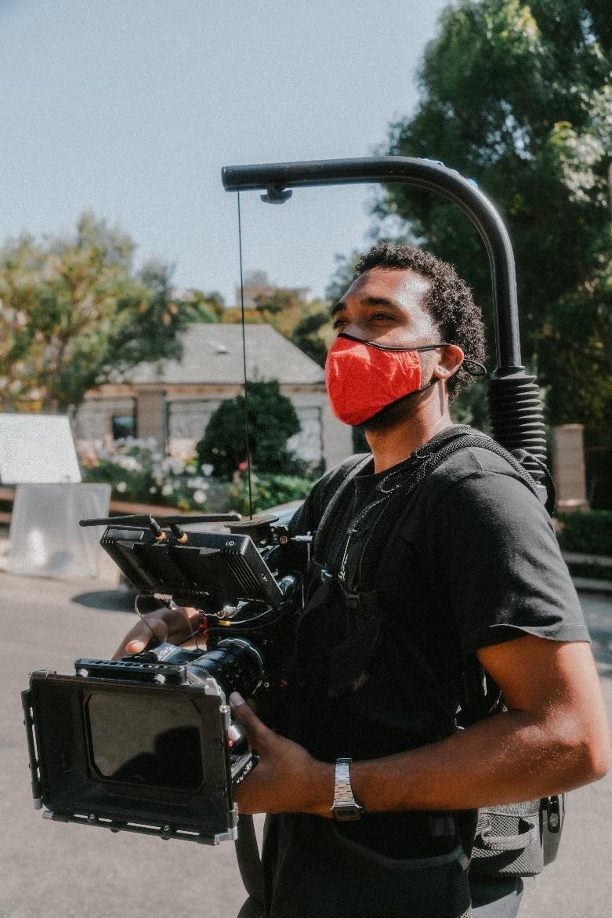

CSO Partnership for Development Effectiveness
Social Media Engagement and Media Relations
Notes:
Not going to go over any social media strategies or media relations techniques since this is information that you either already know or can easily find online. Instead I am going to focus specifically on how we as the Global Secretariat can advance our collaboration and share resources and know-how to amplify our collective voices

Slide 2
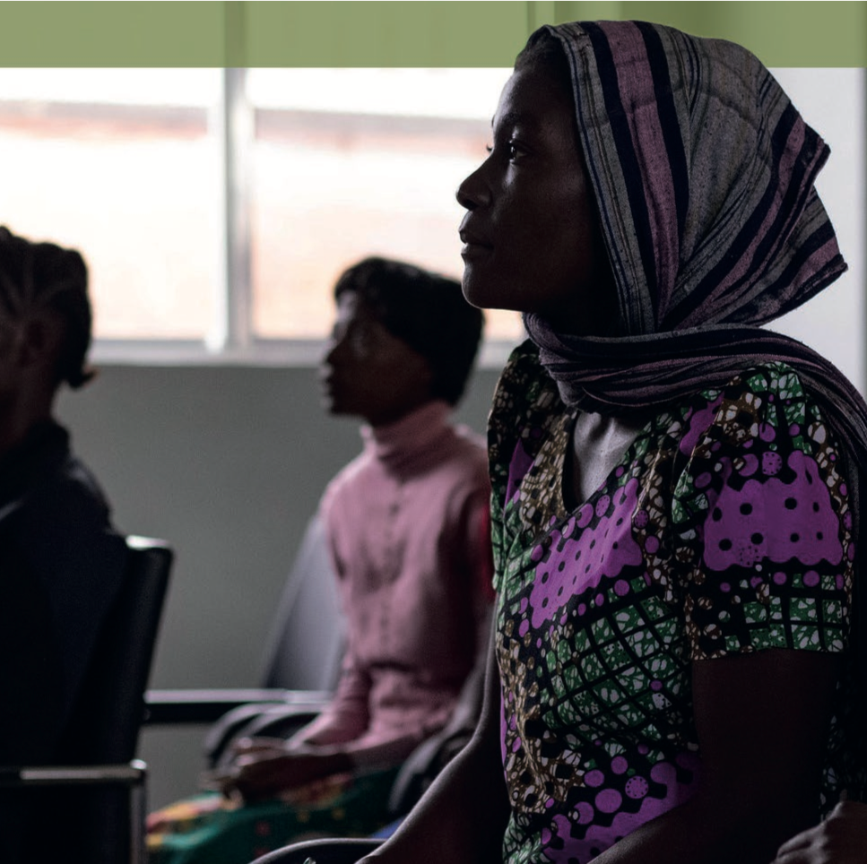
Uniting on our platform’s advocacy/campaigns
From global advocacy to local and national engagement
  Leave no one behind (Covid, inclusive multistakeholder participation)
  CSO Enabling Environment (Reverse Shrinking Civic Space, HRBA, FBA)
  CSO Development Effectiveness (Istanbul Principles, SSC)
  Environmental sustainability (climate finance etc.)
Notes:
- As a platform, we advocate on a global level but the aim is to work for social transformation at the national and local level.
- As a global civil society advocacy platform it’s easy to lose sight of the relevance of our adocacy in a local context since we try to frame issues in the most inclusive way possible at a global level
- So when thinking about the relevance of our advocacy issues in people’s day-to-day lives, communities across the world have felt the devastating effects of Covid, especially marginalized groups; almost every country is experiencing a shrinking of civic space; climate change and environmental degradation affects everyone across the world = these are all very relevant and timely issues that need to be transmitted to the public in an accessible way. And they are also issues that can be projected with greater strength by unifying organisations across the globe through platforms like CPDE.

Slide 3
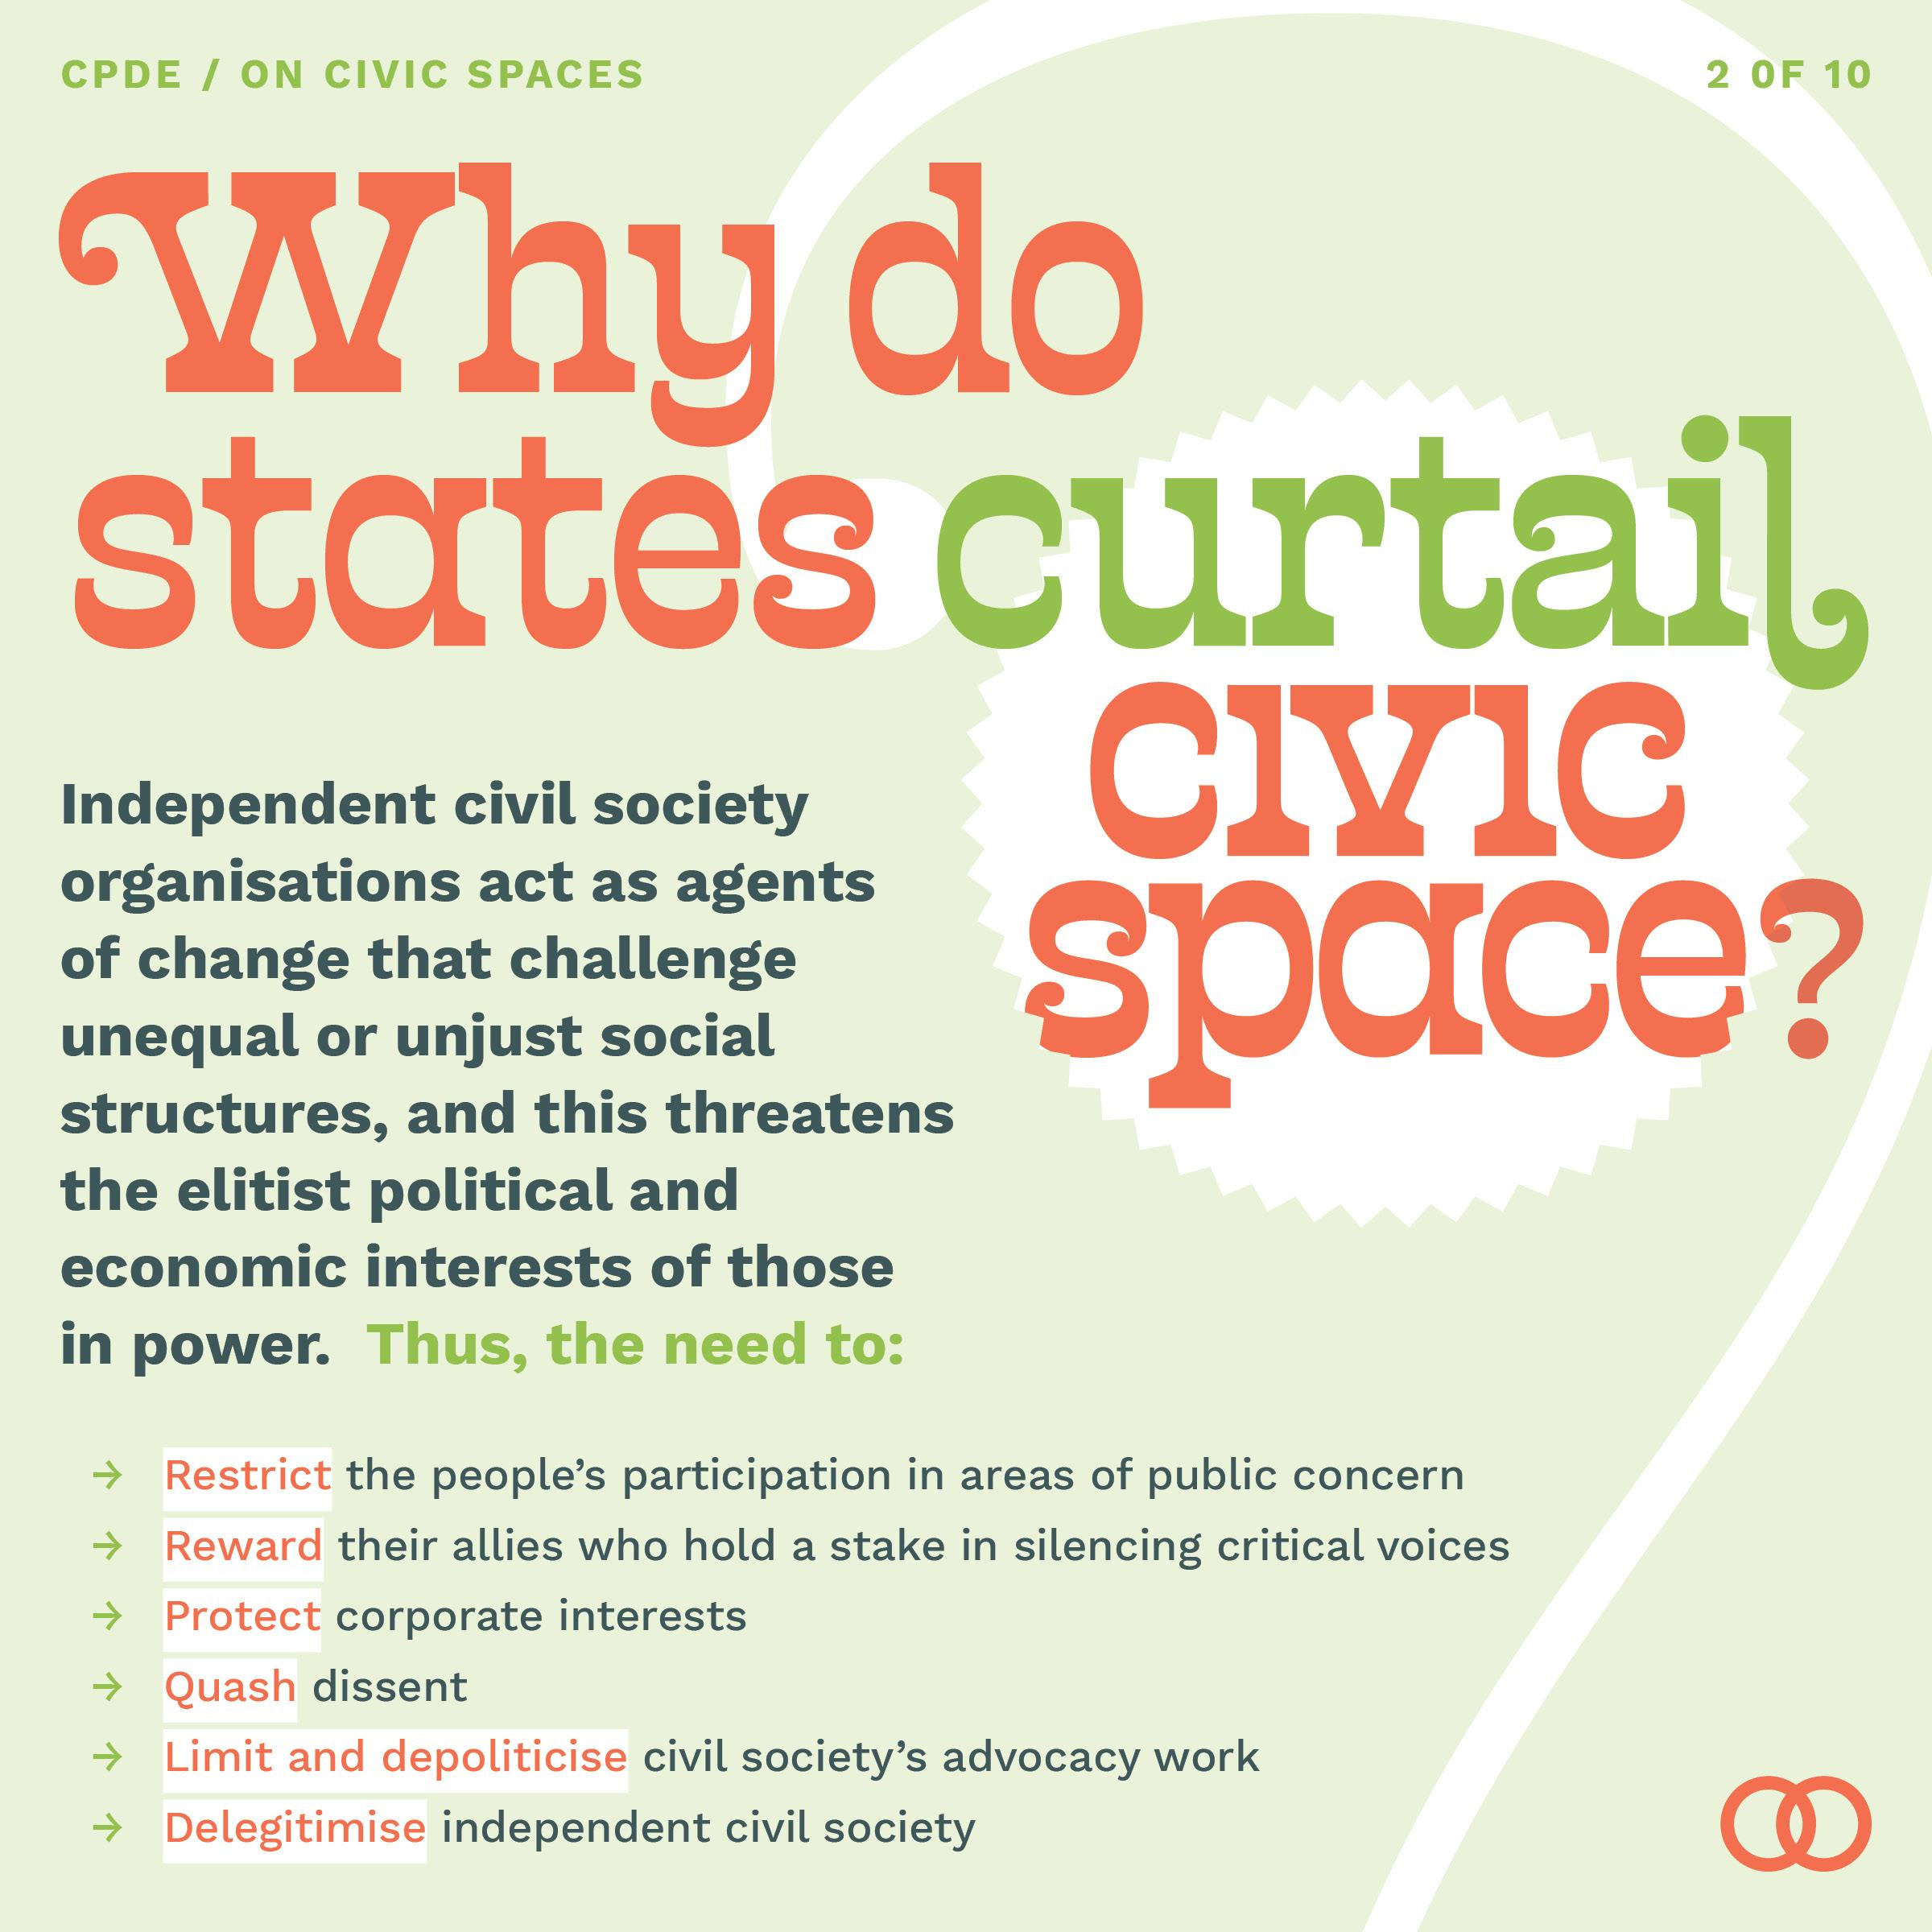



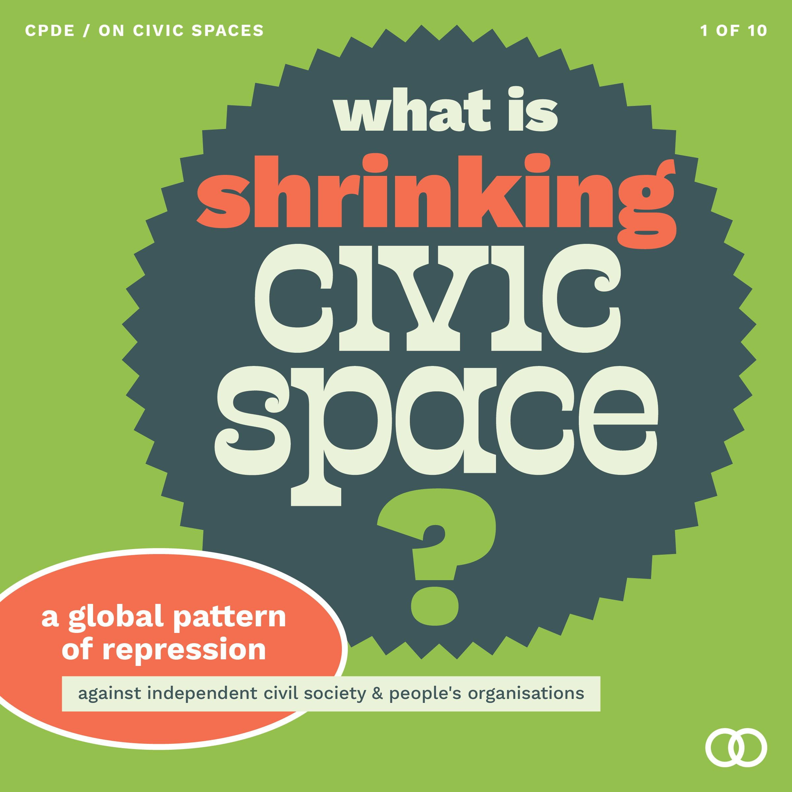
CPDE communications kit (EN/FR/SP)
In this folder you can find all our communications materials
Shrinking civic space
social media cards
Istanbul Principles
Brochure
EDC Brochure

Slide 4
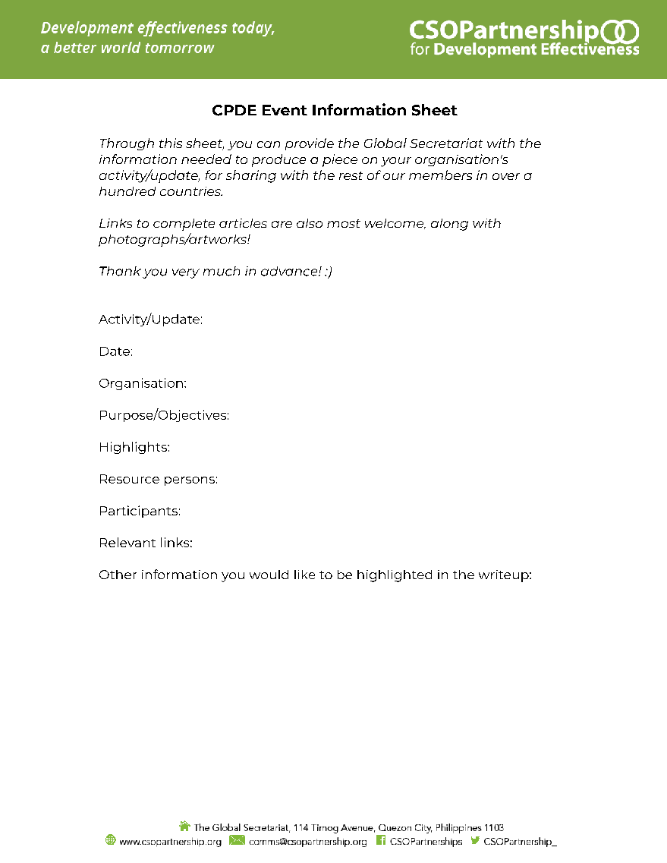
HOW CAN WE WORK TOGETHER?
Event information sheet
Share our own media directory (by region, by theme/topics covered) upon request
Offer support and resources for media relations and social media - share educational resources, comms toolkits, connections, branding elements, collaborations for videos/podcasts
Notes:
You can provide the Global Secretariat with the information needed to produce a piece on your organisation's activities or updates, for sharing with the rest of our members
Event information sheet - provide the Global Secretariat with the information needed to produce a piece on your organisation's activity/update, for sharing with the rest of our members in over a hundred countries.

Slide 5
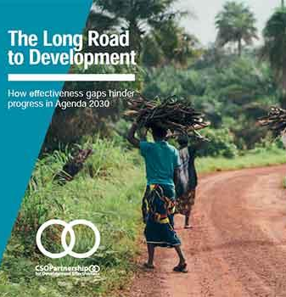
Pitching platform activities to local/national news
Step 1: Receive email by CPDE GS on research study results/event/campaign to take place
Step 2: Think of how this is relevant to your org’s context
Step 3: If it is relevant, access CPDE press kit link for access to materials (e.g. press releases, background material about projects, photos, research paper teaser etc.)
Step 4: Compile a list of media contacts that you think would be interested in writing a story about it
Step 5: Send press kit with personalized press release to media contacts highlighting: 1) how it’s relevant to your national/local context; 2) that there is a robust evidence base; 3) the call to action of the event/campaign/research
Notes:
Step 2: for example, if it is research paper on shrinking civic space you participated in, think specifically about your country’s results and how these results provide evidence on how certain issues are improving or worsening and whether your country is part of a global trend or an outlier in the study
Step 4: to find new journalists, consider searching through twitter by using relevant hashtags and searching the connections of relevant people you follow
Step 5: Press release structures are outlined in the resources available

Slide 6
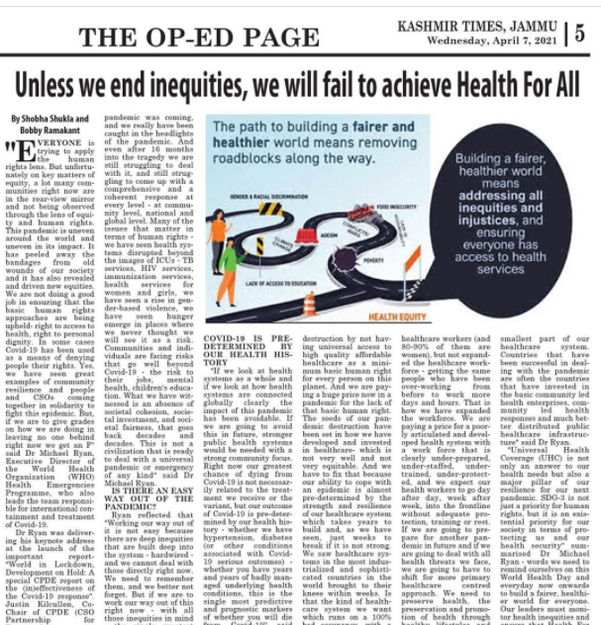
MAKE IT NEWSWORTHY
Proximity - The closer the story is to home, the more newsworthy it is
Human interest - Individual stories are very important in highlighting the bigger picture
Evidence-based - having a robust evidence base can help strengthen a story
A strong call to action - think about what your organisation is calling for - do you want people to sign up to your campaign, protest, etc.?
Notes:
Proximity - relevance to their lives
Human interest - individual stories are more powerful than numbers; wanting to put a face to social issues comes naturally
Evidence-based - providing data as evidence is necessary to back-up our calls to action and principles
AND...
A strong call to action answers the question that many people have when they read about social issues -- how can i get involved to make a difference?
In the upcoming presentation on Search Engine Optimization fanny will elaborate on how stories can be structured to generate a wider audience

Slide 7
PEOPLE’S MEDIA SITES
News websites focusing on social justice issues from both global and national perspectives:
Open Global Rights (EN/SP/FR) - https://www.openglobalrights.org
Equal Times (EN/SP/FR) - https://www.equaltimes.org
Groundswell News - https://groundswellnews.com
New Humanitarian (focused on humanitarian crises) https://www.thenewhumanitarian.org
Mongabay (environmental/indigenous rights focus) https://mongabay.org
Notes:
Here are a few news sites that focus on human rights, grassroots struggles, labour issues, and social and environmental justice issues. Please contact us for a more extensive list and to collaborate on news pitches

Slide 8
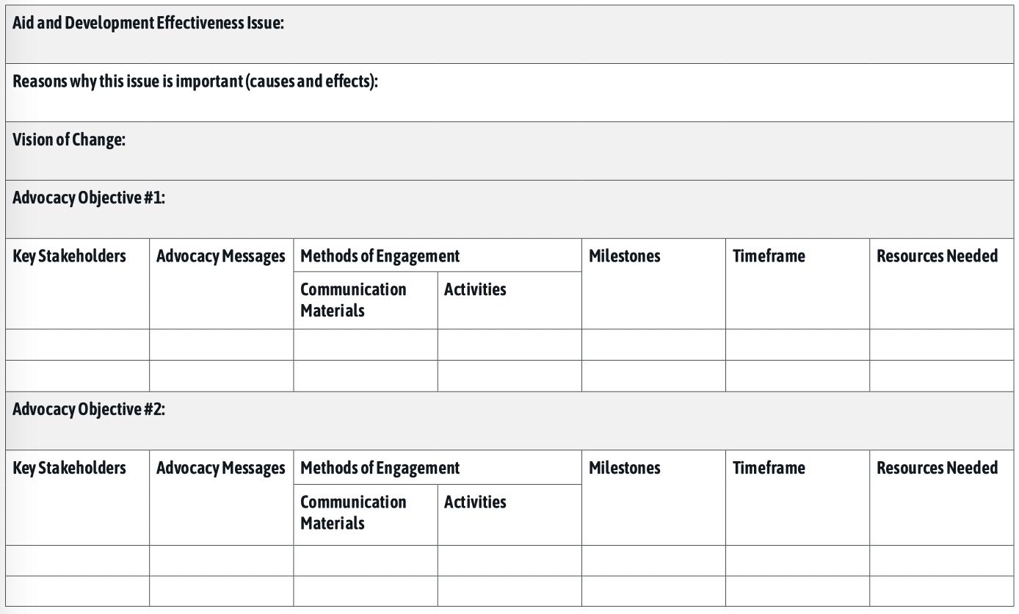
CPDE ADVOCACY AND (SOCIAL) MEDIA EXERCISE
CPDE Advocacy Issue
Notes:
So this is a useful exercise to determine or simply to organize key advocacy issues

Slide 9



LEARNING RESOURCES
Connecting with Media Handbook – CIVICUS
CSO Aid Observatorio Training Handbook 2020 (Module 4 on advocacy) (EN/SP/FR/AR/RU/Bahasa/Nepali)
Media Relations - Guide for Civil Society Organisations – Balkan Civil Society Development Network (BCSDN), 2007
Media Relations Manual for Civil Society Organisations - SIPU International and Consortium Partners, 2013
Social Media Outreach and Digital Advocacy – Project on Middle East Democracy, 2020 (EN/AR)
Guide to Reporting Civic Space: Media Toolkit – CIVICUS (EN/FR/SP)
Notes:
Here is a list of useful resources that contain step-by-step guides for contacting media, writing up press releases, communicating advocacy issues and so on.

Slide 10
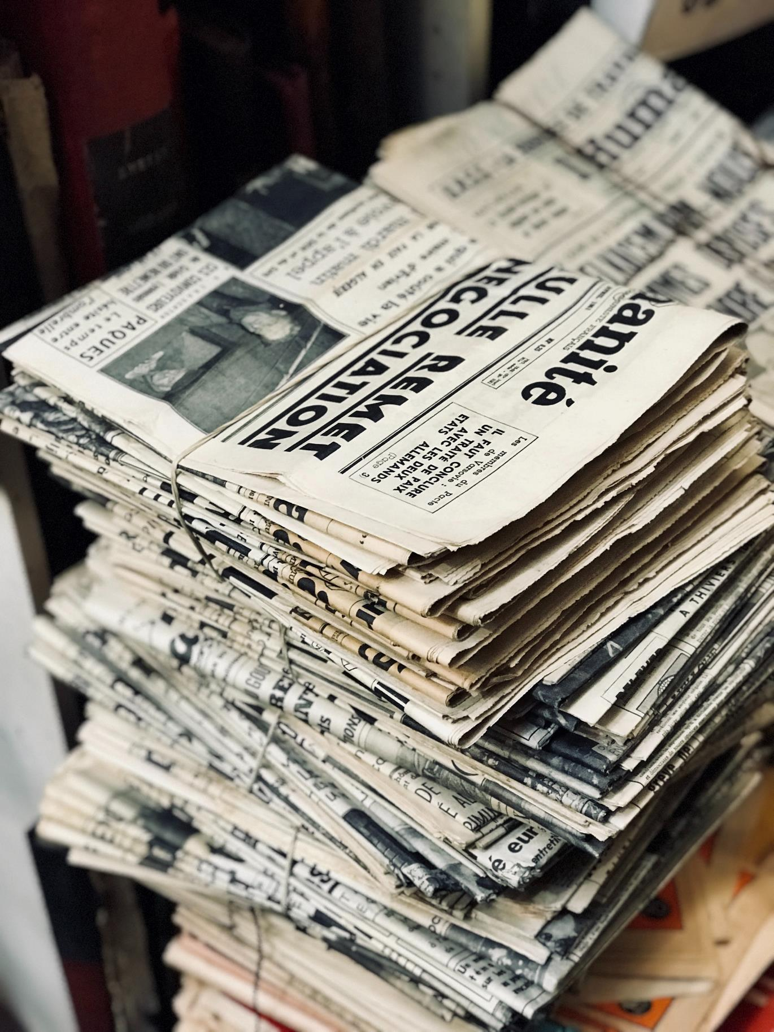
THANK YOU
CSO Partnership for Development Effectiveness

