Slide 1


CSO Partnership for Development Effectiveness
SEO Principles for CSO websites
Improve your online visibility!

Slide 2

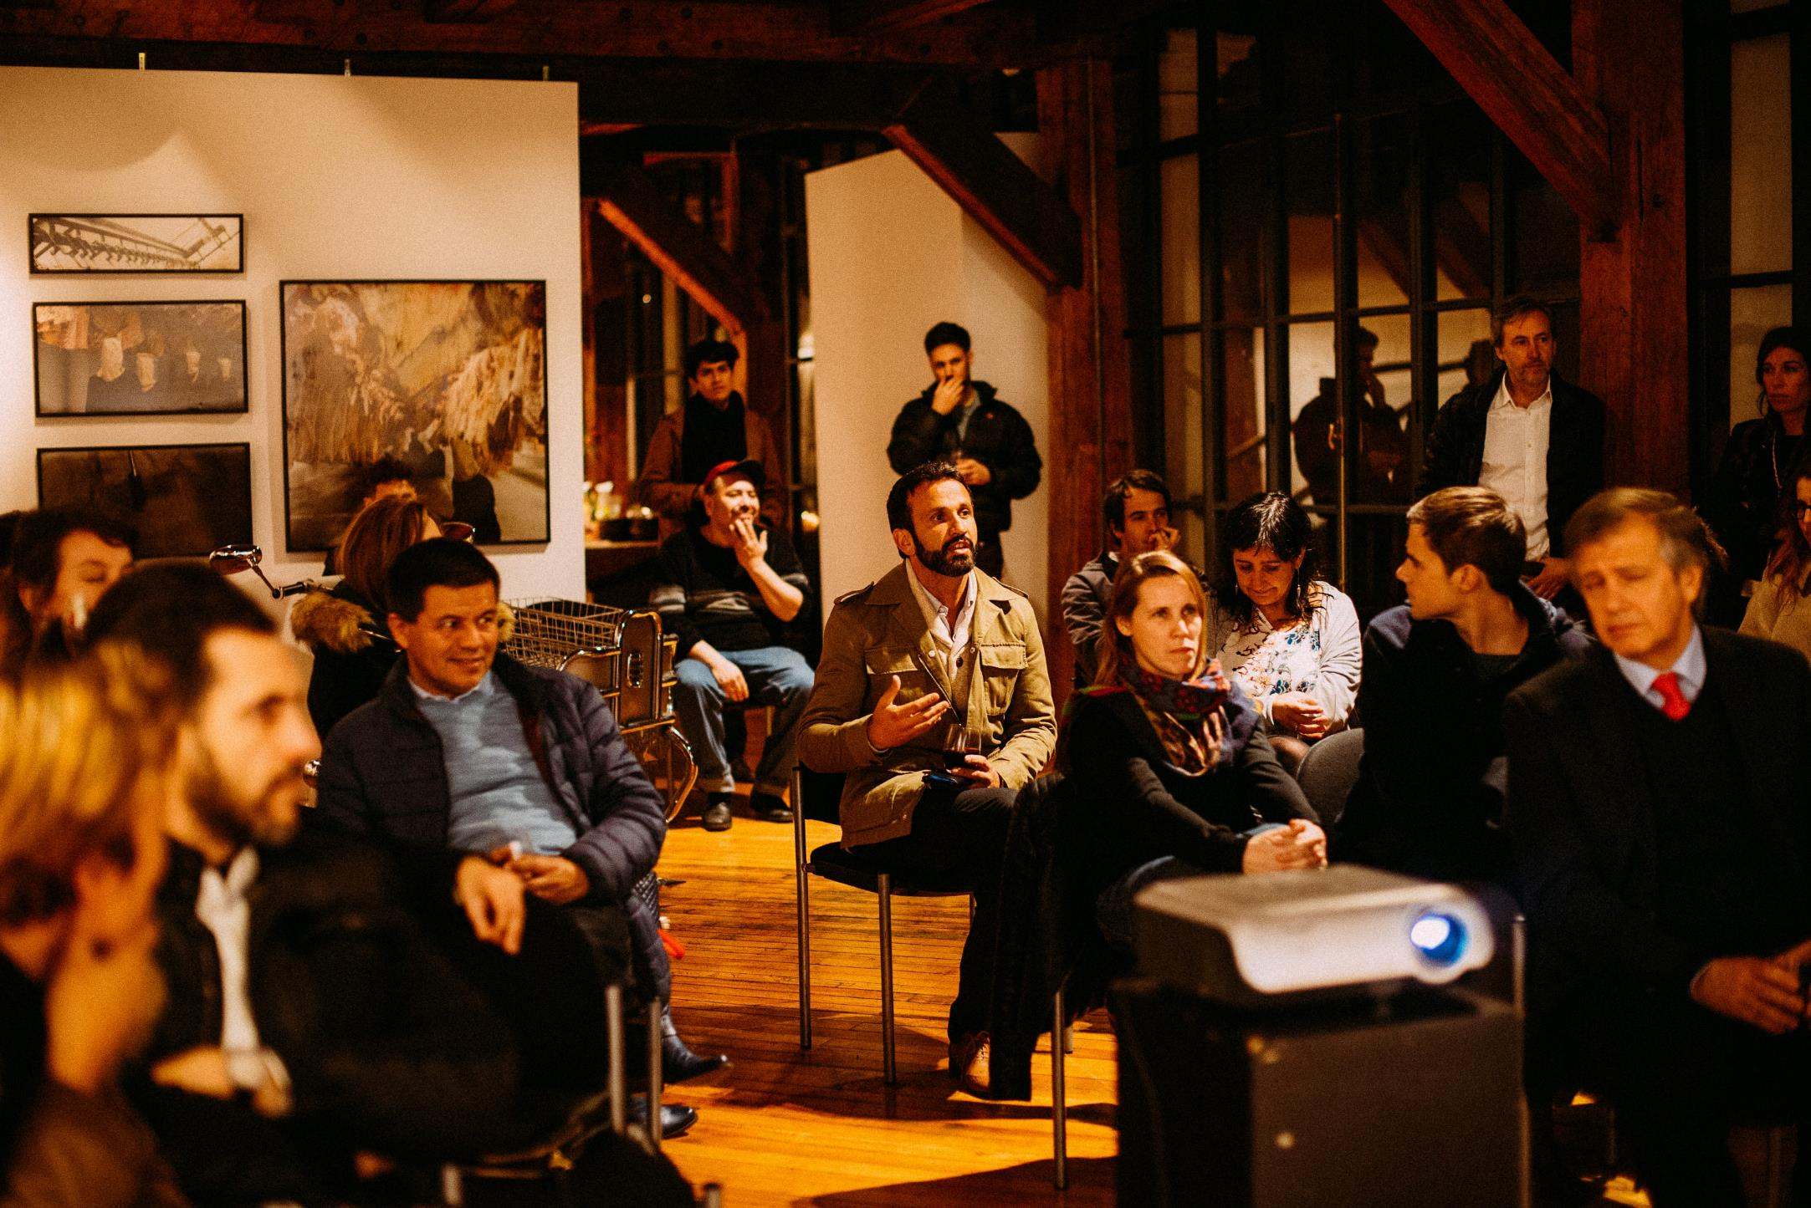
WHAT IS SEO COPYWRITING AND WHY SHOULD WE USE IT?
SEO = Search Engine Optimization
Copywriting in SEO is the art and science of striking a fine balance between content that persuades and content Google can find.
When we write for the web, we need to comply with Google rules and algorithms so our article will be well ranked otherwise it is very likely that no matter how qualitative your content it, it will never be seen by potential readers.
When we write for the web we need to think that we write for a mobile phone reading + a reader who has a very short attention span and who will scan our article in a few seconds, then decide to read it more or not: we need to catch the reader at the first glance.

Slide 3
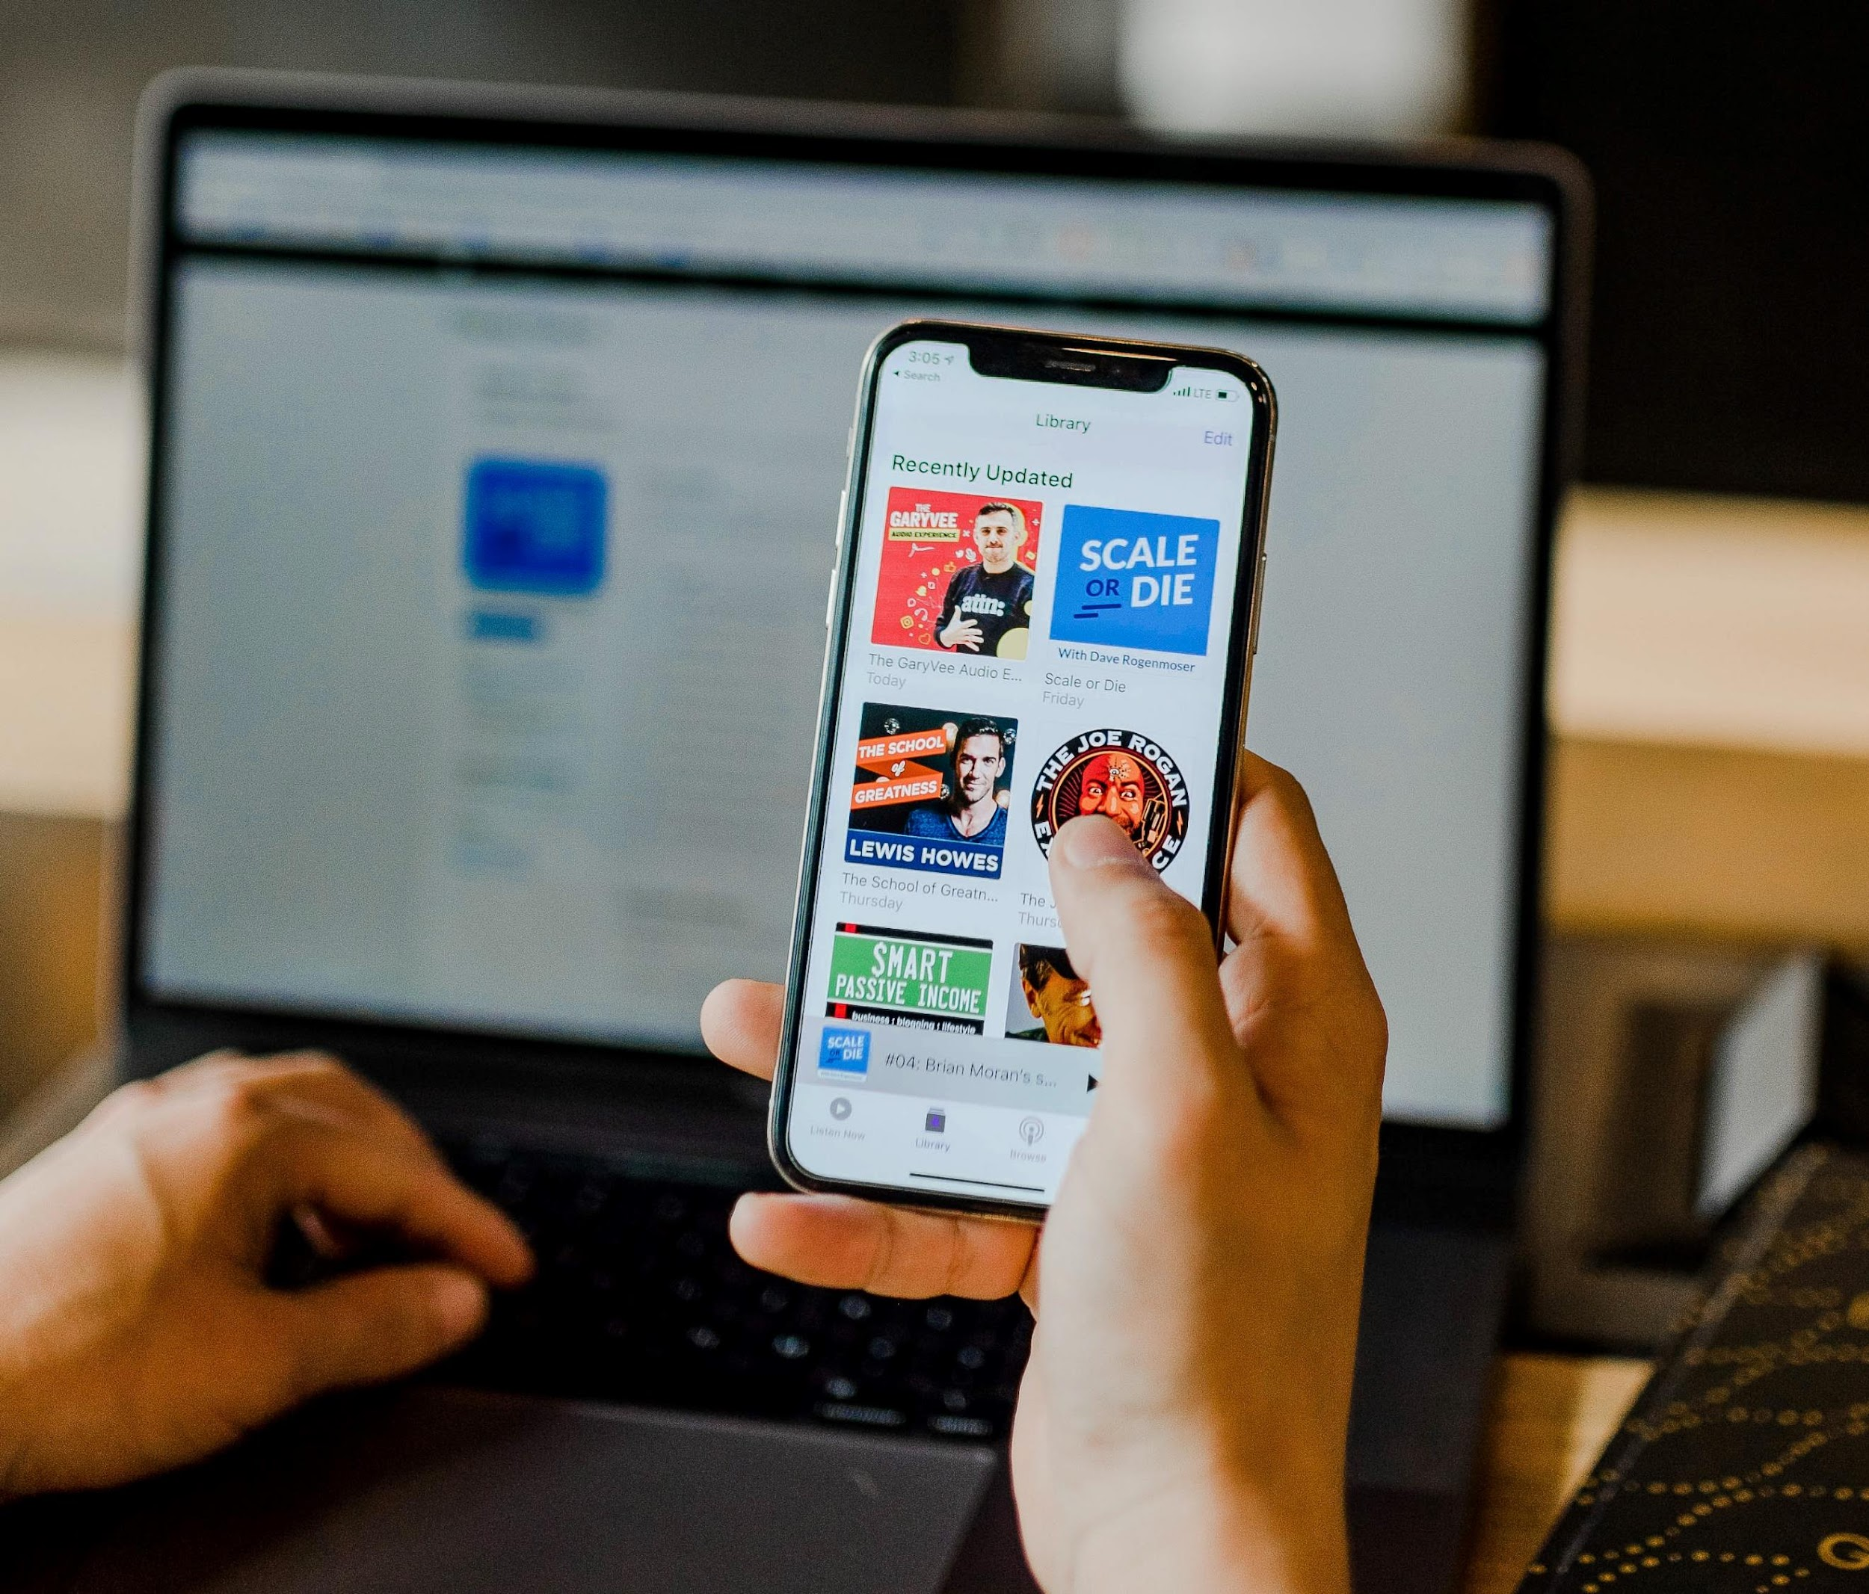
A FEW TIPS TO BE WELL-RANKED BY GOOGLE
Using keywords at all levels of reading
Be careful of your article’s meta-description
Use the inverted pyramid technique in the body of the article
Create traffic: attention, clicks and conversion

Slide 4
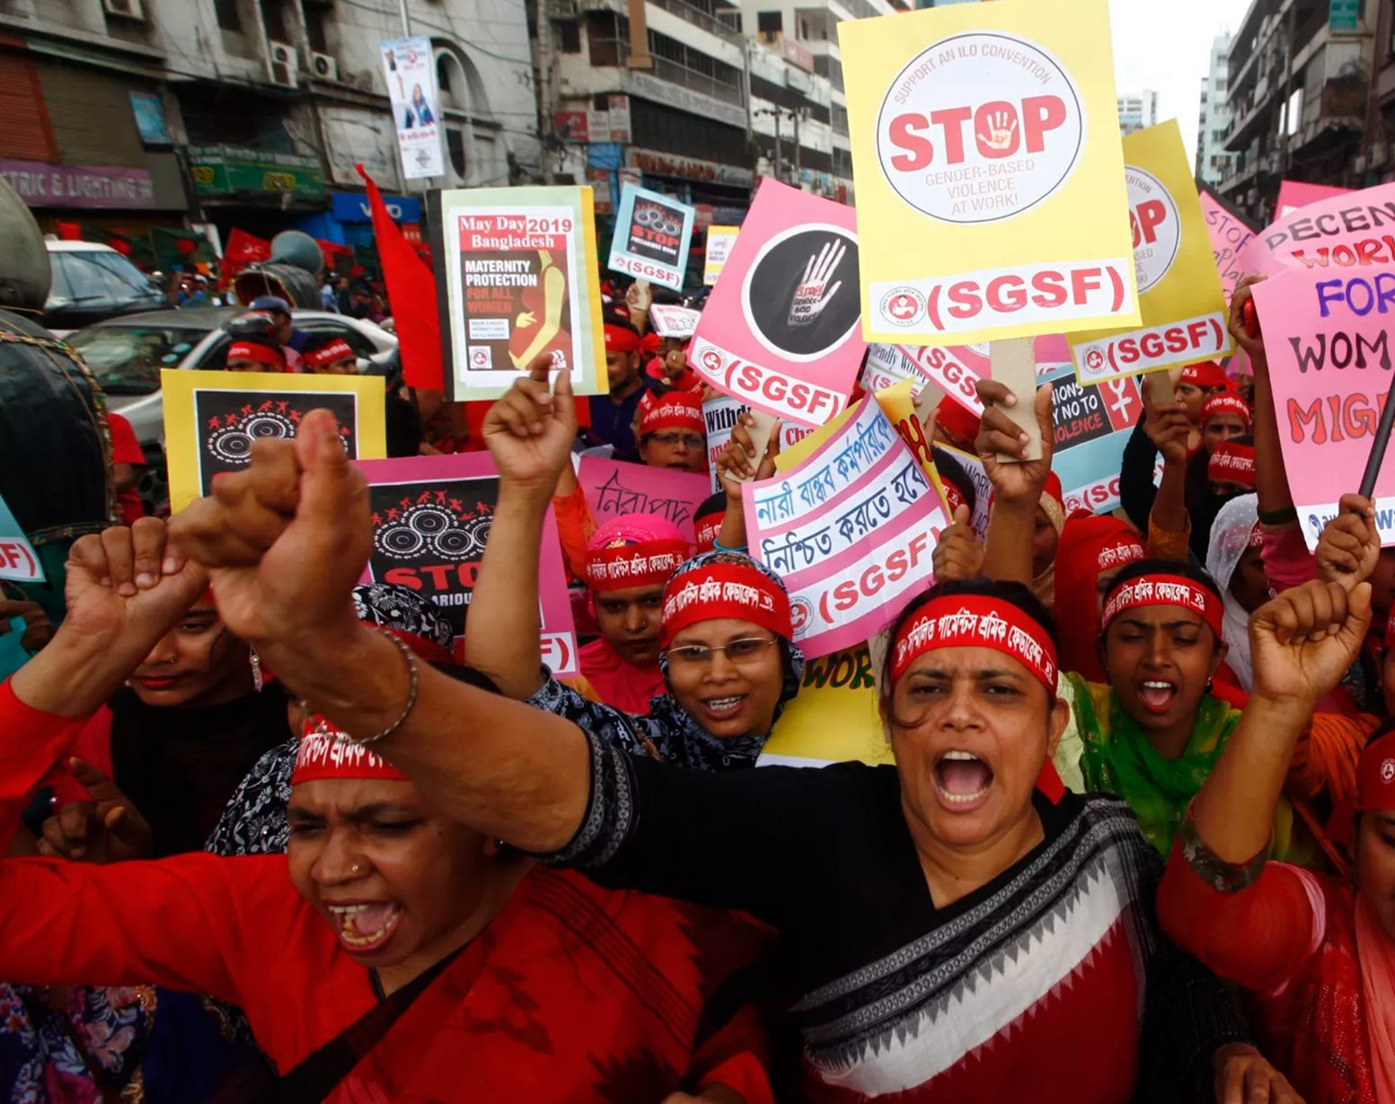
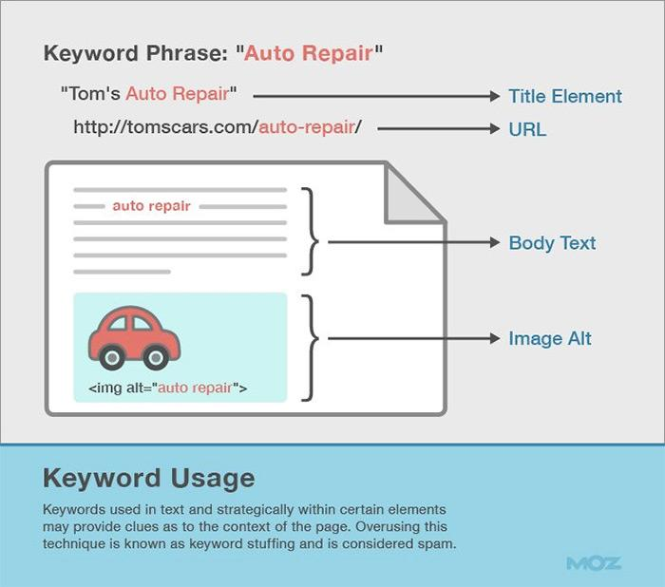
USING KEY WORDS AT ALL LEVELS OF READING
Using keywords is the key to be well ranked on Google. That’s why your keywords should appear at all level or reading: title, subtitles, URL, body text, image alt
Even if it may sound redondant, you need to repeat these keywords as much as possible.
It means for example that instead of using « We », or « The platform », the name « CPDE »or « CSO Partnership » should appear at all levels.

Slide 5
Recommended EDC Key Words, tags and hashtags
Effective Development Cooperation, CSO Partnership for Development Effectiveness, Development Effectiveness, CPDE, Istanbul Principles, CSO, Development Effectiveness, CSO Enabling Environment, Sustainable Development Goals, SDGs, Agenda 2030, CSO Accountability
#EffectiveDevelopmentCooperation, #DevCoop #CSOPartnership #DevelopmentEffectiveness, #CPDE, #IstanbulPrinciples, #CSODevelopment Effectiveness, #SustainableDevelopmentGoals, #SustainableDevelopment, #SDGs, #Agenda2030, #CSOAccountability

Slide 6
Recommended EDC Key Words, tags and hashtags
Shrinking Civic Space, Human Rights, Climate Finance, Climate Emergency, Climate Change, Climate Crisis, CSO Enabling Environment
#ShrinkingCivicSpace #StandUp4HumanRights #ClimateFinance #ClimateEmergency #ClimateChange #ClimateCrisis

Slide 7
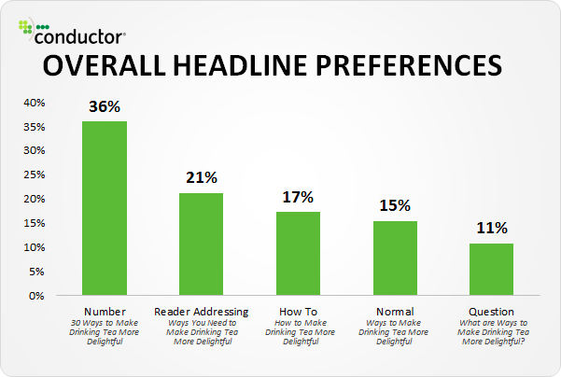
CHOOSE THE RIGHT TITLE
Using keywords, “why”and “how” is strongly advised
Use call to action - directly address the reader
Do not write long and mysterious titles, avoid using acronyms
Using numbers in your titles make people click more (eg: “7 reasons why…”)
Notes:
7 reasons why you should support our campaign instead of how to support our campaign or just support our campaign

Slide 8
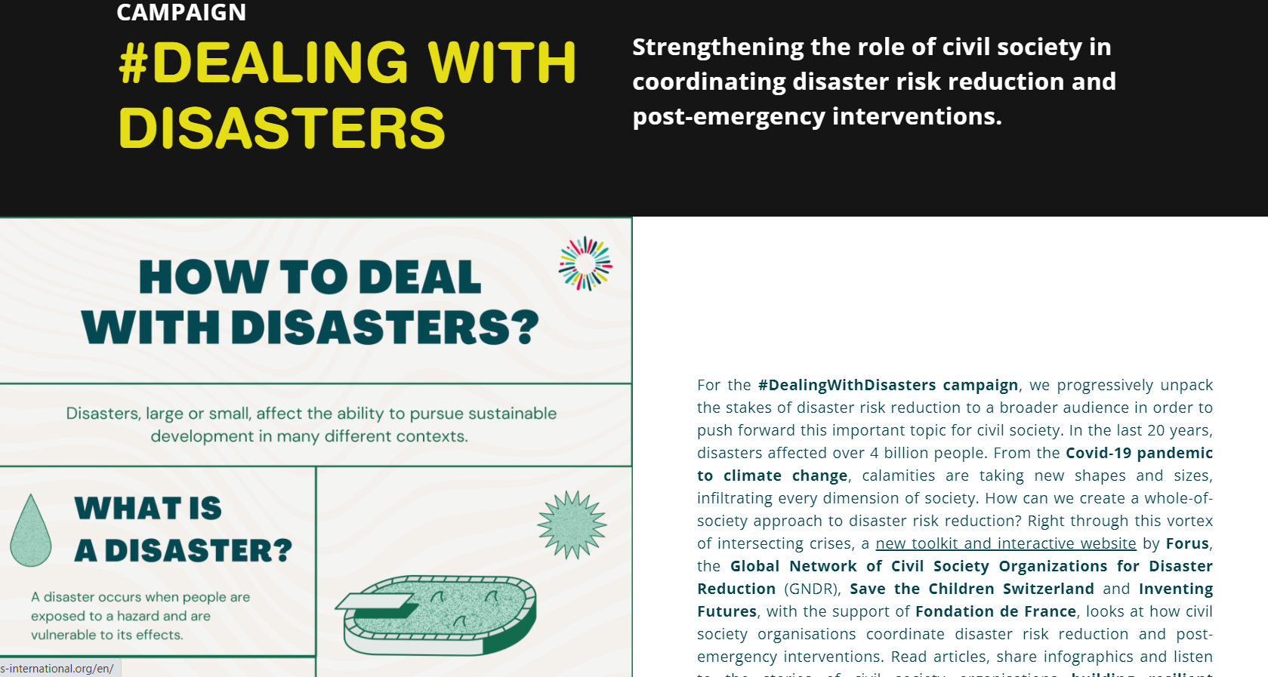

Slide 9

CREATE A COMPELLING METADESCRIPTION
Meta descriptions are the next thing people read after the title. It appears under every search result. If your title is great but your meta description is not, you are killing your chances of getting the click and therefore being well-ranked by Google.
Meta descriptions should be:
Descriptive
Persuasive
Inspire curiosity
Match the searcher's intent
156 characters or less
Include your target words

Slide 10
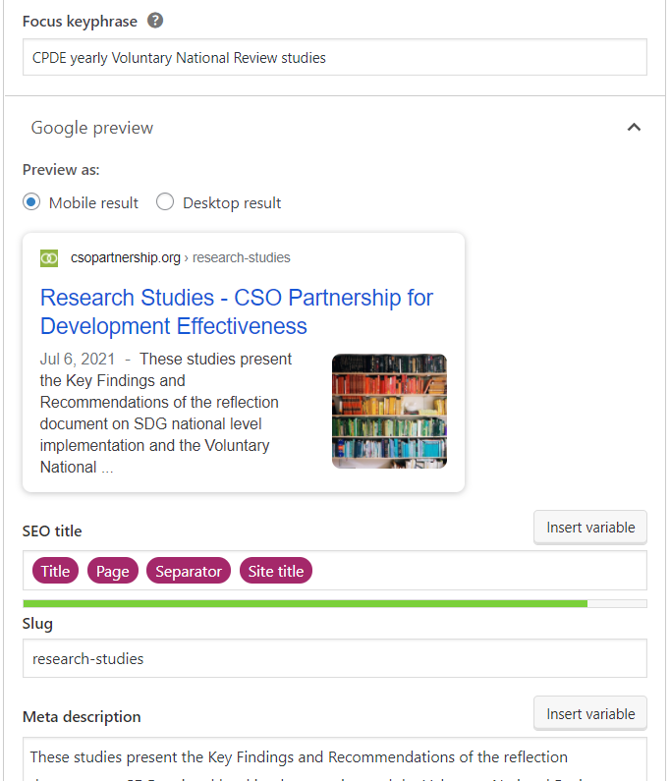
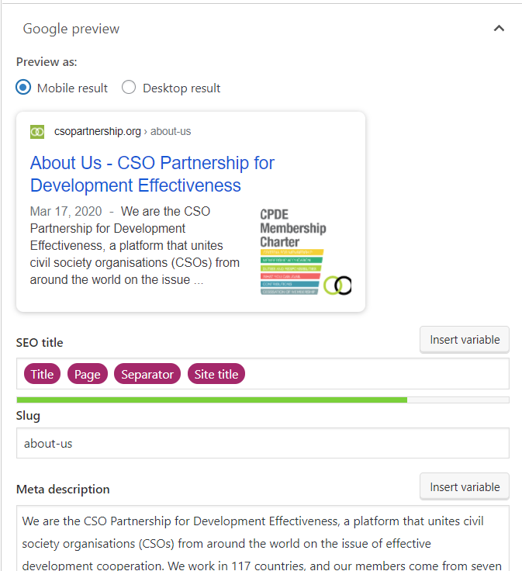
Notes:
YOAST SEO for Wordpress

Slide 11
USE HYPERLINKS TO CREATE TRAFFIC
As much as possible, insert hyperlinks in your article. It creates traffic and helps you to be well-ranked on Google.
Choose the appropriate and accurate link. Make the link open in a new window not to lose your reader!
FINALLY: A good way to to improve your SEO is to ask visitors and searchers to click-through to your article in search, and to share it. Both click-through rate and social sharing are Google ranking signals.
Put the linked logo of FB and Twitter at the end of your article to make it easier

Slide 12
MENTION YOUR CPDE MEMBERSHIP AND LINK US
If you could please include, somewhere in your website (possibly in the 'About us' section), that you are a member of the CSO Partnership for Development Effectiveness.
You can just paste this text, which is linked to our website, and include any of the logos here, as applicable (there is a logo in English, Spanish, French, a short version, and a full version, and in different color configurations to suit your website background):
We are a member of the CSO Partnership for Development Effectiveness, a platform that unites civil society organisations (CSOs) from around the world on the issue of effective development cooperation.

Slide 13

TIPS TO CATCH THE READER’S GOLDFISH ATTENTION
use the inverted pyramide technique in the body of your article
Edit your article in a ‘scannable’ way like billboard style design
Use subtle visual cues to stop readers while they are in scan mode

Slide 14
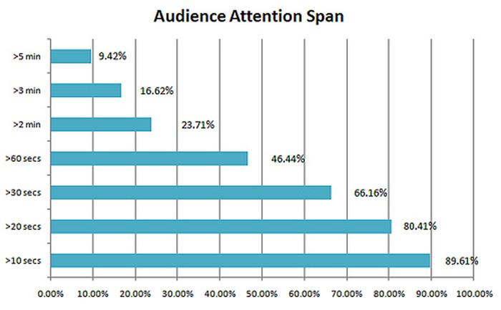
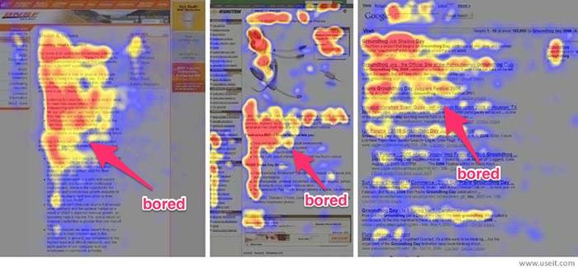
ABOUT THE READER’S GOLDFISH ATTENTION SPAN
Only 16% of people will read every word in your article
Understand readers will never read your text properly, so don't bury the lead
State your most important information in the first two paragraphs
'Front-load' your title, subheads and sentences with key information
Notes:
bottom right images shows were the reader’s eyes go when in screen mode on a smartphone

Slide 15
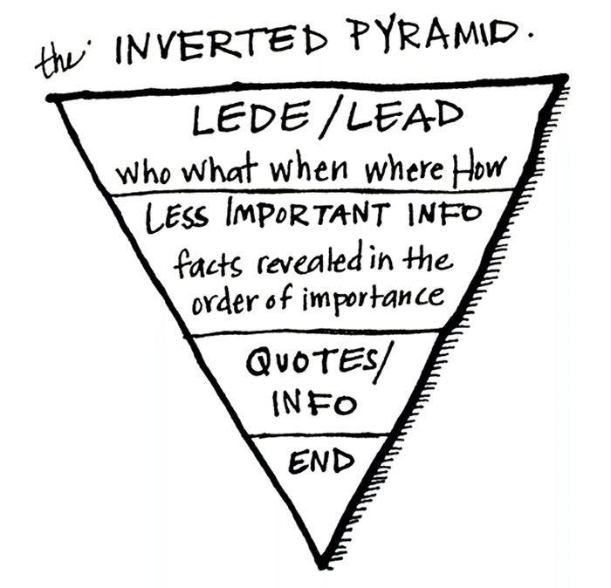
THE INVERTED PYRAMID TECHNIQUE
The idea is simple:
You don't end with the conclusion, like you would in an academic paper, you start with it.
Notes:
end: useful links, download documents, registration, call to action

Slide 16
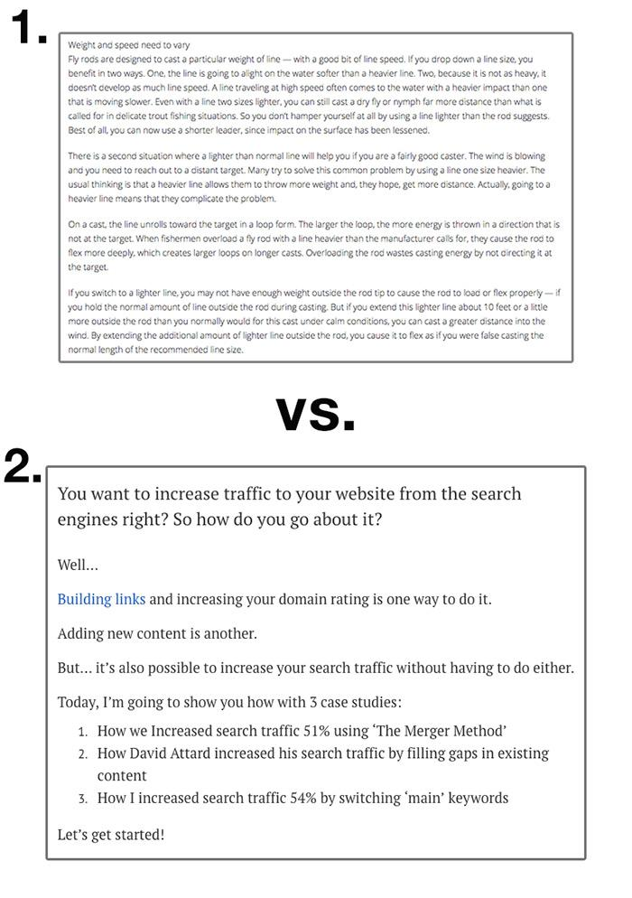
MAKE YOUR TEXT
SCANNABLE
As soon as you (or anyone who visits your website) sees a block of text they can't instantly skim
The features of scannable text include:
One sentence paragraphs
Short enticing lines that draw the eye further down the page
Questions
Bullet points
Ellipses
Subtitles
Quotes

Slide 17
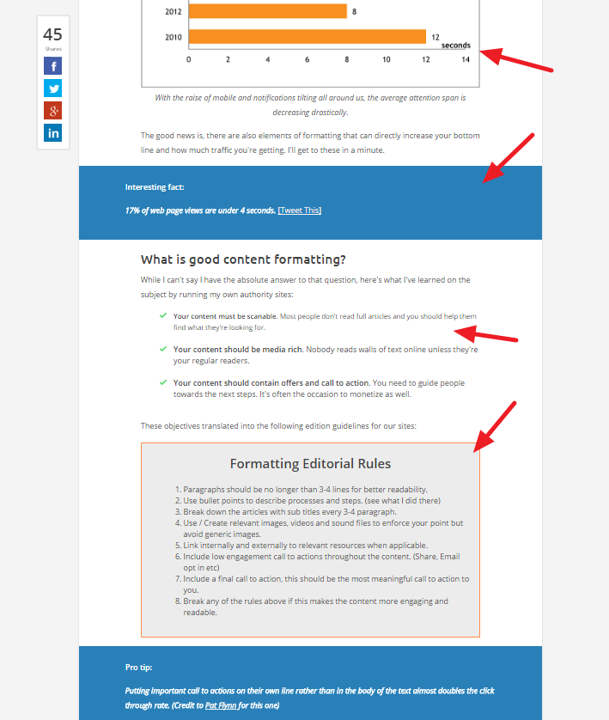
USE SUBTLE VISUAL CUES TO STOP READERS WHEN THEY ARE IN SCAN MODE
Use a range of formatting elements to capture and keep the attention of the readers, including images, banded call outs, quotes boxes, checklists and action boxes/buttons.

Slide 18
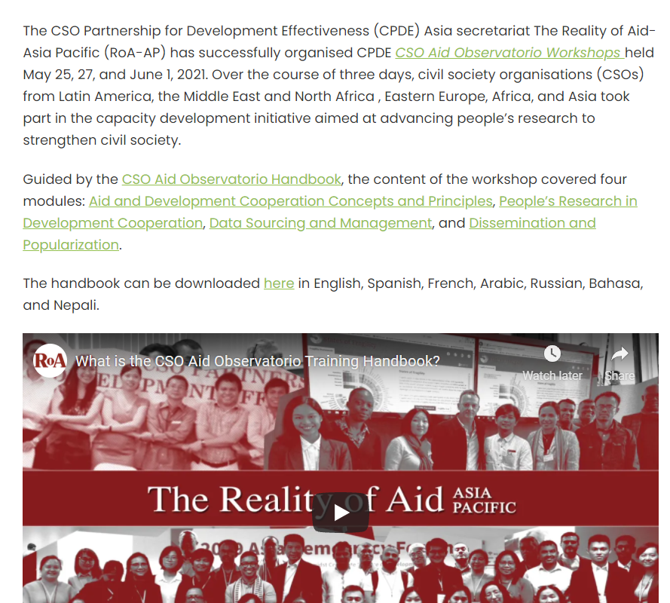
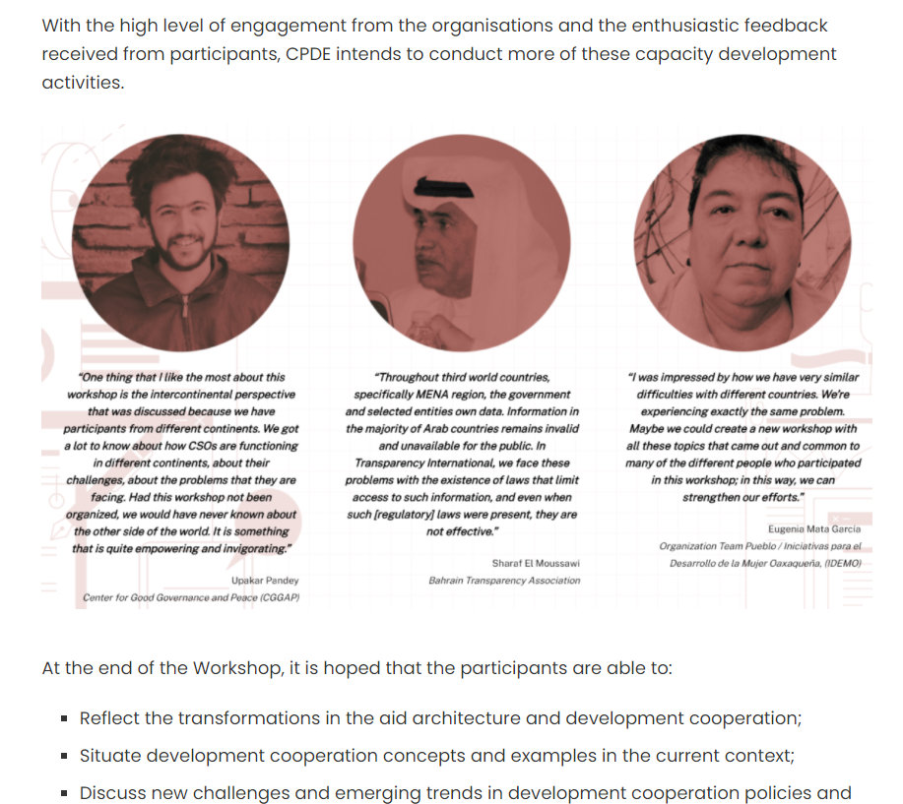

Slide 19
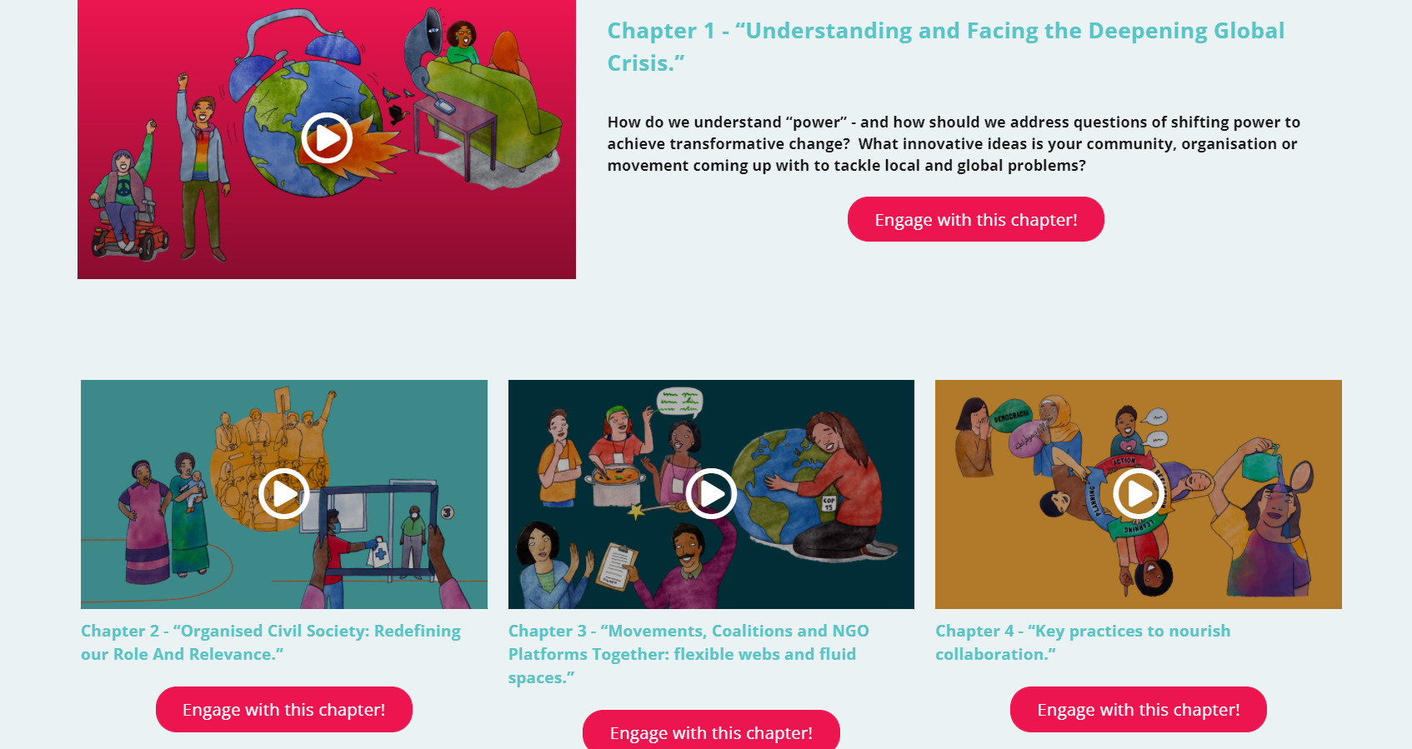
Notes:
more images, less text, buttons to click

Slide 20
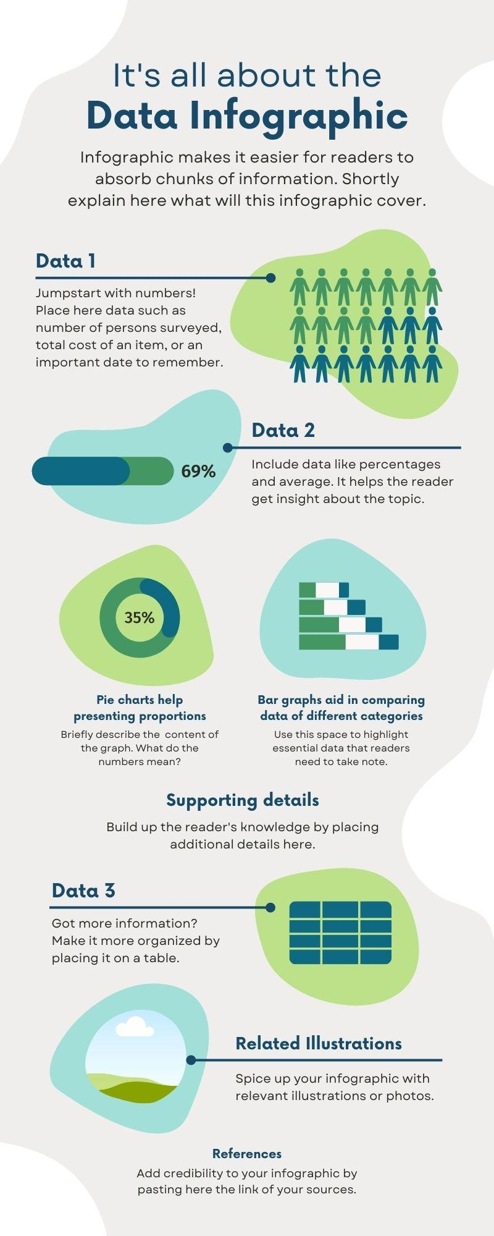
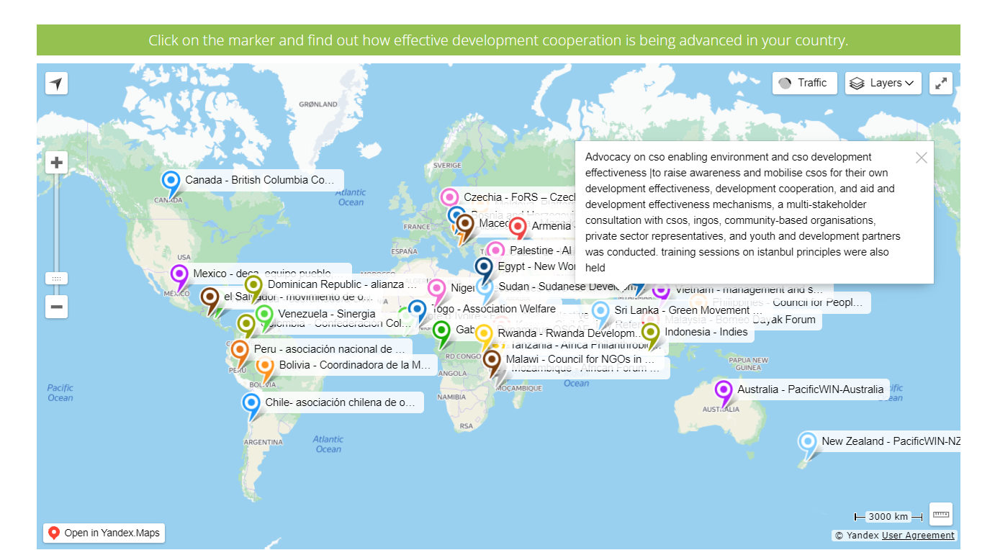
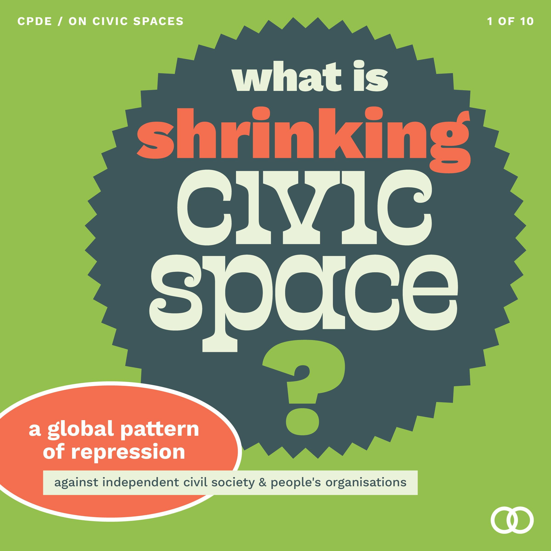
USE INFOGRAPHICS, MAPS, TIMELINES AND OTHER ILLUSTRATIONS
Illustrate your article with a lot of images
Infographics are usually red 5 times more than text: Canva, Infogr.am, Piktochart
- Interactive maps: Google Map, StoryMapJS
- Chronology : TimeLineJS
Notes:
free tools and software available online = you don’t need to be a webdev/graphic designer to create good looking designs

Slide 21

THANK YOU
CSO Partnership for Development Effectiveness

