Slide 1

CSO Partnership
for Development
Effectiveness
WEBINAR
How to Connect OBS and Zoom

Slide 2
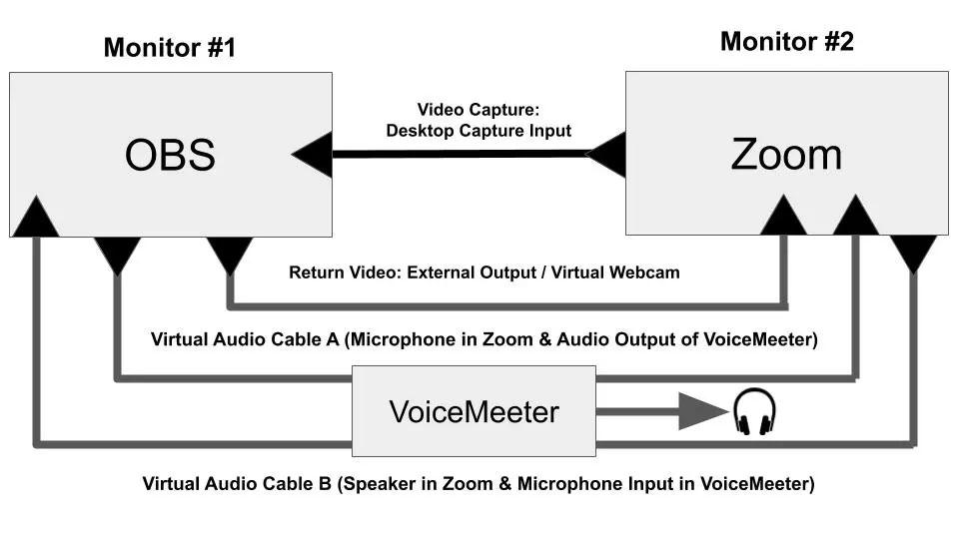
Diagram
The picture above is a complete connection diagram showing you how to connect audio and video between OBS and Zoom. Essentially, you are able to bring audio and video directly from Zoom and OBS with any Windows or Mac PC. The main difference between Windows and Mac computers is the type of Audio setup that you use.

Slide 3
Requirements
Zoom
Latest version of OBS - Link
OBS Virtual camera - Link
VB-Audio Cables (SoundFlower on Mac) - Link
VoiceMeeter (optional) - Link
Headphones or laptop speaker
2 Monitors (Video)

Slide 4
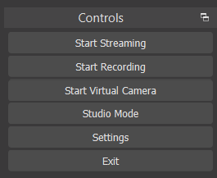
Connecting Video Between OBS and Zoom
First you need to install the OBS-VirtualCam
You can now use the virtual camera output inside of OBS to send your OBS video output into Zoom. To do this, simply click the Virtual Camera Output button. This button is below the “Start Recording” button in the bottom right hand corner by default. Some people still prefer to use the Virtual Camera plugin available for OBS as well. Also, if your video is mirrored you can fix this in the video settings area of Zoom.
To bring your video from Zoom back into OBS you can use a desktop or window capture. Click the add source in OBS inside of one of your scenes. Then select either Desktop or Window Capture. You will then be able to bring in everything happening in Zoom into your OBS production. This is great because you can now record 1080p videos with high bitrates using Zoom. Using OBS will allow you to record in a higher quality and do it locally on your harddrive without Zoom’s compression settings.

Slide 5
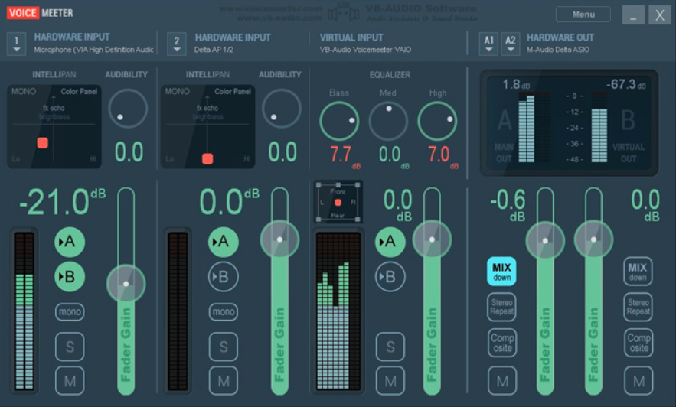
Using VoiceMeeter with OBS and Zoom
In order to get VoiceMeeter set up properly, you do need to set it up as your default audio device in Windows sound controls. You can do this by right clicking the audio speaker in Windows and select “Open Sound Settings.” Then select “Sound Control Panel.” Here you can right click VoiceMeeter and set it as your default device. This allows VoiceMeeter to output your audio to any source attached to your computer. In this case, you will eventually choose your headphones.

Slide 6
Connect OBS and Zoom with VoiceMeeter
Take another look at the connection diagram between OBS and Zoom. You can see that VoiceMeeter is being used to connect OBS and Zoom’s audio. You can also see that it is being used to send audio into your headphones. You can now set up VoiceMeeter with virtual audio cable A and B. Next, you can select your headphone output to monitor the audio.
OBS only has one audio output bus that you can use with a virtual audio cable. Open the settings area and click the Audio tab. Here you can select Audio Cable A as your “Monitoring Device.” This will allow you to send any audio inside of OBS you would like out via your Audio Cable A. To select audio sources to send out via this virtual audio cable navigate to the Advanced Audio Properties area of OBS.

Slide 7
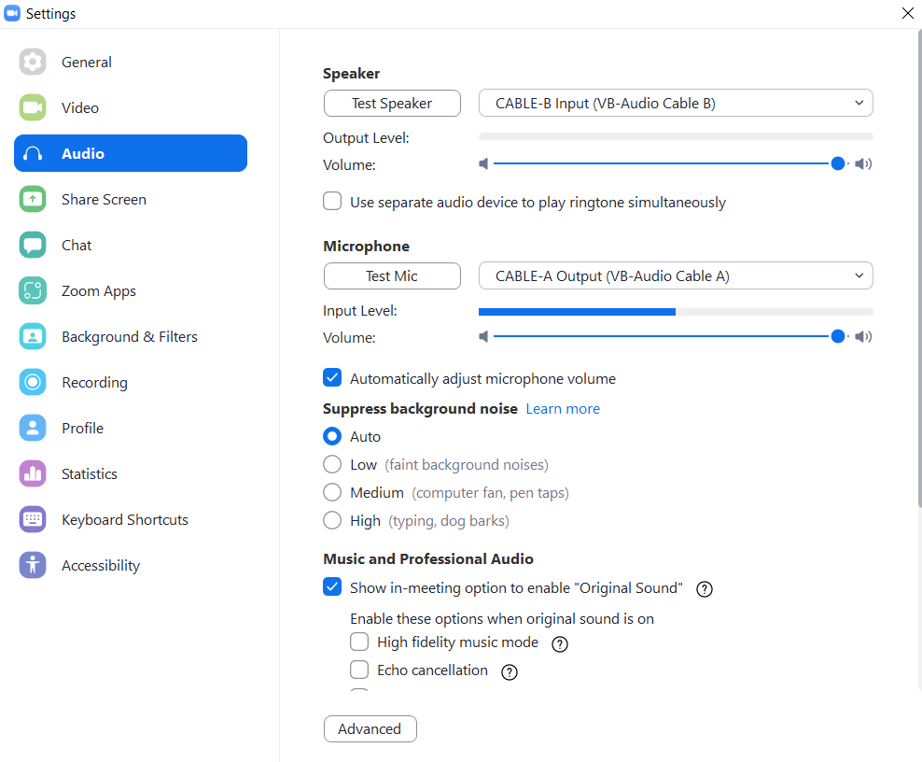
OBS Audio Settings to Connect to Zoom
Open up Advanced Audio Properties by right clicking the audio mixer and select all audio sources you would like to send to Zoom. Set all audio sources to Monitor and/or Monitor and Output to send them via your virtual audio cable. Each audio source that you select here can be setup to go through the monitor headphones output and sent to Zoom.
Next you should bring audio into OBS from Zoom. In the audio settings area you can select audio CABLE B as a “Global Audio Source.” This will bring the audio coming out of Zoom’s speakers into OBS. To test this and make sure it’s working properly, click the “Test Speaker” option inside of Zoom. You can access this in the Audio Settings, area of Zoom.

Slide 8
OBS Audio Settings to Connect to Zoom
That’s it. You are done!

