Slide 1

CSO Partnership for Development Effectiveness
Building a communications strategy

Slide 2
WHO HAS A COMMUNICATIONS STRATEGY?
Please go to menti.com and enter 2059 9665

Slide 3
IF NOT, HOW DO YOU DO COMMUNICATIONS?

Slide 4


WHY IS COMMUNICATIONS WORK IMPORTANT?
Serves as our guide in promoting advocacy
Influences the public and decision-makers to rally behind us
Provides fellow people’s and civil society organisations with resources

Slide 5
THE IMPORTANCE
OF A COMMUNICATIONS STRATEGY
Clarifies our goals and target audience
Shapes our message to resonate with our target group
Helps ensure the effectiveness of our communications work

Slide 6
WHAT IS EFFECTIVE COMMUNICATIONS WORK?
Is relevant to the concerns and interests of the audience
Grounded in the reality of the constituencies
Uses resources efficiently
Generates the results we want

Slide 7
COMMON THOUGHTS
ON EDC AND COMMUNICATIONS
Effective Development Cooperation (EDC) is too technical
People are not interested in EDC
Each should just focus on what our organisation does
There is no need for a communications strategy or a plan
We have no resources for communications, so there’s no need to focus on it

Slide 8
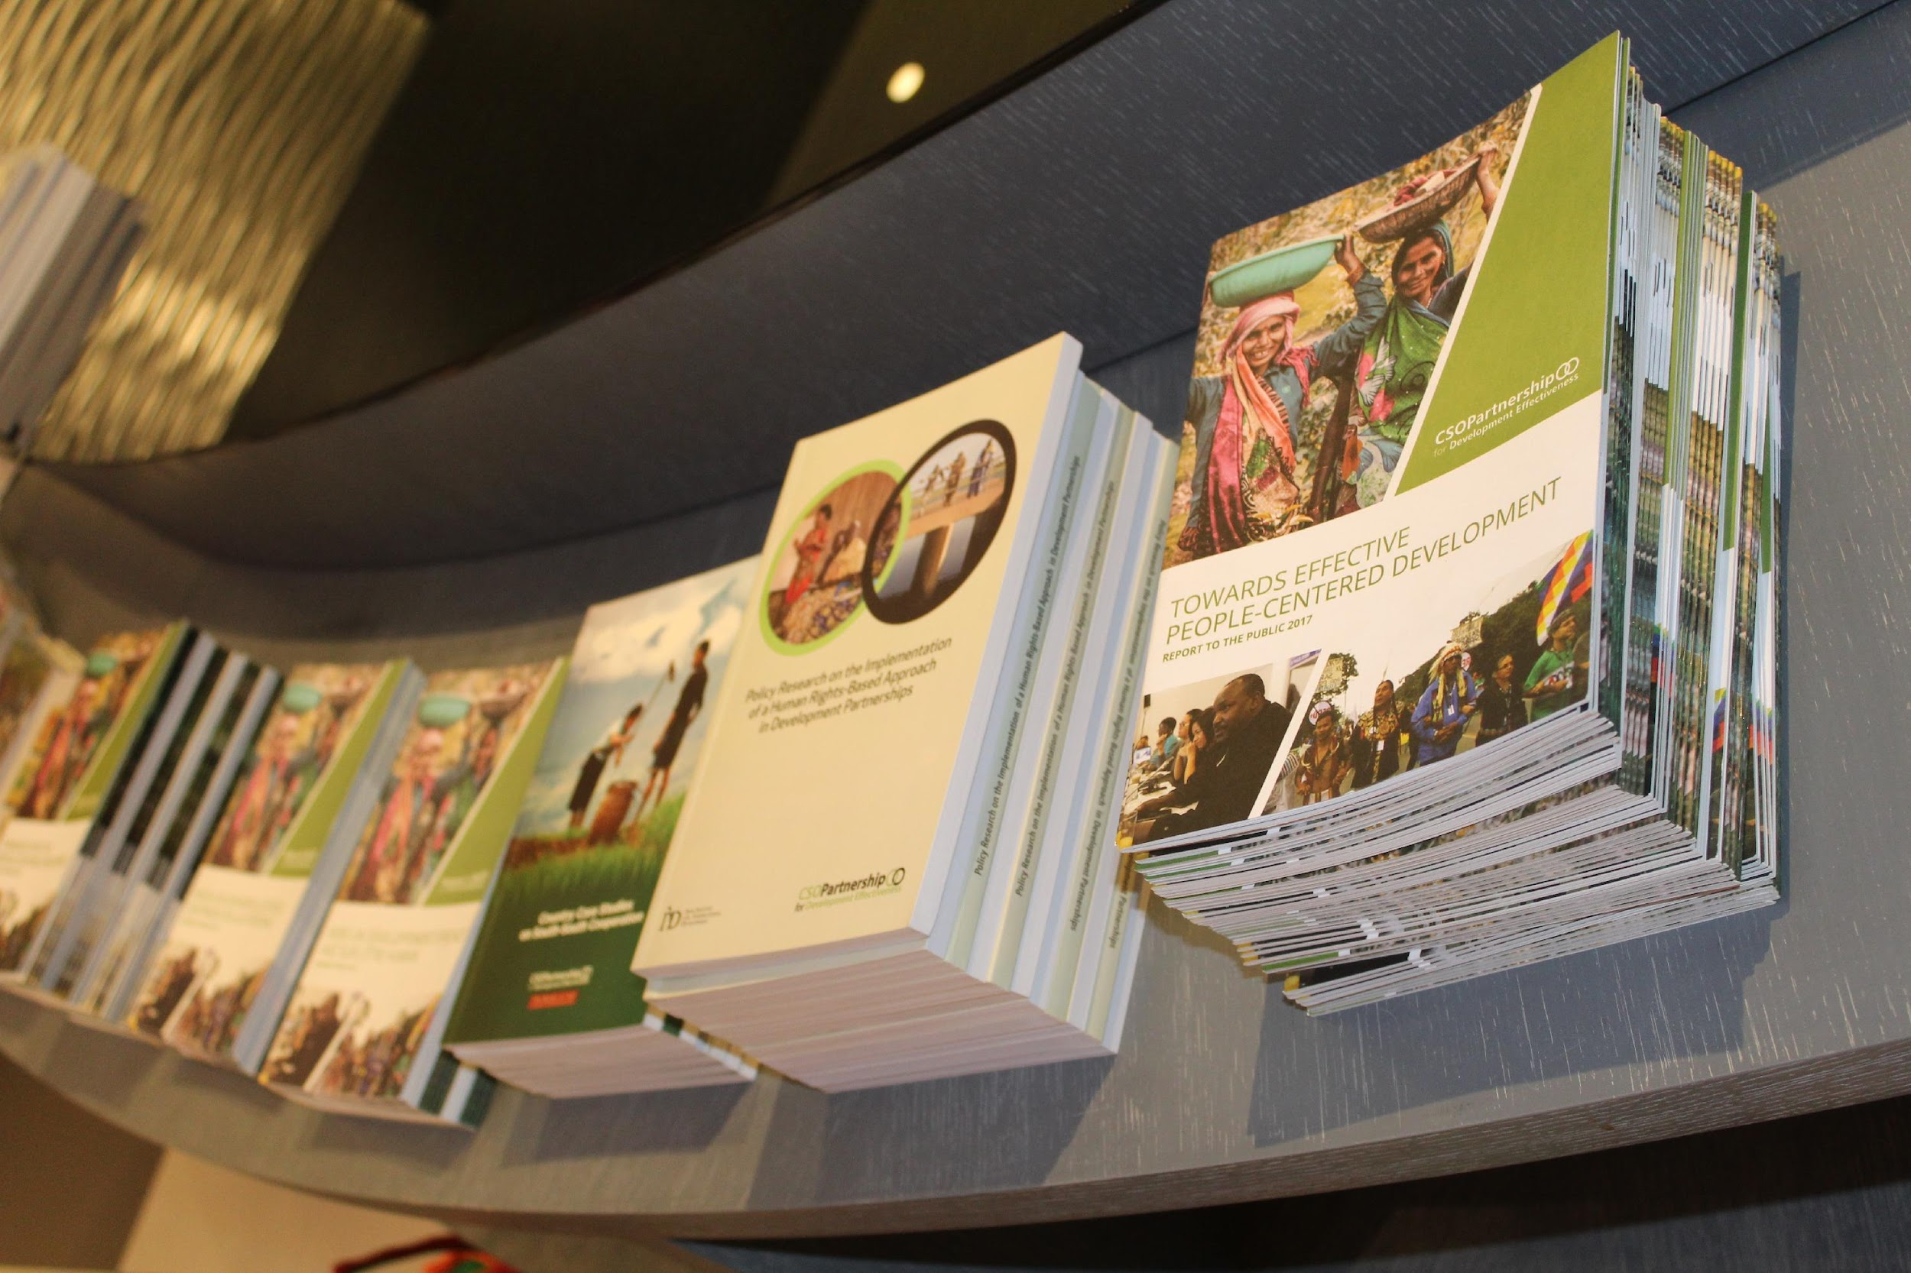
PARTS OF A COMMUNICATIONS STRATEGY
External context
Internal context
Stakeholder analysis
Planning imperatives
Resource map
Objectives
Key activities

Slide 9
APPROACHES
Rebrand
Repurposing materials
IEC materials development
Exploring new platforms
Focusing on specific platforms

Slide 10
PARTS OF A COMMUNICATIONS PLAN
Background
Objectives
Target audience
Key messages
Activities and outputs
Timeline

Slide 11
WHAT ARE YOU PROBABLY DOING WRONG?
Policy messages = communications messages
No strategy or planning
Not knowing your audience, or the right platform for you

Slide 12

QUESTIONS TO ASK
Where is our audience?
What kind of language do they respond to?
What resources do we have?

Slide 13
WHAT ARE YOUR RESOURCES?
Time
Funds
Equipment
Stories
Knowledge/analysis
Creativity

Slide 14

STEPS IN BUILDING A STRATEGY
Know where you are.
Identify your goals and objectives.
Look for examples to inform your plans.
Know your message and platform.
Find a way to monitor and measure your impact.

Slide 15
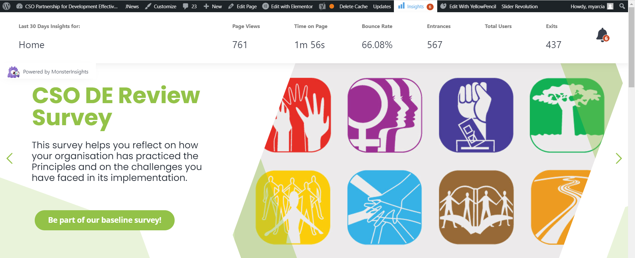
MEASURING YOUR IMPACT

Slide 16
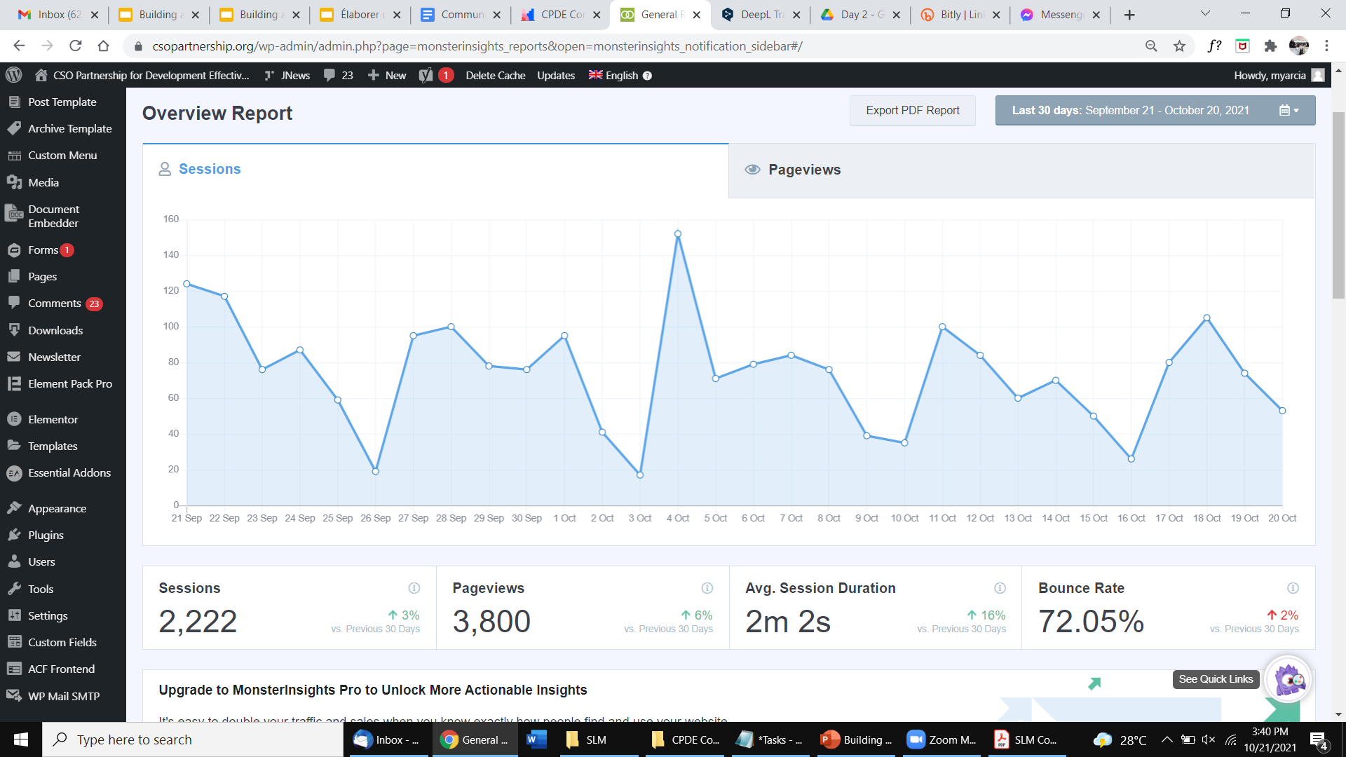
MEASURING YOUR IMPACT

Slide 17
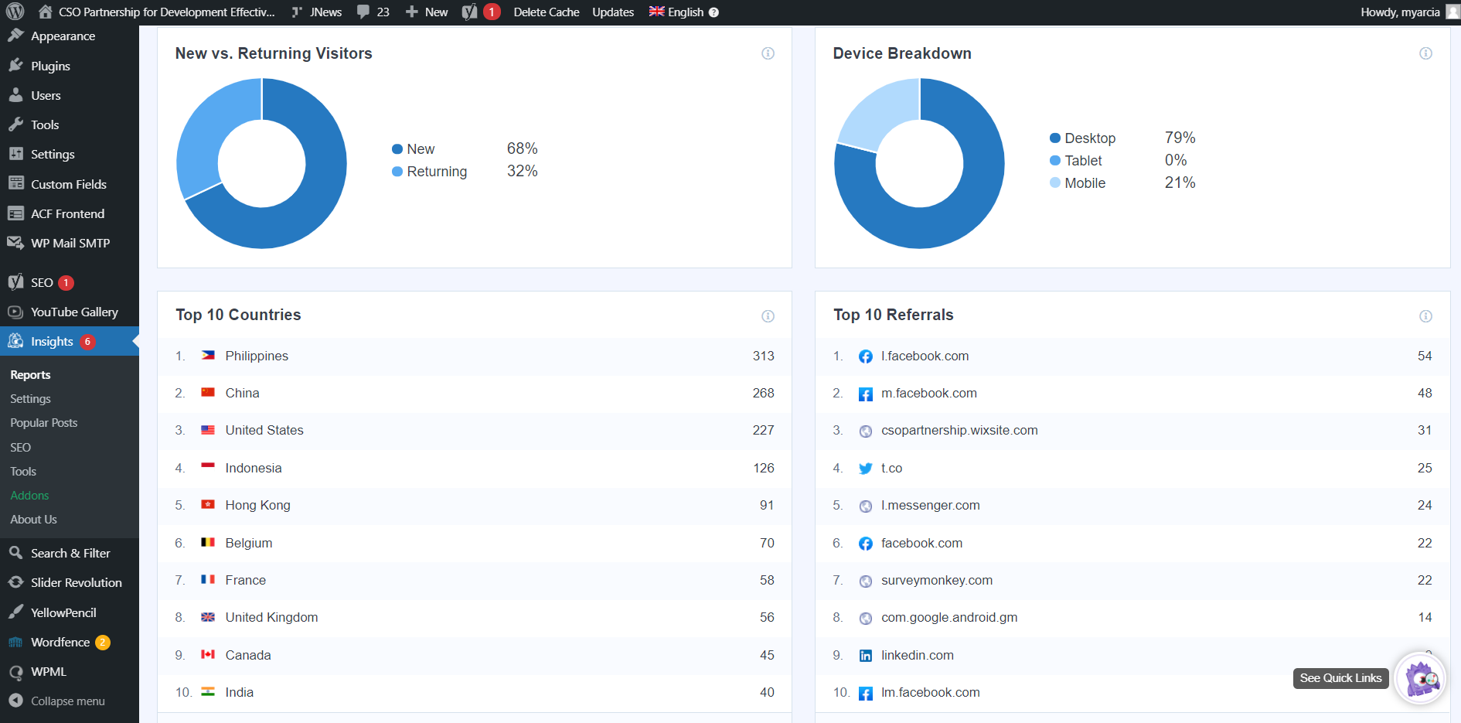
MEASURING YOUR IMPACT

Slide 18
CRAFTING YOUR KEY MESSAGES
Be simple and explain the cause clearly.
Emphasise the critical importance of the cause.
Tell people something new, something they have not yet thought about.
Be engaging, interesting, perhaps even shocking.
Provide a call to action.
Notes:
Framing the message is a critical step in creating strategy for producing media. The message is what will pull people towards your campaign. Through your research, find out what needs to be communicated and how. There can be several messages that you send to different audiences, but they should all lead to the same goal.

Slide 19
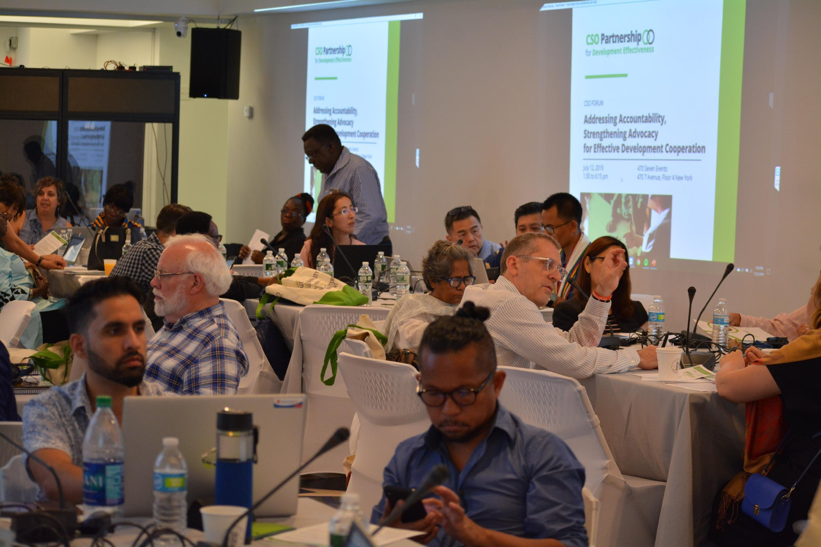
EDC AND CIVIL SOCIETY COMMUNICATIONS
Issues we engage in:
Effective Development Cooperation
Sustainable Development Goals
CSO DE and EE

Slide 20
EDC AND CIVIL SOCIETY COMMUNICATIONS
EDC
SDGs
Private sector
engagement
Development finance
Conflict and fragility
ODA
Climate finance
Development through constituency lens
Accountability of all development stakeholders
CSO Development Effectiveness
CSO Enabling Environment
Istanbul Principles
Shrinking Civic Space
Human rights

Slide 21

CSO Partnership for Development Effectiveness
THANK
YOU!

